Slide 1

Citizen Corps of Delaware County
Orientation &
Handbook Training
CCDC Orientation V.4 (2019)

Slide 2
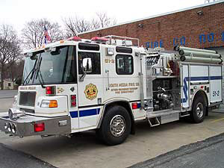

A little about me…
Delaware County Volunteer Management Coordinator, since September 2011. CERT instructor since 2004.
Firefighter and Emergency Medical Technician in Delaware County, Pa. since 1987.
Have served in the positions of Training officer, Lieutenant, Captain, Assistant Chief, Deputy Chief and Chief. Most recently Chief of the South Media Fire Company from 2011 to 2017.
Previously employed for 6 years as a certified Police, Fire, EMS dispatcher for the County of Delaware, Pa
Previously employed for 20 years as a Police Officer with the Swarthmore Borough Police Department.
A.A.S. Emergency Management & Planning, D.C.C.C.
B.A. Liberal Studies, Neumann University

Slide 3


Welcome!
Thank you for taking your time to come out tonight. Without your time and dedication the Citizen Corps of Delaware County would not exist.
This Handbook was previously known as the Delaware County MRC Handbook. The Delaware County MRC, now, as part of Citizen Corps utilizes the same Handbook and is incorporated by reference.

Slide 4
Introductions and Organization
Staff
  Tom Morgan – Chief, Special Operations
  Ed Kline – Volunteer Management Coordinator
  Danielle Koerner – Public Outreach & AFN Coordinator
  Inder Bains – Special Operations Logistics
Deputy Coordinators
  Annie Favinger
  Dennis Daye
  Tammi Maciolek

Slide 5
Introductions and Organization
Assistant Coordinators
  Christine McCreesh
  Tom Barrett
  Julia Lewandowski
  Elizabeth Walls
  Donna Burdett
  Sonya Fazio
  Maureen Ingram
  Robbie Kankus
  Judy McKinney
  Cathy Pensyl
  Jim Smith

Slide 6
Introductions and Organization
Joe Cirillo & Kathy LaFleur – Captains, Red Cross Disaster Action Team (DAT)
Luke Rodgers – Deputy Director, Salvation Army, PA & DE Division
Lori Devlin – Director, Office of Intercommunity Health Coordination (ICH)
Tom Morgan- Chief, Special Operations, Department of Emergency Services
Shannon Thomas – DCORT Coordinator, Human Services Liaison
Deborah Henderson – Captain, Delaware County Security Reserve Unit (SRU)
Dennis Henry – Chadds Ford Community Emergency Response Team Coordinator
David Ingram – Citizen Corps Logistics Section Chief
Sue Kelley – Delaware County Animal Response Team (DelCART) Coordinator
Michael Thomas – Amateur Radio Emergency Service (ARES) Coordinator

Slide 7
Overall Citizen Corps FAQs:
Who?
Currently over 500 Citizen Corps of Delaware County volunteers are deployable in ServPA. More than 2,000 volunteers have completed training. Our Citizen Corps is integral part of the Delaware County Emergency Operations Plan (EOP) and is sponsored by the Delaware County Department of Emergency Services
What?
Citizen Corps of Delaware County volunteers (medical and non-medical support) contribute their skills and experience throughout the year as well as during times of community need. Volunteers enhances the emergency preparedness and response capabilities of the county by effectively organizing, training, and preparing medical and non-medical volunteers to respond, in the case of a mass care or public health emergency or disaster.

Slide 8
Overall Citizen Corps FAQs (cont’d)
How?
  Major local emergencies can overwhelm the capability of first responders. An organized and effective Citizen Corps program means that volunteers can effectively respond to local emergencies. Volunteers will be identified, credentialed and trained prior to deployment, and will know how they fit into the emergency plan and how best to respond so that they are a positive support structure for the first responders.
Why?
  Our Mission Statement: The mission of our Citizen Corps is to provide education, training, and volunteer opportunities to engage all citizens in making our community safer, stronger, and better prepared for emergencies and disasters of all types, including threats of terrorism, crime, public health emergencies, natural, man-made, and technological disasters by improving preparedness, mitigation, response, and recovery efforts.

Slide 9
Citizen Corps Goals and Objectives
Recruit, enroll and maintain a sufficient number of medical and non-medical volunteers.
Develop and maintain a database to match volunteers’ skills with the community’s needs, including medical surge capacity.
Provide opportunities for volunteers to assist with non-emergency public health initiatives, such as health education, vaccinations and public awareness campaigns.
Design, develop and train specialized response teams to appropriately augment current response teams.
Deliver comprehensive training opportunities to volunteers through simulation exercises, classroom training, access to online education resources, etc.
Foster a culture of acceptance, recognition of the value of volunteers and utilization of volunteer staffing.
Promote a system and organization that will support the community’s medical needs

Slide 10
Why a Handbook?
We have provided you with a set of regulations to provide protection to our volunteers and the public.
Be mindful that some situations may require more or less stringent rules.
  For example, tighter restrictions were utilized at the 2014 WCU Ice Storm Supershelter than were in place at the Marcus Hook Pirate Festival fur Public Preparedness.
  Generally speaking, you will not be blindly sent into a scenario.
  HOWEVER….. Situations can quickly change and we need to ensure adaptability.

Slide 11
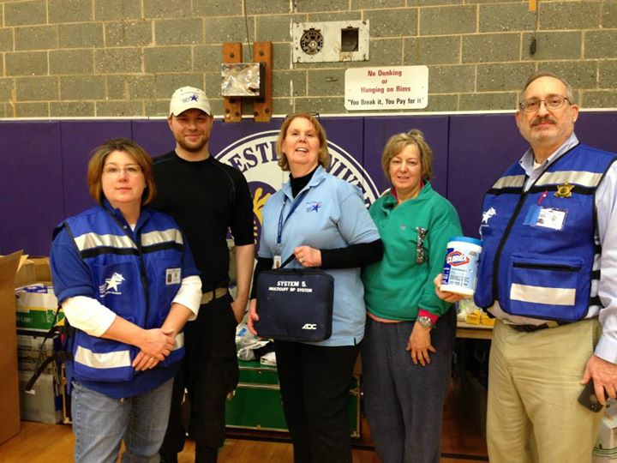
Ice Storm Shelter Staff (partial)

Slide 12
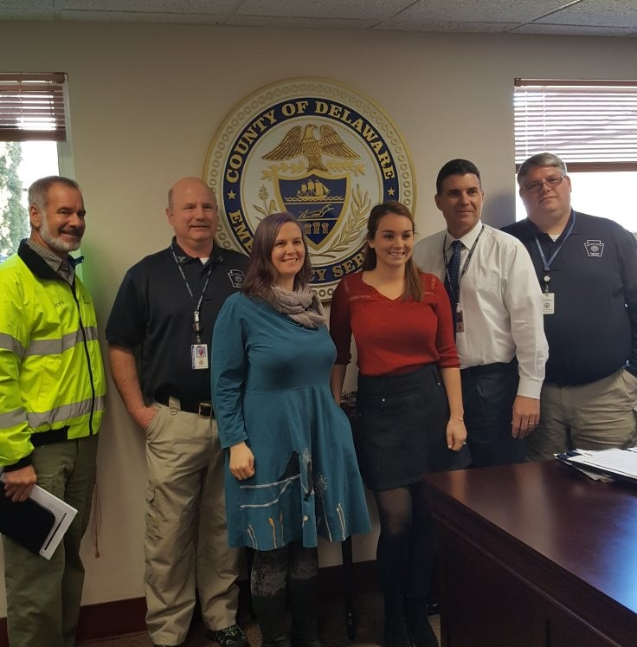
Important Principles of the Handbook
3 Key Signature pieces
  Confidentiality Pledge
  Photography Consent
  Receipt of Handbook

Slide 13
Confidentiality Pledge
Due to the nature of services of the Citizen Corps of Delaware County, you may process information that is confidential and not public record. For that reason you are asked to sign this confidentiality statement indicating that you will keep information to which you have access confidential and not discuss it with anyone other than the staff person with whom you are working.
I certify that I have read the statement below and agree to comply with the terms.
I realize that as a volunteer with the Citizen Corps of Delaware County I may acquire knowledge of confidential information from files, case records, missions, conversations, etc. I agree that such information is not to be discussed or revealed to anyone not authorized to have the information.

Slide 14
Photography Consent
The Citizen Corps of Delaware County frequently takes photographs of volunteers in action during trainings, exercises, and actual events. In addition, each volunteer is photographed for identification purposes. Photographs may be used on the website, in newsletters, and other publications.
I give (or do not give) Citizen Corps of Delaware County permission to use my photo as stated above.
Those who do not give permission MUST also notify the coordinator, team leader, or a supervisor when they arrive at an event, training, exercise, or deployment of their desire not to be photographed.

Slide 15
Receipt of Handbook and Training
In addition to the Confidentiality Pledge and Photography Consent, you will be asked to sign a Receipt of Handbook and training.
This is your verification that you have read and understand the Citizen Corps of Delaware County Handbook, and that you agree to comply with the instructions provided in this handbook.
The Citizen Corps will keep this documentation on file.

Slide 16
About the Handbook
Your enrollment and orientation are important first steps to an exciting and complex organization, which offers a variety of opportunities to serve our community. The following pages describe the benefits to our volunteers, plus policies and procedures that provide a framework for the services we deliver.
The information in this handbook is extensive but not complete. You will learn much of the information regarding your responsibilities through training and on the job. This handbook will be updated annually to reflect any changes made to specific rules or regulations of the Citizen Corps of Delaware County. Copies of the updated sections will be made available to all existing Citizen Corps of Delaware County volunteers.

Slide 17
General Information
Brief History of the Citizen Corps Program.
  In his 2002 State of the Union Message, President Bush called on all Americans to make a lifetime commitment of at least 4,000 hours—the equivalent of two years of their lives—to serve their communities, the nation and the world, thus founding the USA Freedom Corps and Citizens Corps.
  The Citizen Corps also works regularly with the American Red Cross and other Voluntary Organizations Active in Disaster (VOAD) partners, when areas require evacuation, when shelters need to be established and maintained.
  Citizen Corps is an umbrella organization for our MRC, CERT, DelCART, SRU, Red Cross, Salvation Army, ARES, DCORT, VOAD, ICH, non-government organizations (NGO’s), faith bases groups, human service agencies & DES.
Goals and Objectives
  Recruiting and maintaining adequate number of volunteers
  Provide training for volunteers
  Promote a system and organization that will support the community’s unmet needs.

Slide 18
About the Citizen Corps of Delaware County (CCDC)
Mission of the Citizen Corps of Delaware County:
  Is to provide education, training, and volunteer opportunities to engage all citizens in making our community safer, stronger, and better prepared for emergencies and disasters of all types, including threats of terrorism, crime, public health emergencies, natural, man-made, and technological disasters by improving preparedness, mitigation, response, and recovery efforts
Benefits to the Community
  Major local emergencies can overwhelm the capability of first responders, especially during the first 12-72 hours. Having citizens who are prepared to take care of themselves, their families and others during times of crisis will allow first-responders to focus their efforts on the most critical, life threatening situations.
An organized, credentialed and trained Citizen Corps means that volunteers can effectively respond to local emergencies
Notes:
To improve the health and safety of the residents of Delaware County by establishing a group of medical and non-medical volunteers to augment our existing emergency medical personnel resources in the County.
Our goal is to allow local volunteer medical and health professionals contribute their skills and expertise throughout the year as well as during times of community need. Our Medical Reserve Corps unit is made up of medical and support volunteers who can assist our community during an emergency, such as an earthquake, hurricane, ice storm, an influenza epidemic, a chemical spill or an act of terrorism.
Major local emergencies can overwhelm the capability of first responders, especially during the first 12-72 hours. Having citizens who are prepared to take care of themselves, their families and others during times of crisis will allow first-responders to focus their efforts on the most critical, life threatening situations.
An organized, credentialed and trained Medical Reserve Corps means that volunteers can effectively respond to local emergencies. Members should take the responsibility to become familiar with their community’s response plan, know what materials are available for their use, know their partners in the response , know where their skills will be most advantageous and be able to follow through in a cohesive, coordinated manner.

Slide 19
Service Principles
The Citizen Corps of Delaware County will play an integral role in our local preparedness and response strategy.
Major community emergencies may arise from natural (earthquake, flooding), mechanical (sewage back up, power outage), or intentional (biological, chemical or other terrorist) events. In the event of an emergency that impacts or threatens the health and safety of a large number of our citizens, or presents health issues, the Citizen Corps of Delaware County will be involved.

Slide 20
Service Principles
The overall goal of our involvement in an emergency is to minimize or eliminate negative health effects, improve the safety of individuals, provide mass care services, augment existing medical and public health systems, and support the recovery process. Our volunteers may participate in the following activities:
Mass vaccination
Mass prophylaxis
Mass medical care
Communicable disease control
Public preparedness campaigns
Stop the Bleed training
Lap person CPR training
Mass sheltering operations
Mass logistical support
Assisting those with Disabilities and other Access and Functional Needs
Disaster Assessment
Maintenance
Service/Information Center
Other needs as they arise

Slide 21
Management Principles
The Citizen Corps will operate in accordance with the following principles:
  We treat all people, volunteers, clients and co-workers with respect and dignity in all situations.
  We honor the fact that volunteers are donating their time and expertise for the overall health and well-being of the recipients of our services.
  We will communicate clearly and consistently with all volunteers.
  Input from Citizen Corps volunteers is encouraged and valued.
  No Citizen Corps volunteer will be asked to perform beyond the scope of his or her licensure/credentialing, training or comfort level.
  The Citizen Corps will consistently seek inclusion of the residents across all demographics, thereby becoming truly representative of all the citizens of the county.

Slide 22
Eligibility and Enrollment
ELIGIBILITY:
Citizen of United States or legal/registered alien.
Age 18 or older and able, both physically and mentally, to respond to disasters and other emergencies.
Current mailing address and contact information in ServPA.
Current professional licensure information (for medical professionals) in ServPA.
Attendance to Orientation and Handbook sessions.
Maintain a current ServPA account.

Slide 23
Eligibility and Enrollment
ENROLLMENT:
All candidates must complete an application by registering through SERVPA before being accepted into Citizen Corps.
https://www.serv.pa.gov
After the registration process with SERVPA is completed and your information is reviewed for approval by the Citizen Corps Coordinator, or designee. The volunteer should receive notice that they have been accepted into the Citizen Corps.

Slide 24
Orientation
Volunteer orientation meetings will be offered to enrolled volunteers as well as individuals interested in finding out more about the Citizen Corps.
Orientation meetings will include a summary of the Citizen Corps, organizational structure, volunteer requirements, response plan, and volunteer opportunities.
Usually held every other month.
Who can we use?
  EVERYBODY!!! Without bodies and brains, all we have is “stuff.”

Slide 25
Credentialing and Placement
Current licensure is not a requirement for medical professionals to volunteer.
Inactive and active medical professionals will be required to provide license number(s) via the SERVPA application.
  Credentials/licenses will be verified annually.
  May include criminal history and child abuse clearance.
Placement
  The coordinator may interview prospective volunteers and determine what roles they will serve.
  If at any time your volunteer assignment does not meet your expectations or you wish to explore other areas or volunteer service please make the team leader or coordinator aware so that we can find an assignment which better matches your skills, interests, availability, and comfort level.

Slide 26
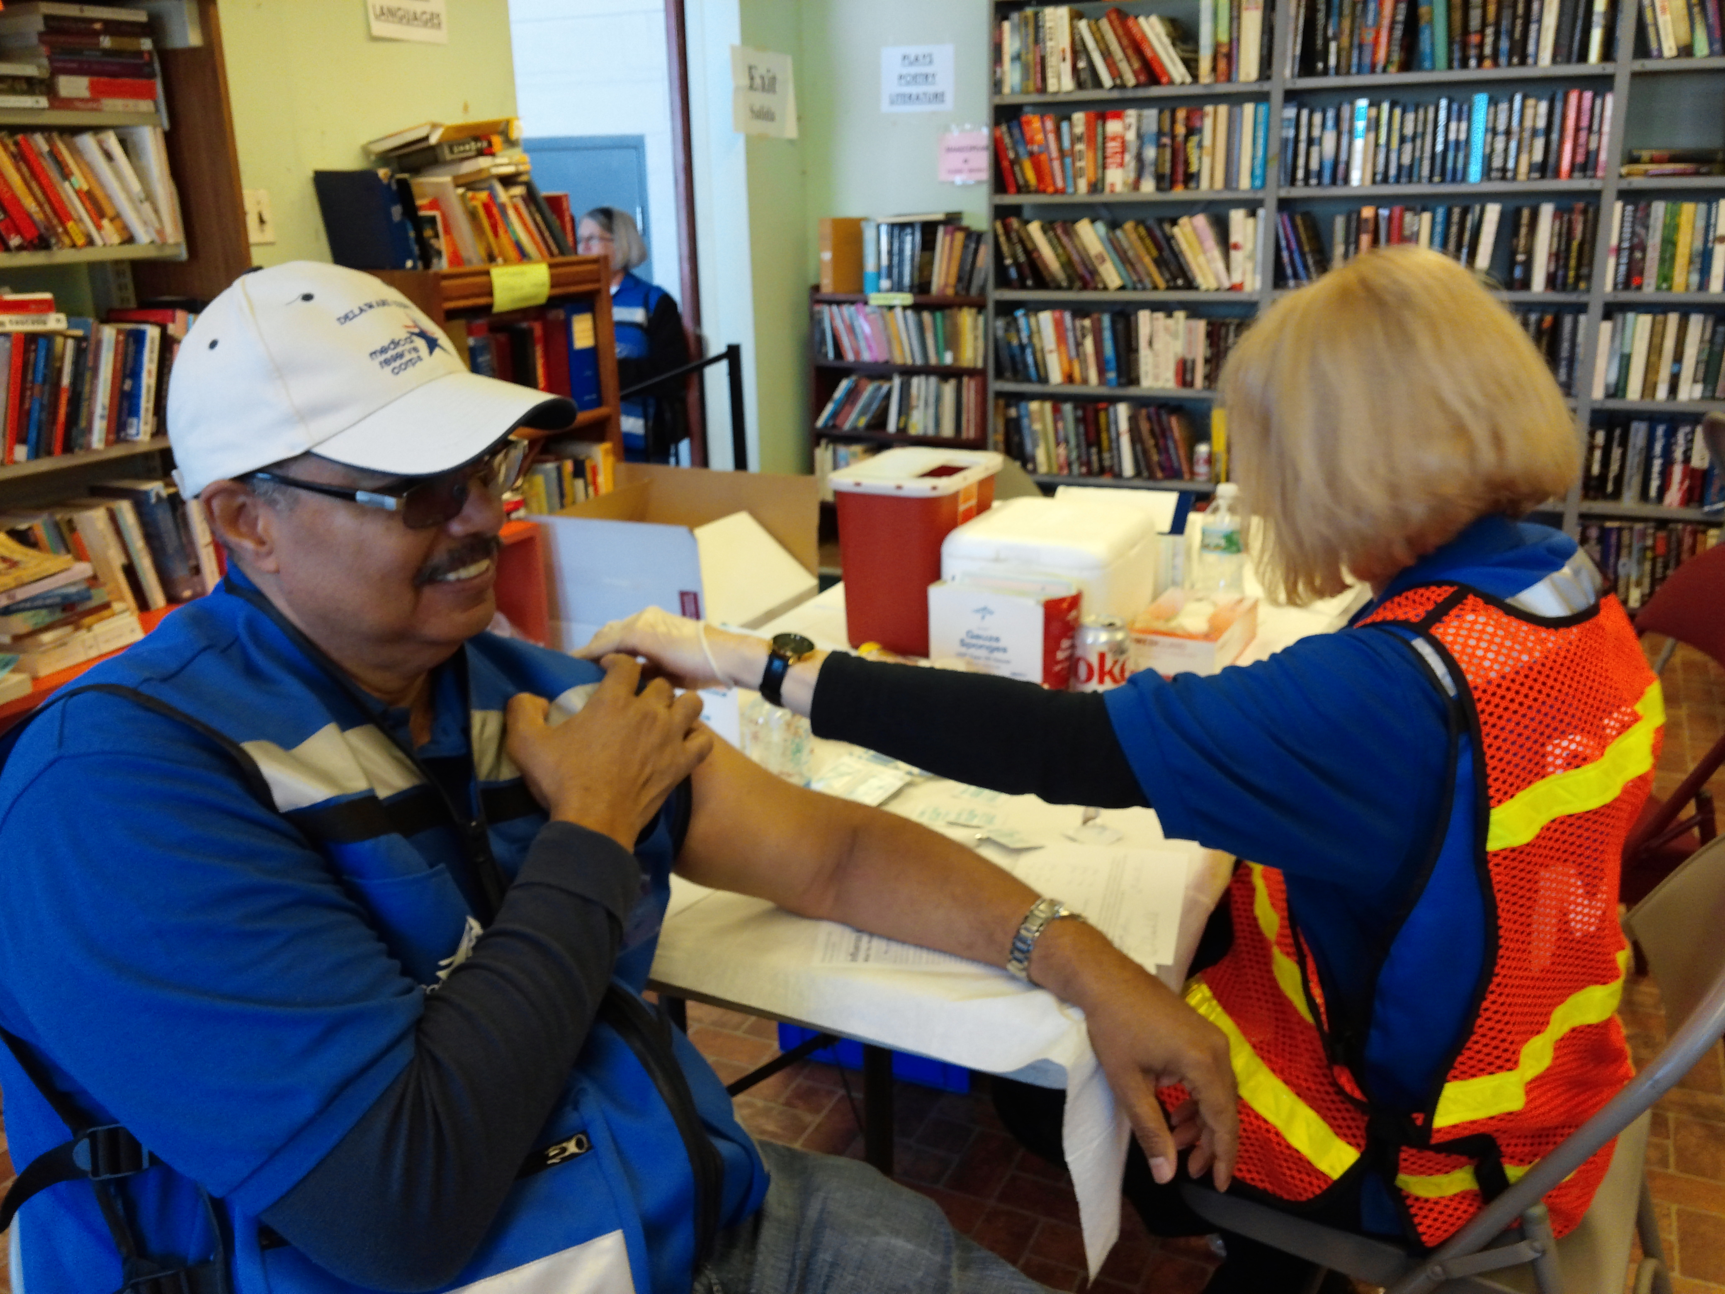
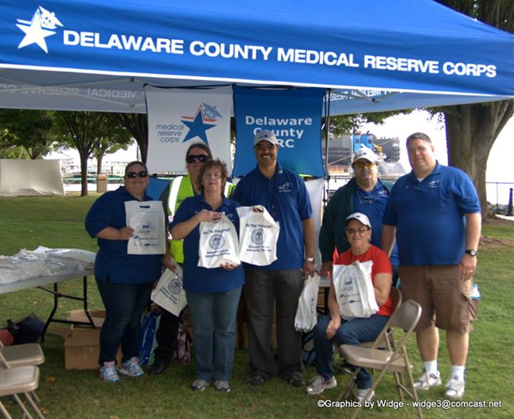
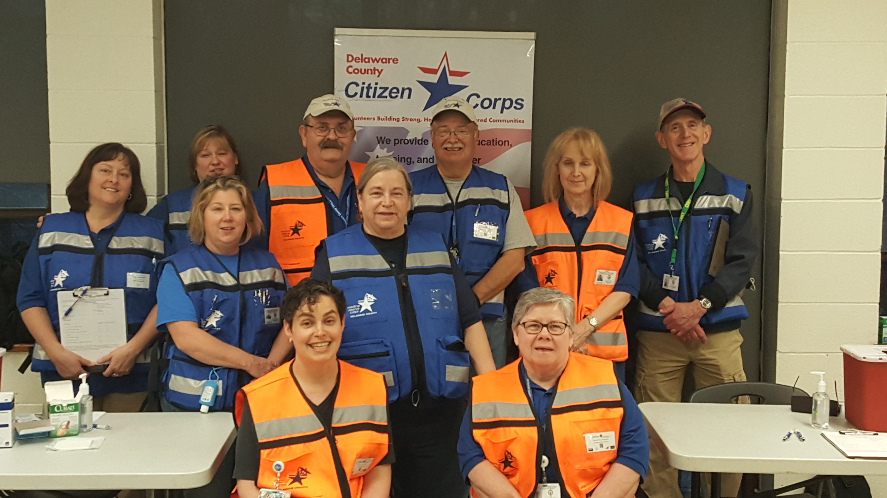
Volunteer Opportunities
Emergency Preparedness
Public Education
Flu Clinics

Slide 27



Ways to volunteer
Delaware County Citizen Corps (CC)
Animal Response Team (DelCART)
Community Emergency Response Team (CERT)
Medical Reserve Corps (MRC)
Disaster Crisis Outreach & Referral Team (DCORT)
Amateur Radio Emergency Service (ARES)
American Red Cross, Disaster Action Team (DAT)
Salvation Army (SA)

Slide 28
County Animal Response Team (DelCART)
Part of a statewide network of Animal Response Teams (SART)
Responds during emergencies and disasters to assist in the rescue and sheltering of domestic animals and livestock.
Train all year long in case there is a need to serve locally, regionally, or even out of state.
Training in most cases is FREE and includes animal first aid & CPR, animal sheltering, large animal rescue and response, swift water rescue, and more.
Monthly meetings are on the fourth Tuesday at Penn State Brandywine.
For further information contact Sue Kelley at skelleynps@Verizon.net or delcartpa@gmail.com

Slide 29
Community Emergency Response Teams (CERT)
Program educates citizens about disaster preparedness for hazards that may impact their community and teaches them basic disaster response skills, such as fire safety, light search and rescue, team organization, and disaster medical operations.
The Delaware County CERT is a shared entity between all 49 municipalities and the county.
CERT members can assist others in their neighborhood or workplace following an event when professional first responders are not immediately available.
CERT members are also encouraged to support emergency response agencies by taking an active role in emergency preparedness projects in their community.
TEEN CERT course are offered.

Slide 30
Medical Reserve Corps (MRC)
Collaborates with other MRC Units in Southeastern Pennsylvania, local hospitals, and other governmental and non-governmental organization to strengthen the local emergency preparedness and response plans of the county, support the SNS program, and provide for mass care and medical sheltering.
The mission of the MRC is to effectively organize, train, and prepare medical and non-medical volunteers to respond in the case of a public health emergency or disaster.

Slide 31
Medical Reserve Corps Volunteers
Medical
Licensed medical professionals, including: Physicians, Physician Assistants, Nurses—NP, RN, LPN, Dentists, Pharmacists, Veterinarians, Paramedics, EMTs, Mental Health Professionals, Respiratory Therapists, Epidemiologists, and Social Workers.
Non Medical
Community members without medical training to play a vital role as interpreters, administrative assistants, educators, inventory/supply, management, data entry, and other roles, as identified.

Slide 32
Disaster Crisis Outreach & Referral Team (DCORT)
DCORT‘s mission is to assist those individuals that have been impacted by crisis or disaster by providing emotional support and therapeutic activities to ease stress, foster a compassionate presence, and to aid in community resilience.
Each county is expected to be capable of providing assistance for a basic behavioral response to an all hazard incident or support service during a crisis, disaster, or for an incident with the potential of causing emotional trauma to the general populous.
Training includes NIMS 700. ICS-100. ICS-200 for Supervisors / Leads. DCORT training course. Psychological First Aid (PFA).
For more information contact Shannon Thomas at 610-713-2479 or ThomasSF@delcohsa.org or visit our webpage at:http://www.delcohsa.org/dcort.html

Slide 33

Amateur Radio Emergency Service (ARES)
Our Mission: Providing emergency communication support via amateur radio.
The Delaware County Amateur Radio Emergency Service is an organized unit of trained FCC licensed volunteer Amateur Radio operators dedicated to providing back up & auxiliary emergency communication support to Delco DES, local, county, state, and federal agencies including PEMA & FEMA during public events, health emergencies, exercises, drills, and during disasters and other large emergencies.
Contact our Delco ARES Emergency Coordinator (EC),
Michael Thomas, at michaelo.thomas@gmail.com.

Slide 34
Red Cross - Disaster Action Team (DAT)
American Red Cross, Eastern Pennsylvania Region
Delaware County Disaster Action Team (DAT)
Training includes disaster response courses, shelter operations, ERV operator, Psychological First Aid
Monthly meetings are held on the second Tuesday at 1600 Clifton Ave in Sharon Hill or the 911 Center on alternating months.
The team responds to fires, floods, and other disasters throughout the county and region. Provides client assistance, sheltering, food, clothing, and case management.
Health/mental health providers, large scale disaster responders, client casework volunteers.
For more information contact Mary Elizabeth Newsom at mary.newsom@redcross.org or 267-940-8646

Slide 35
Salvation Army (SA)
“Doing the Most Good”
The Salvation Army, an international movement, is an evangelical part of the universal Christian church. Its message is based on the Bible. Its ministry is motivated by the love of God. Its mission is to preach the gospel of Jesus Christ and to meet human needs in His name without discrimination.
The Salvation Army is a nonprofit, tax-exempt charitable organization under Section 501(c)(3) of the Internal Revenue Code. Donations are tax-deductible as allowed by law.
Contact Luke Rodgers at luke.rodgers@use.salvationarmy.org

Slide 36
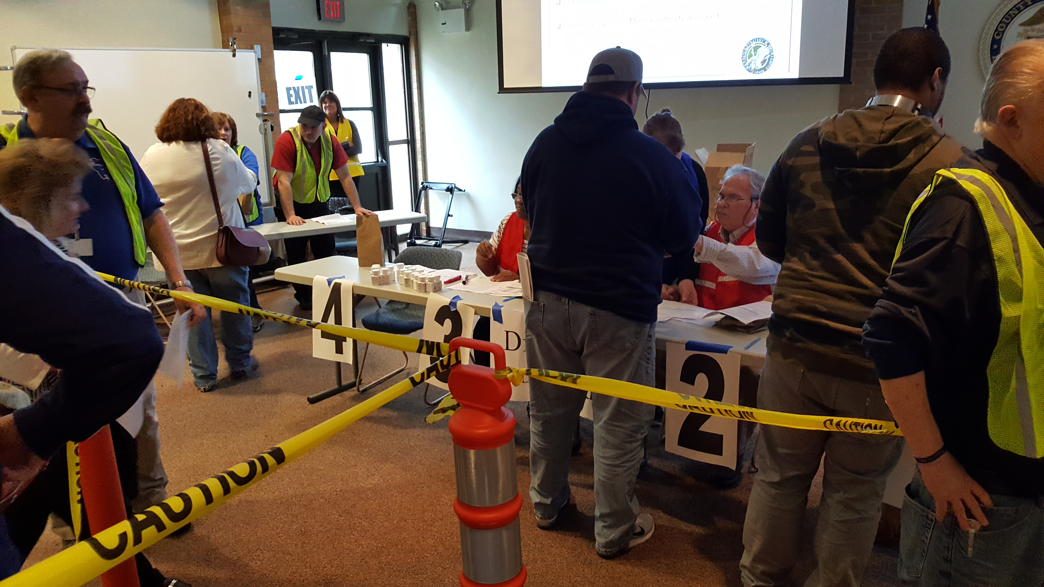
Tiered Volunteering
There will be three (3) levels, or tiers, of volunteers.
Tier 1 – Medical
  Nurses, Medics/EMTs, MDs/PAs, LSW
Tier 2 - Client Contact
  Client/patient registration areas
  Provide patient education
Tier 3 – Logistics
  IT support
  Transportation
  Logistics

Slide 37
Safety
It is of paramount important that our volunteers remains safe at all times. We are of no help to anyone otherwise. Please keep yourself and your team safe.
  Environmental Dangers
  Bending/Lifting
  Secure perimeters
  Crowd control
  Keep ID in view
The Citizen Corps Coordinator will ensure that individual photo ID badges are prepared and issued to each volunteer. Badges will include at least a name and photo with “Delaware County Citizen Corps” on the front. Additional information or color coding, position or assignment, certifications and licensure may be added.

Slide 38
Growing volunteers!
Training, Training, Training!!!
Delco Citizen Corp has over 200 events each year. The state average is 15.
Training fixes everything:
  Education, knowledge, skills, & abilities
  Recruitment & Retention
  Need to be needed
  Interpersonal communication
  Esprit de Corps - pride, fellowship, and common loyalty
Exercises – Recognition Prime Decision Making (RPM) – muscle memory
Leadership opportunities – Deputy & Assistant Coordinators, Citizen Corps Council, Project Leader, Team Leader.

Slide 39
Readiness and Training
All Citizen Corps volunteers are strongly encouraged to complete the following training prior to activation:
Orientation & Handbook
Fire Safety
Hazardous Materials
Disaster Preparedness
Disaster Management
CPR/AED/First Aid
Family/Personal Preparedness
START Triage
NIMS/ICS
Activation Protocol

Slide 40
Additional Training
The Citizen Corps Coordinator will:
  Periodically list pertinent web-based trainings.
  Offer American Red Cross courses upon request and at the discretion of the coordinator
  Conduct trainings throughout the year on various topics.
  Exercises which simulate activation, mass vaccination clinics, etc. will be developed and offered as appropriate. Real life situations that provide hands-on experience may preclude simulations.

Slide 41
CCDC Team Leaders
Team Leader Requirements –
Citizen Corps Orientation & Handbook Training
SNS Point of Dispensing Exercise
Leadership Classroom & Training Lanes
Red Cross Sheltering & Logistics Training
National Incident Management System Training:
  IS-100, IS-200, IS-700, IS-800
At least one of the following:
  SNS Screening & Dispensing Training
  CERT Basic Course
  Pet Sheltering Course
Psychological First Aid
Attend at least one Annual Logistics Exercise
Current First Aid & CPR Certification

Slide 42
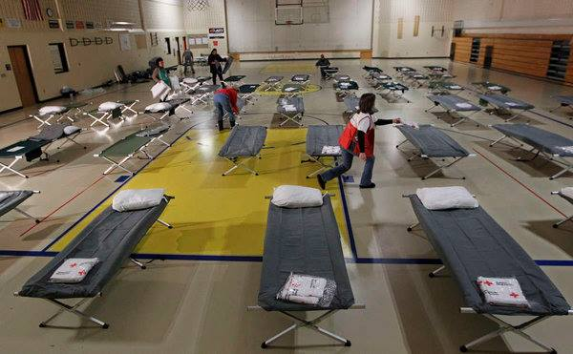

Slide 43
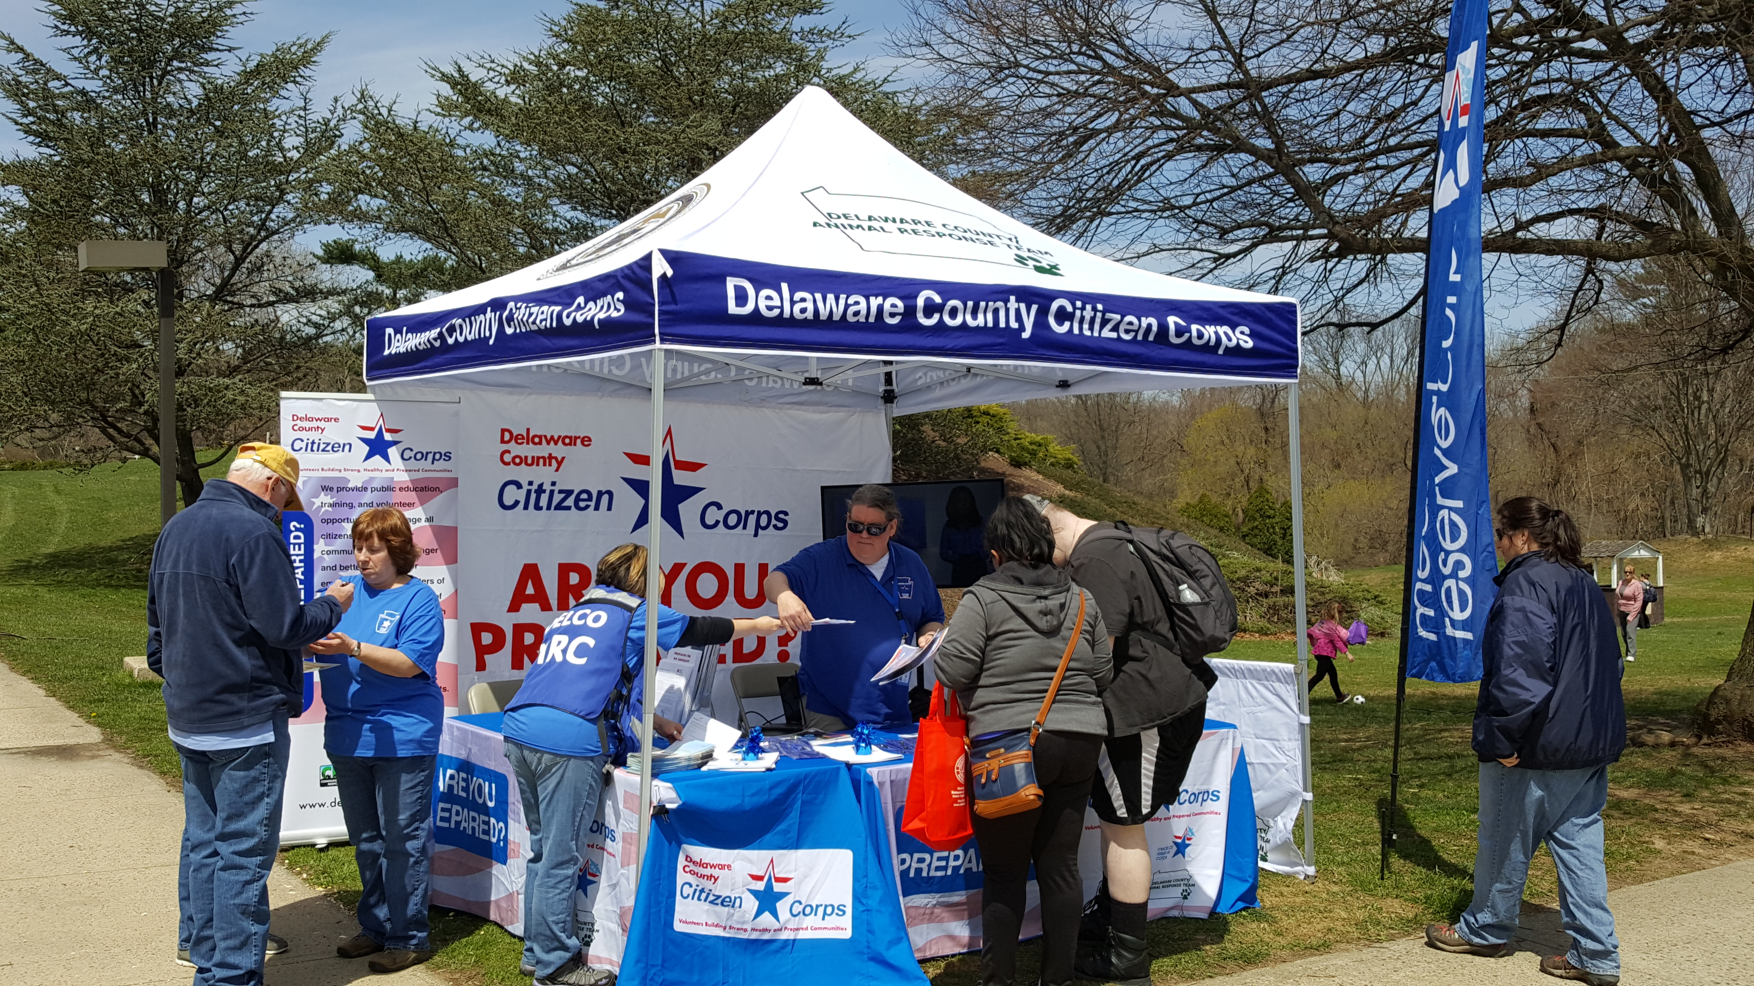
Notes:
Sun Valley Exercise

Slide 44
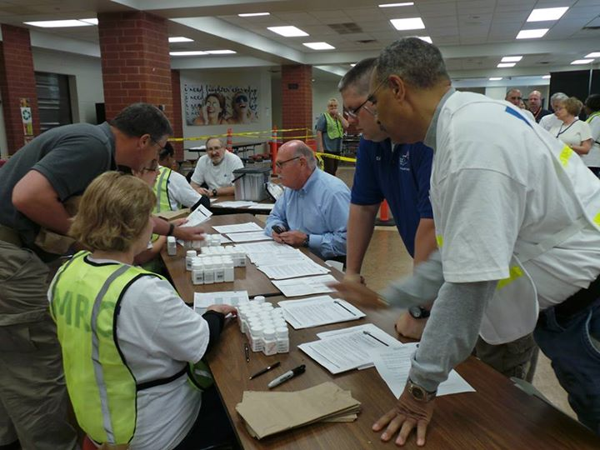

Slide 45
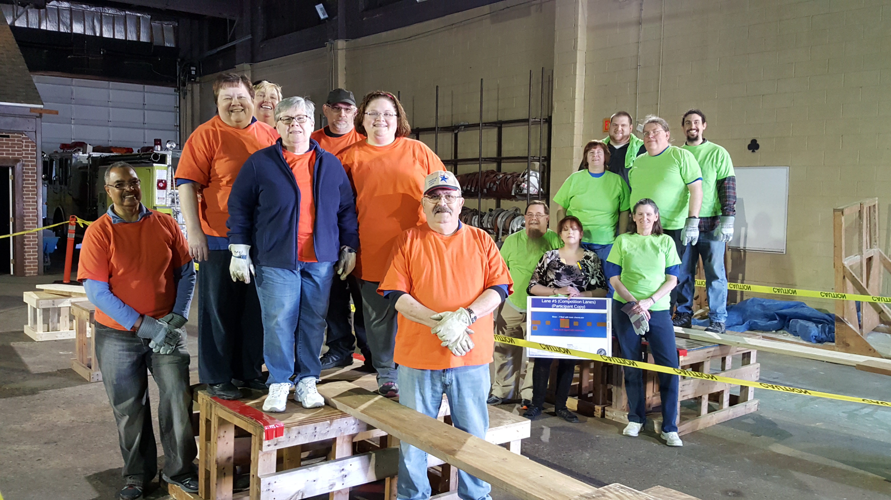

Slide 46
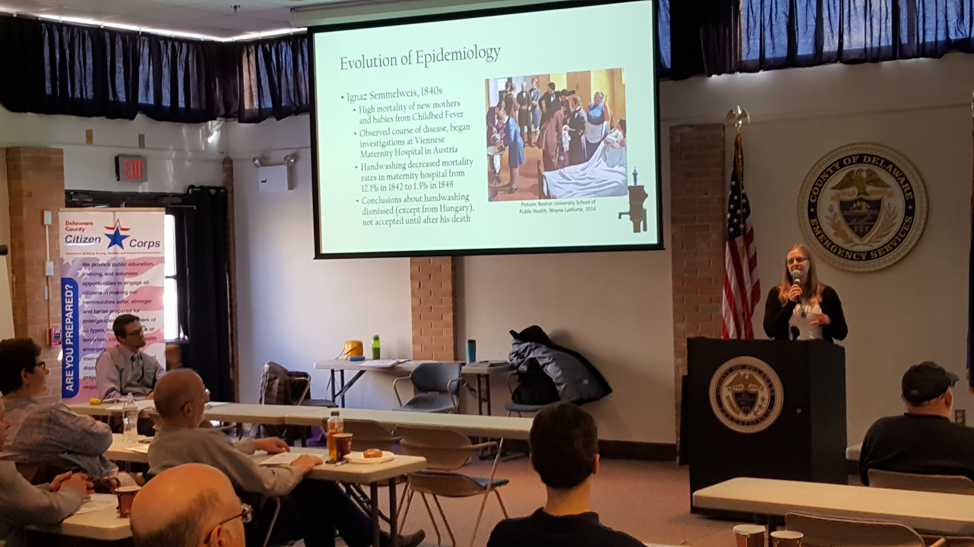

Slide 47
Volunteer Participation
We ask that each volunteer make themselves available for at least one training per year.
The Citizens Corps of Delaware County participated in over 200 events annually. 251 in 2018. 258 in 2019!
Volunteers are encouraged to join one of our five workgroups.
  Training
  Communications
  Recruitment and Retention
  Health & Safety
  Community Outreach

Slide 48
Emergency Activation
A declaration by the governor of the State of Pennsylvania indicating that there is a state of emergency- public health or otherwise.
A declaration by the county executive of Delaware County, Pennsylvania, that there is a county emergency- public health or otherwise.
A declaration of the Delaware County Department of Emergency Services director or his/her designee that Citizen Corps is needed for emergency or non-emergency activities

Slide 49
Emergency Activation
In the event of a public health or medical emergency Citizen Corps volunteers will initially be notified through ServPA which provides emergency alerts, notifications and updates to email accounts, cell phones, pagers and smartphones.
This is one of the reasons why registration on ServPA is a requirement.

Slide 50
Command Structure
Citizen Corps emergency operations will be coordinated through the Delaware County Emergency Operations Center (EOC). Organizational structure will be in accordance with accepted Incident Command System (ICS) protocols.
ICS training can be found at: https://training.fema.gov/nims/
  ICS 100, 200, 700, 800

Slide 51
Citizen Corps Deployment Staffing
Each emergency will be staffed in accordance with DCDES emergency response plans.
Citizen Corps volunteers will be assigned duties according to skills, abilities, credentialing/licensure (for medical professionals), experience and comfort level. No volunteer will be asked to perform tasks that he or she is uncomfortable doing. Staffing needs may require that volunteers will be requested to work at sites other than the one closest to their home.

Slide 52
Accountability
The Citizen Corps of Delaware County is under the jurisdiction of Delaware County Department of Emergency Services (DCDES). As such, the Director of DCDES holds the ultimate responsibility for Citizen Corps. The Director of DCDES supervises the Citizen Corps Coordinator (Ed Kline).
The coordinator maintains direct responsibility for day-to-day administrative management tasks of Citizen Corps:
Recruitment & retention
Maintaining records
Issuance of ID badges
Organizing meetings, training, events, exercises, drills
Management of grant funds

Slide 53
Out of Area Deployment
Some Citizen Corps volunteers may opt to be registered as “deployable” to areas outside of the county. During large disasters/emergencies (hurricanes, floods, earthquake, wildfire, pandemic or outbreak, etc.) outside the district a determination may be made that volunteers need to be brought in from other areas to assist in response and recovery.
Those volunteers who choose to register as deployable must meet established criteria for statewide and out-of-state deployment. While criteria may be established pre-event, final approval authority is the responsibility of the requesting organization/agency. When deployment opportunities arise the coordinator will notify volunteers via ServPa.
The coordinator is responsible for tracking volunteer hours donated to all outside deployment. Each volunteer will be responsible for reporting his/her hours to the coordinator upon completion of the deployment

Slide 54
Provisions
These will be provided for you:
  Education and training
  Shirts, hats, vests
  Protective equipment and clothing
  Supplies (gloves, syringes, splints, etc.)
  Food and shelter
However, please be responsible and make sure to bring your own water, snacks, medications (if needed), etc. GO KIT

Slide 55
Communications
Non-emergency communications will be achieved via e-mail, phone and the postal system if necessary.
A Citizen Corps schedule and training notification will be distributed to all volunteers on a regular basis. If you do not have internet access, please let the coordinator know and communications will be mailed to you or provided by phone.
Training sessions and classes will also serve as an opportunity to communicate with volunteers as well as an opportunity for volunteers to meet each other.

Slide 56
Website
Web Site: www.delcocitizencorps.com
The Citizen Corps website includes information that will keep you updated as to training schedules, events, etc. Your family, friends, and colleagues, can also use this site to find out more about the Citizen Corps and to access SERVPA to apply to become a volunteer.

Slide 57
Data Management
Citizen Corps volunteer information is maintained through SERVPA in our Citizen Corps Database. Information includes essential data (address, phone, e-mail, licensure information) as well as data that contributes to efficient management of the Citizen Corps program (credentialing information, volunteer interests, volunteer’s level of involvement, etc.).
  Training and activity hours are maintained separately
  Make sure you sign in at each activity

Slide 58
Liability
Volunteer Citizen Corps are given certain protections under the following Federal or Pennsylvania State laws:
The Federal Volunteer Protection Act of 1997
No volunteers shall be liable for harm caused by the act or omission of the volunteer if …
A. The volunteer was acting within the scope of their responsibilities;
B. The volunteer was properly licensed, certified, or authorized to undertake the activities in question;
C. The harm was not caused by willful or criminal misconduct, gross negligence, reckless misconduct, or a conscious, flagrant indifference to the right or safety of the individual(s) harmed; and
D. The harm was not caused by a volunteer operating a vehicle that requires an operator's license or insurance.

Slide 59
Liability
Delaware County also holds an “Accident” policy for disaster volunteers. This is gap insurance.
Worker’s compensation is available during mutual aid incidents.
Additional insurance coverage comes into play during declared disasters.
PREP ACT - The Public Readiness and Emergency Preparedness Act (PREP Act) added new legal authorities to the Public Health Service (PHS) Act to provide liability immunity related to the manufacture, testing, development, distribution, administration and use of medical countermeasures against chemical, biological, radiological and nuclear agents of terrorism, epidemics, and pandemics.

Slide 60
Policies
Harassment Free Policy
  It is the policy of our Citizen Corps that harassment based on race, color, religion, age, gender, sexual orientation, national origin, marital status, disability, veteran status or any other basis is strictly prohibited.
  Any harassment, whether verbal or physical, is unacceptable and will not be tolerated
  If you feel you may have been the subject of discrimination or harassment, you should contact the coordinator. Any reports of discrimination or harassment will be thoroughly investigated and resolved promptly.

Slide 61
More policy
Safety
  No job is considered so important or urgent that volunteers cannot take time to perform their job safely.
  If you are unclear about any safety policies or procedures you may ask the coordinator.
  You have a responsibility for your own safety and health. This includes using all required safety devices. You must also notify your supervisor of any physical conditions such as drowsiness due to medication, illness or emotional strain, which may affect your performance and safety. You are expected to immediately report all work-related accidents, injuries, illnesses and near-misses to your team leader or the coordinator.

Slide 62
Electronic Communications
Electronic communication systems, including telephones, e-mail, voice mail, faxes, internet, HAM radio and FRS/VHF radios are available to conduct business.
All communications are to be professional and appropriate and users are prohibited from using any communications systems for the solicitation of funds, political messages, harassing messages, or personal use.
Furthermore, all electronic data is the property of the Delaware County Department of Emergency Services and may be considered public records.

Slide 63
Drug Free Workplace
The Citizen Corps of Delaware County is dedicated to a safe, healthy and drug-free work environment. No Citizen Corps volunteer will report to work while under the influence of any drug or alcohol whether legally or illegally obtained.
Any member determined to be under the influence of any drug or alcohol will be immediately relieved of duty and escorted offsite.
JUST DON’T DO IT !!

Slide 64
Violence-Free Work Environment
This policy has been developed to help ensure a safe workplace and to reduce the risk of violence.
Citizen Corps will not tolerate any type of threat or act of violence committed by or against a volunteer and therefore prohibits workplace violence.
In order to ensure a safe work environment Citizen Corps prohibits members from possessing a handgun, firearm, or weapon of any kind while engaged in any Citizen Corps sponsored function or event.

Slide 65
Press and Media
Citizen Corps media and/or news releases will be submitted and released in accordance with existing DCDES protocol. Newsletters and other official releases will be submitted and approved via the coordinator.
Photos of Citizen Corps Volunteers and/or DCDES staff may be included in newsletters or released to the media only if the person depicted in the photo has signed a photography consent form.

Slide 66
Code of Conduct
In the event that the volunteer’s obligation to operate in the best interests of the Citizen Corps conflicts with the interests of any organization in which the individual has a financial interest or an affiliation, the individual shall disclose such conflict to the Citizen Corps Coordinator.
If another volunteer or team leader is dissatisfied with a volunteer’s performance the first course of action is to communicate that concern to the volunteer. If the two are unable to reach an understanding the coordinator will resolve the matter. The volunteer will be given sufficient time to respond to the allegation. In some cases, however, immediate action may be required depending upon the severity of the issue.
Please read the complete Code of Conduct before signing handbook training. (20)

Slide 67
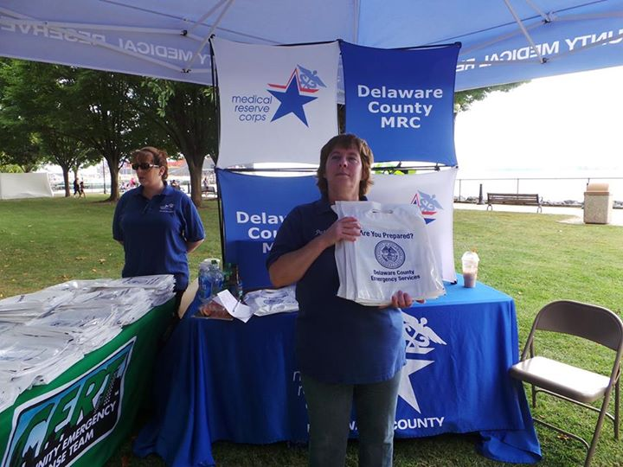
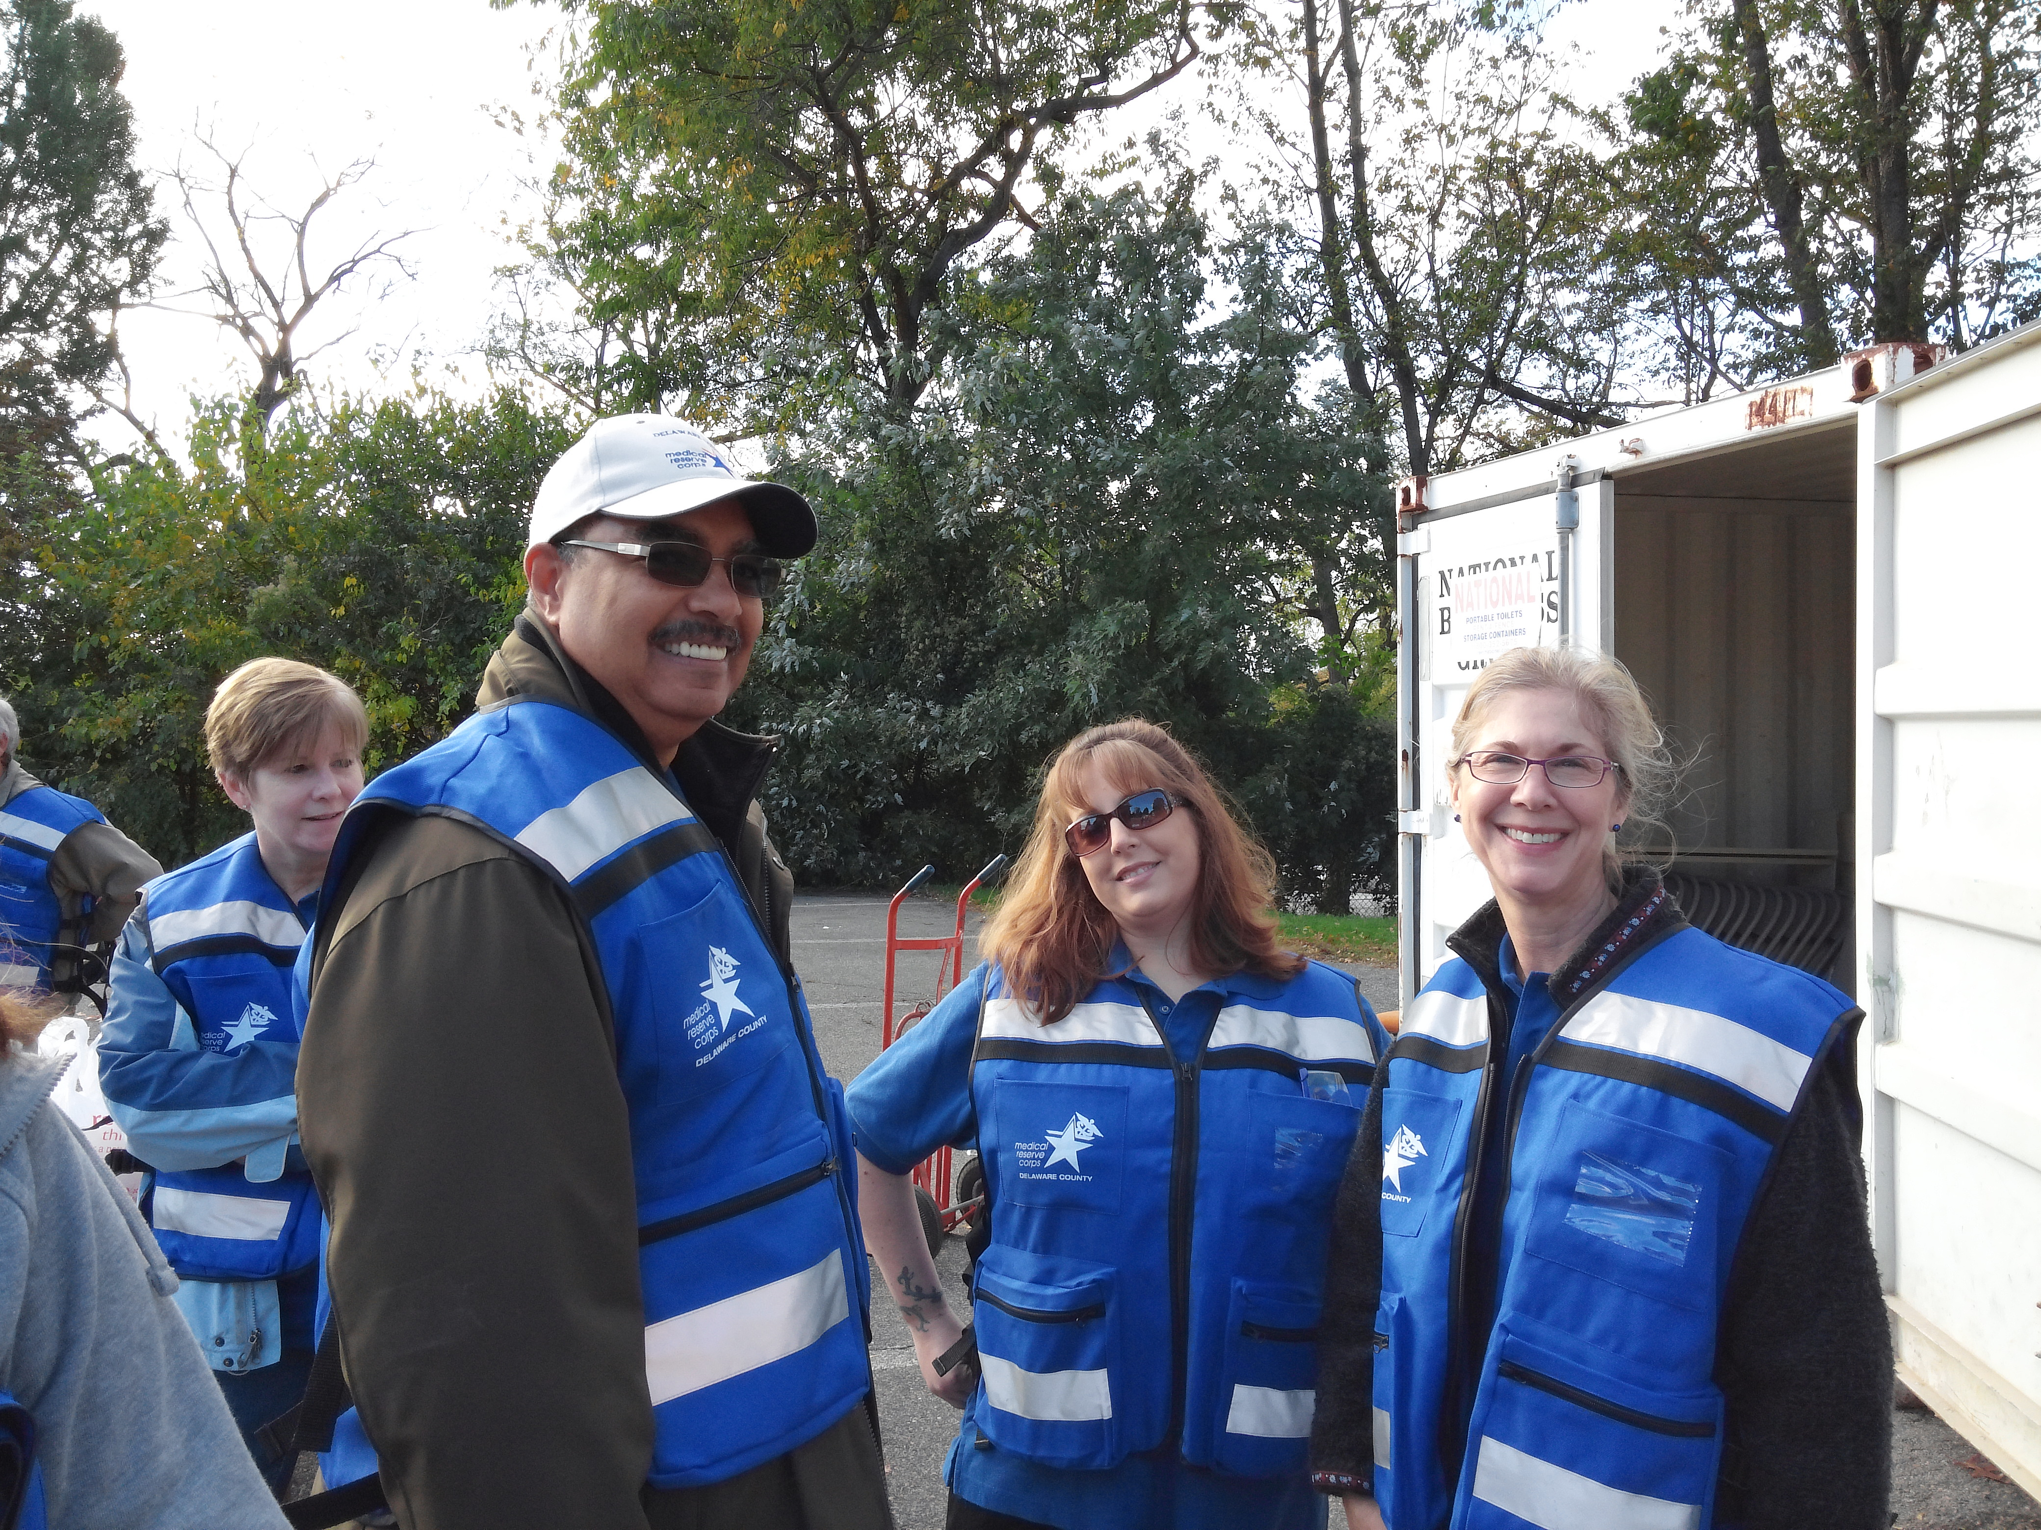
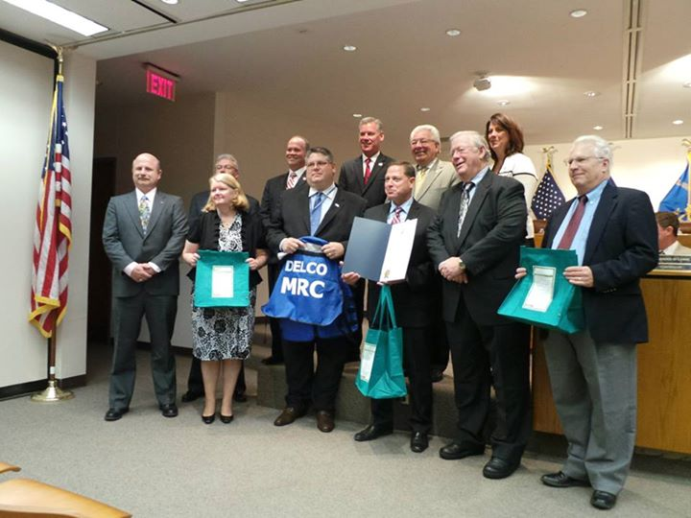
We are BUSY…

Slide 68
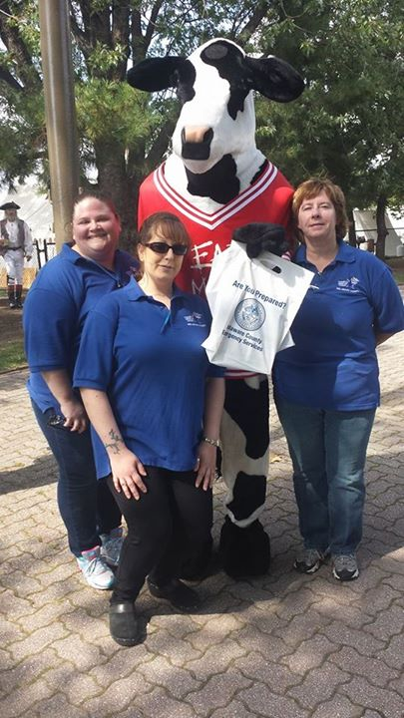
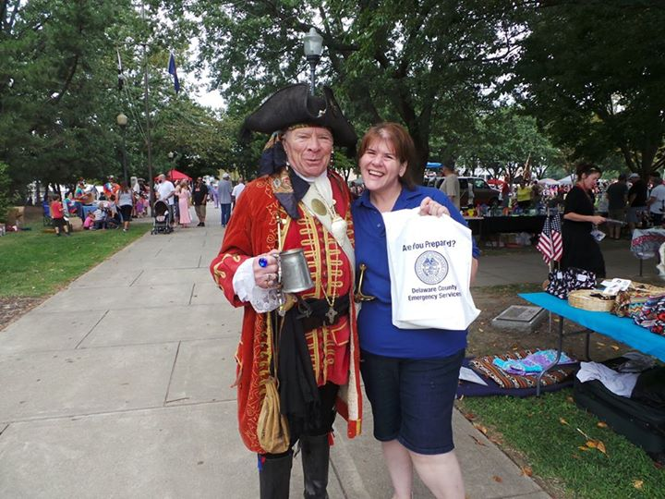
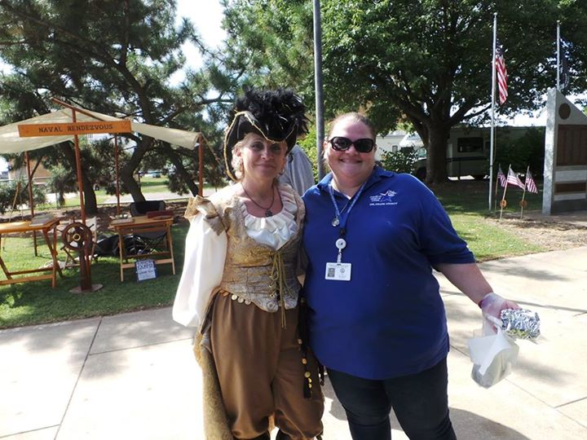
…then there were Cows and Pirates…

Slide 69
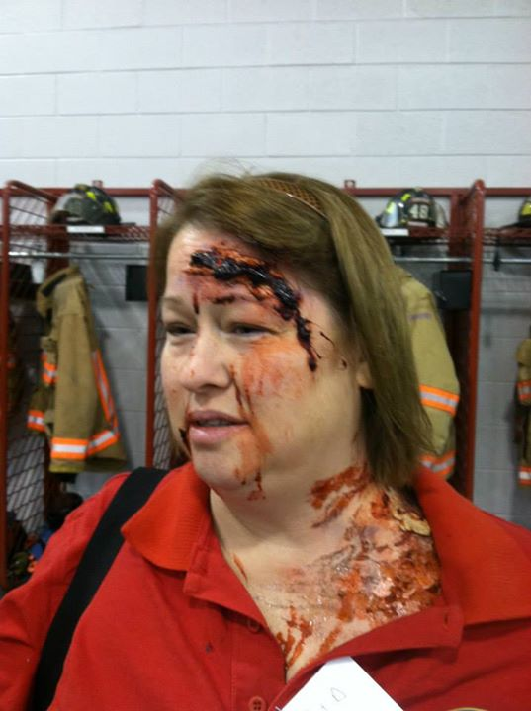
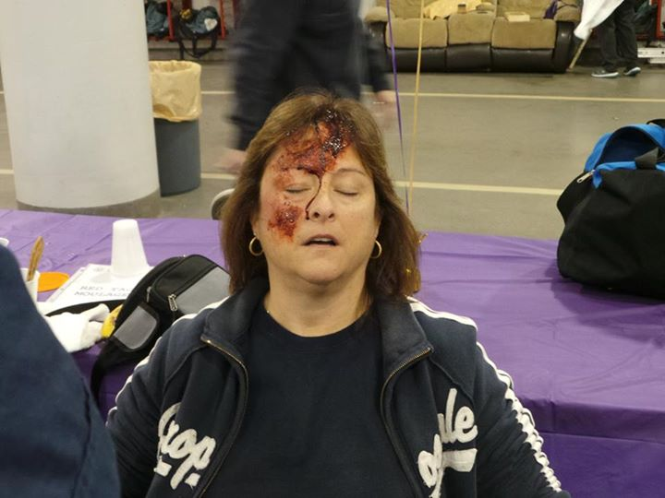
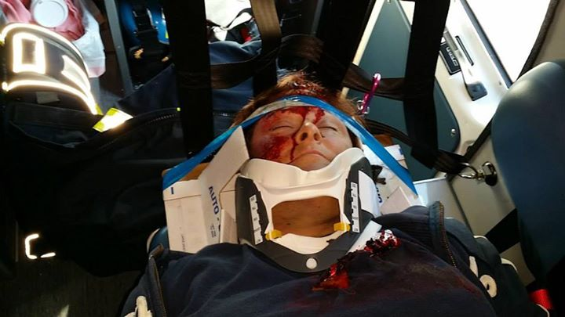
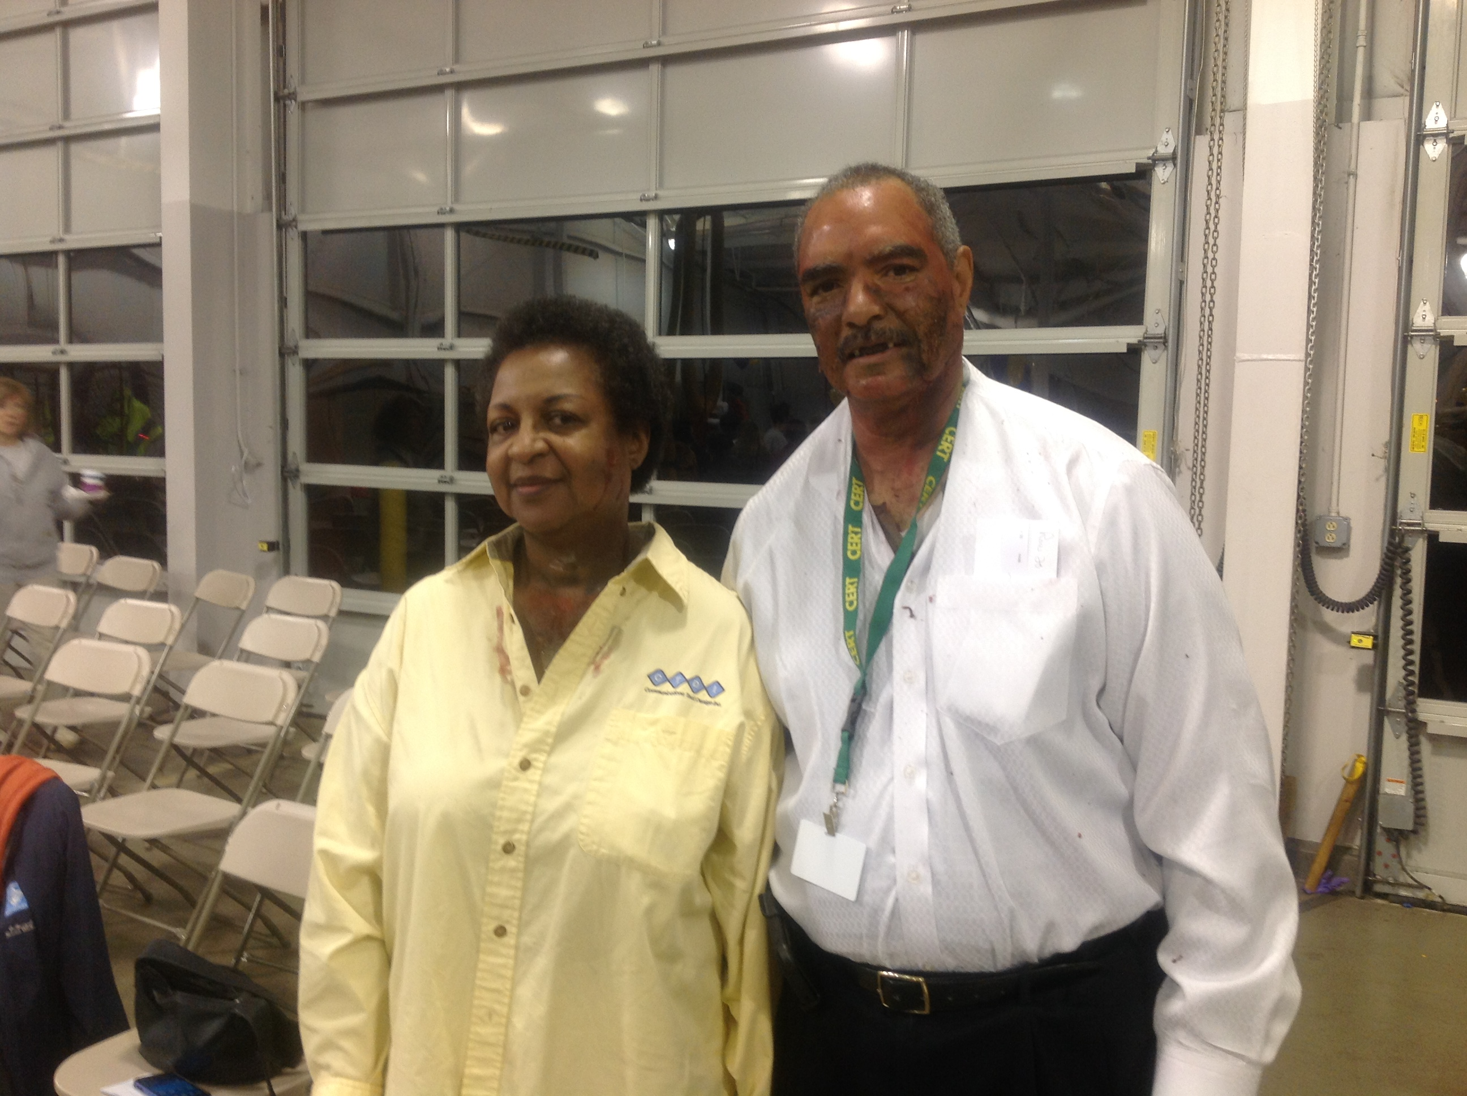
…then THIS happened – at PHL Airport!

Slide 70
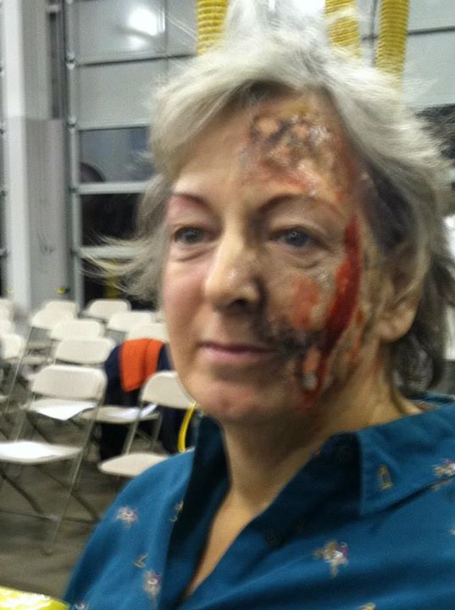
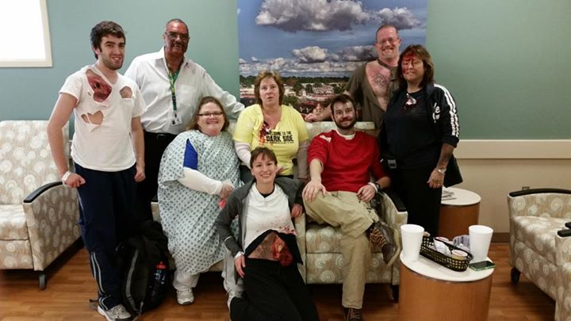
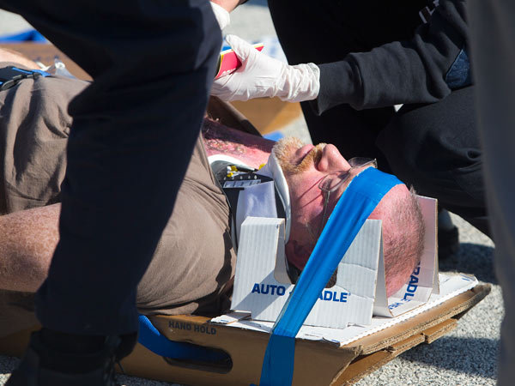

Slide 71
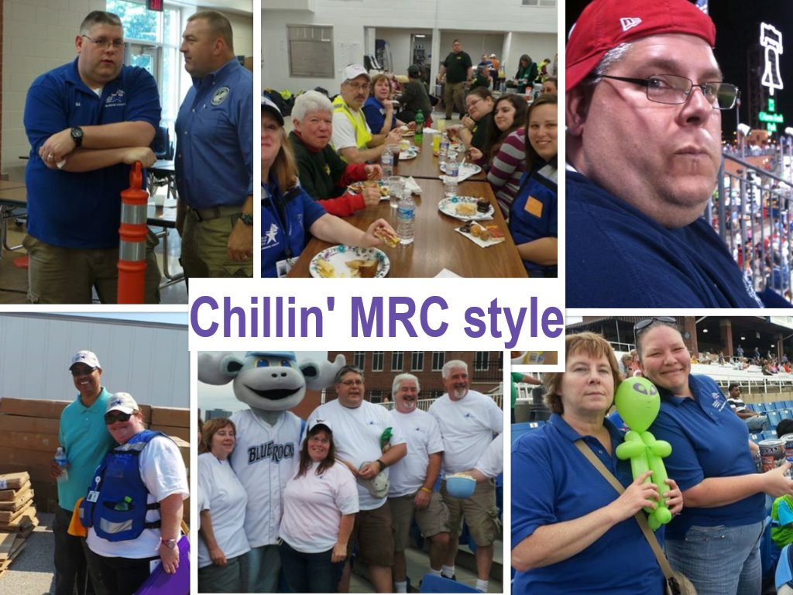
Work hard, play harder

Slide 72
Medical Countermeasures (MCM) Program ESF - 8
Points of Dispensing (PODS) sites will serve to
distribute medications or vaccinations to large
segments of the County’s population.
Disaster Volunteers will be key in staffing POD sites.
Volunteers will be integrated to perform a variety of duties:
Registration Crowd control
Data entry Assist with special needs residents
Language translation Conduct medically-appropriate tasks

Slide 73
Strategic National Stockpile (SNS)
A National Stockpile of Medicines and Medical Supplies
Managed by the Centers for Disease Control (CDC)
Stored in secure/classified locations around the United States
Shipped anywhere in the United States within 12 hours
Designed to assist in the local emergency response to:
  Pandemic
  Chemical/industrial accident
  Terrorist attack (used in NYC and WDC following 9/11)
  Major Natural Disasters (used in response to Katrina/Rita)

Slide 74
MCM 2019 Status – Established!
Open POD Sites
  16 Sites with Plans
  All sites have conducted site-specific exercises
Local Distribution Site (LDS)
  Primary and Alternate Sites with Plans
  Both Sites have conducted exercises
Closed POD Sites
  72 sites currently registered and executed MOU
  60+ sites have participated in exercises in 2007 to 2018
Hospitals
  All 6 major hospitals are active participants in the program and have participated in multiple exercises
MCM Operations Center (MOC)
  Located within the Delaware County Emergency Operations Center (EOC) at the Delaware County 911 Center. Has hosted multiple exercises.

Slide 75
MCM Staffing & Volunteers
Total needed – 3000
Currently Identified and Trained – about 1200-1500
Staffing Needs – Skills/Experience
  Medical Staff - Medically qualified volunteers to…
    Do medical screening
    Provide injections
    Dispense medications
    First Aid
    Counseling/Mental Health Support
  Non-Medical Staff – a broad range of needs…
    Greeters and Line Staff
    Logistics/Material Handling
    Runners
    General Administrative
    Communications – experienced with tactical radios
Staffing Needs – Locations
  In general – some staffing needed at ALL of our PODs
  DELCO Medical Reserve Corps SNS Strike Team

Slide 76
Mass Care ESF - 6
Delaware County Emergency Services works in conjunction with Non Government Organizations (NGOs) to provide mass care services:
American Red Cross
Salvation Army
Community Interaction
Southern Baptists
Red Paw
Team Rubicon
Delaware County Interfaith Food Assistance Network (DIFAN)
SEPA Volunteer Organizations Active in Disasters (VOAD)
Among others

Slide 77
Mass Care
Initial response and case management conducted by the local Red Cross Disaster Action Team
Initial first responder canteen and client feeding services conducted by the Salvation Army
Resources are requested directly from municipalities and generally handled at that level.
When a shelter is needed or multijurisdictional resource sharing is required the county begins to coordinate the response.
Citizen Corps Volunteers participate in shelter operations:
  Registration, First Aid, Housing, Feeding
County can run up to three large shelters at one time.
Multiple small shelter kits or “30 packs” are deployed throughout the county.

Slide 78
Community Outreach and Training
Delaware County has one of the largest public outreach programs in PA!
Local public health fairs
Community events
Hand only CPR
National Night Out
Pirate Fair
Emergency Preparedness Handbook & Bags
Municipal & Community group emergency preparedness education courses

Slide 79

Department of Emergency Services (DES)
Delco Citizen Corps is part of the Delaware County Department of Emergency Services
Oversight from the Director of Delco DES
  Tim Boyce
Coordinated by the Special Operations Division
  Tom Morgan
Supervised by the Volunteer Management Coordinator
  Ed Kline
Lead by Citizen Corps Leadership Council
  Deputy & Assistance Coordinators, Project Managers

Slide 80

DES Workgroups
Communications
  911 phone, radio, video, dispatchers, mobile
Emergency Management
  Federal, state, municipal, planning, hazmat
Special Operations
  Police, fire, medical, SNS, MCI, Citizen Corps
Technology, Training & Innovation
  Infrastructure, equipment, support

Slide 81
DES Organizational Chart
Director
Homeland Security
Communications
Special Operations
Emergency Management
Technology, Training & Innovation
Supervisors
DelComm & Fireboard
Teams
Resources
Planning
Hazardous Materials
Deputy Directors

Slide 82
DES 911 Center Events per Year
911 calls – 450,000
Police events – 350,000
  7 police sectors
EMS events – 55,000
  2 medical channels
Fire events –17,000
  49 municipalities

Slide 83

Special Operations Group
ATV – Fire & Medical
Drones
Field Comm & MCP
Generators
Hazmat
IST
Light Tower
Radio Tower
MCI PODs and Trailers
Police, Fire & EMS Teams
USAR
MCM
Volunteer Teams
  Citizen’s Corp, CERT, DelCART, ARES,
Hospitals
Mass Care
Support Equipment

Slide 84
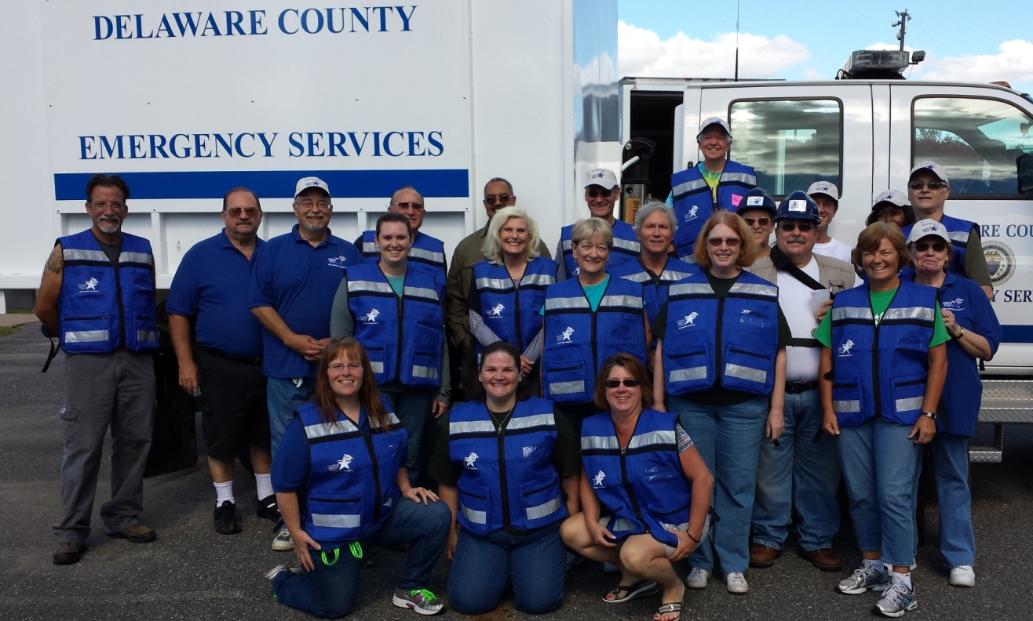
CCDC Volunteer Benefits
Being part of an organized volunteer group means you have the greatest potential to make an impact, ensuring a quick return to stability within your community after a public health emergency.

Slide 85
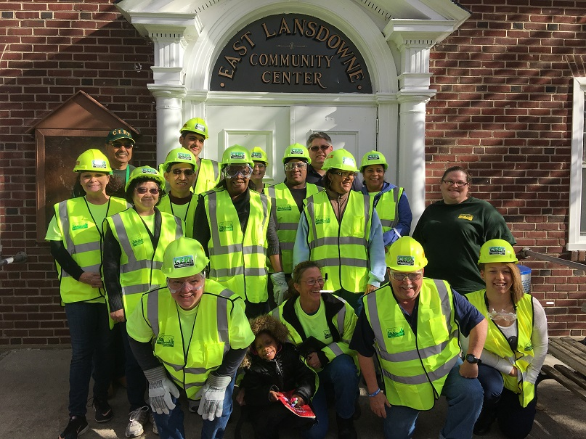
CCDC Volunteer Benefits
Be among the first who are notified when an emergency happens.
Receive medication for yourself and your family.
Receive periodic newsletters on topics related to public health preparedness.
Take advantage of specialized trainings in your community.
Meet others who have experience and insight in emergency preparedness.

Slide 86
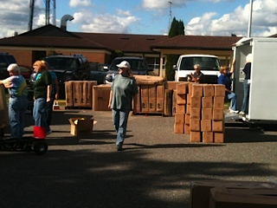
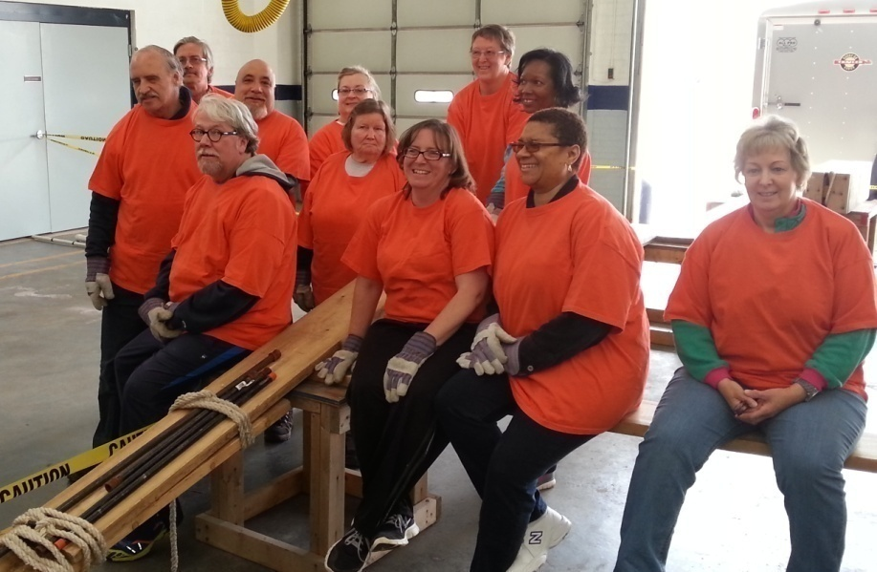
CCDC Volunteer Benefits
Use your skills in a helpful way!
The Delaware County Citizen Corps will help you apply your skills where they are needed most.
Because of the training that you will receive, you will be better prepared to help yourself and others during an emergency.

Slide 87
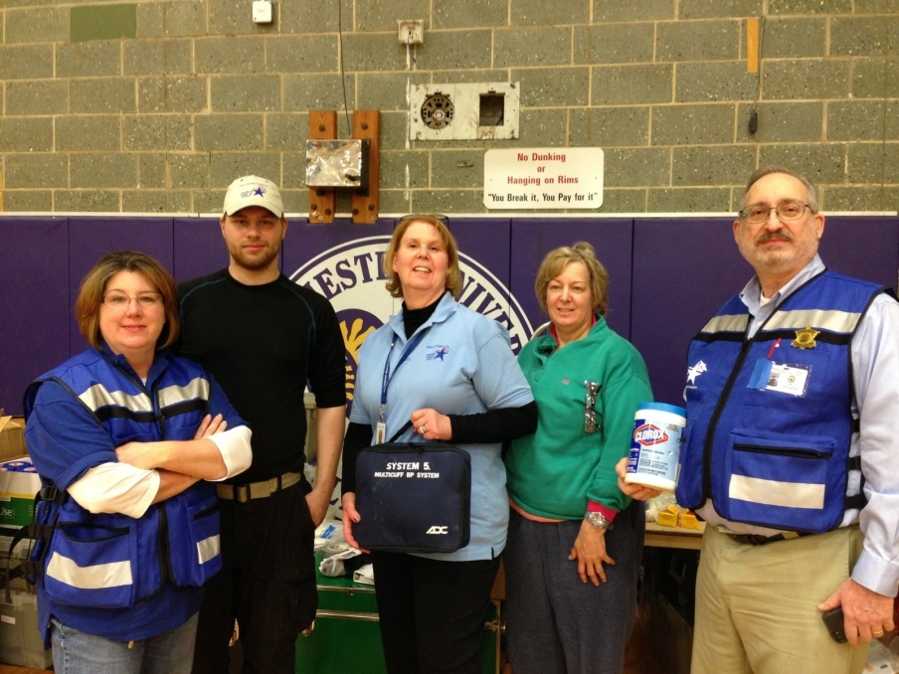
CCDC Volunteer Expectations
Attend a Citizen Corps Orientation.
2. Register on SERV-PA.
Sign up for Delco Alert.
Complete FEMA NIMS training:
IS-700, IS-800, IS-100, IS-200.
https://training.fema.gov/nims/
5. Attend a Handbook training course.
Participate in activities, drills, and exercises as able.
Maintain your information on the SERV-PA website. www.serv.pa.gov

Slide 88
CCDC Volunteer Expectations
Participate in Delaware County Events
Volunteers should plan to participate in at least one County of Delaware event per year. Opportunities include:
Seasonal Flu Clinics
POD Drills
Community Health & Emergency Preparedness Events
County & Regional Presentations
Local & County exercises
Shelter & Logistics Training
Leadership Training

Slide 89
Volunteer Rights
  Full orientation and training
  Assignments that utilize and develop your skills
  Adequate information and training to carry out your assignments
  Clear and specific directions
  Recognition and appreciation for your contribution
  Opportunity to offer feedback and ask questions
  Expect regular feedback on your work
  Adequate space, equipment and supplies to perform your job
  Know as much about the organization as possible
  Be respected in your workplace

Slide 90
Volunteer Responsibilities
Be dependable, reliable, and businesslike, and abide by the policies of Citizen Corps & DCDES.
Dress appropriately for the setting and the task at hand.
Carry out duties in a safe, responsible way.
Maintain the confidentiality of information revealed to you regarding clients and coworkers.
Keep track of the hours you work on the form provided.
Be non-discriminatory in serving all people regardless of race, gender, age, religion, sexual orientation, or disability.
Work within the guidelines of your job description and accept supervision.
Offer feedback and suggestions.
Be prepared for any regularly scheduled meetings.
Represent our Citizen Corps professionally in the community.

Slide 91
CCDC Goals
Recruit Citizen Corps volunteers / Conduct Marketing
Grow our countywide disaster volunteer base
Maintain a positive reputation with state and federal
officials
Maintain & build relationships with other response and volunteer entities
Exercise best practices as they relate to deployment
across county and state lines

Slide 92


Wed Resources
www.delcocitizencorps.com
www.readypa.org
www.citizenscorps.gov
www.redcross.org
www.fema.gov
www.disaster.org

Slide 93
Contact
Still have questions or concerns?
Contact the Citizen Corps of Delaware County Coordinator
Edwin C. Kline
360 N. Middletown Road.
Media, PA 19063
klinee@co.delaware.pa.us
215-439-1407

