Slide 1
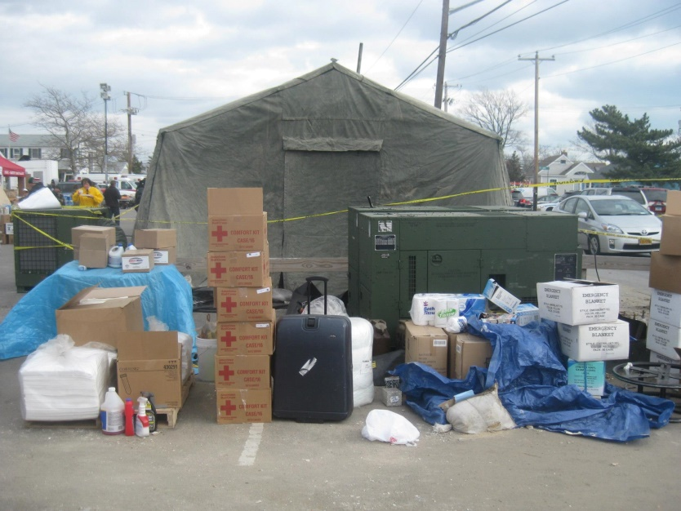
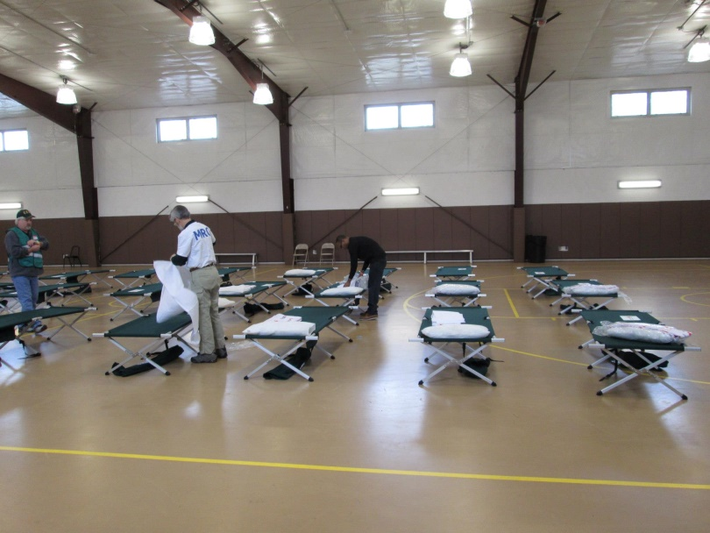
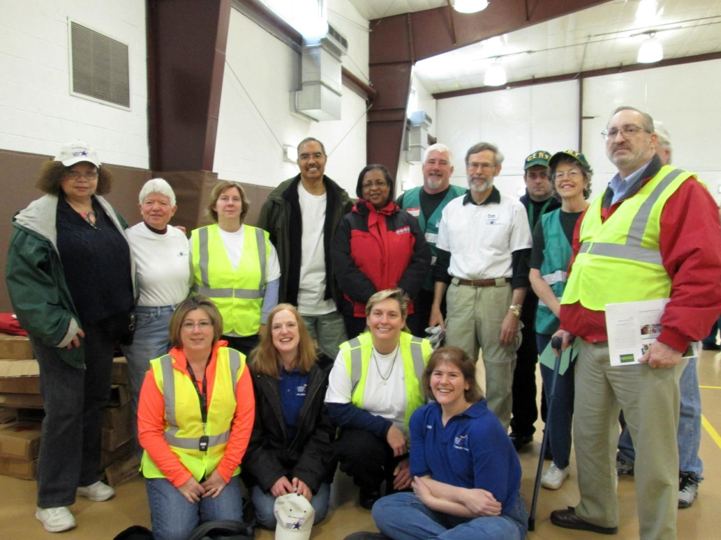
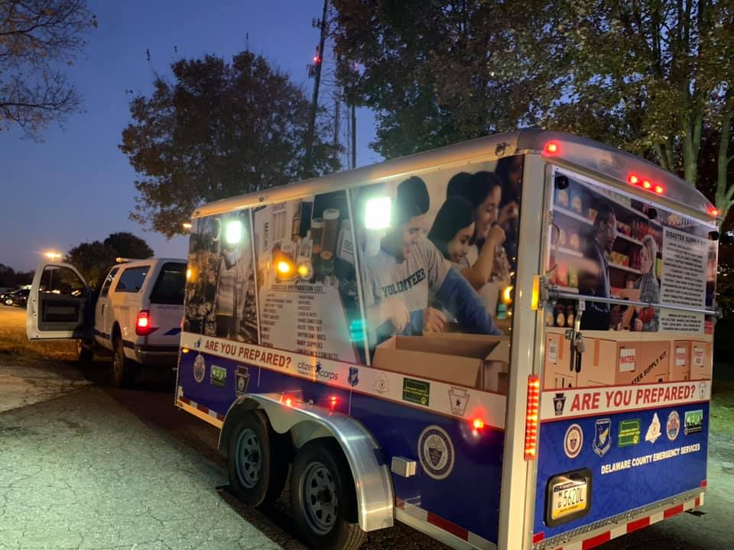
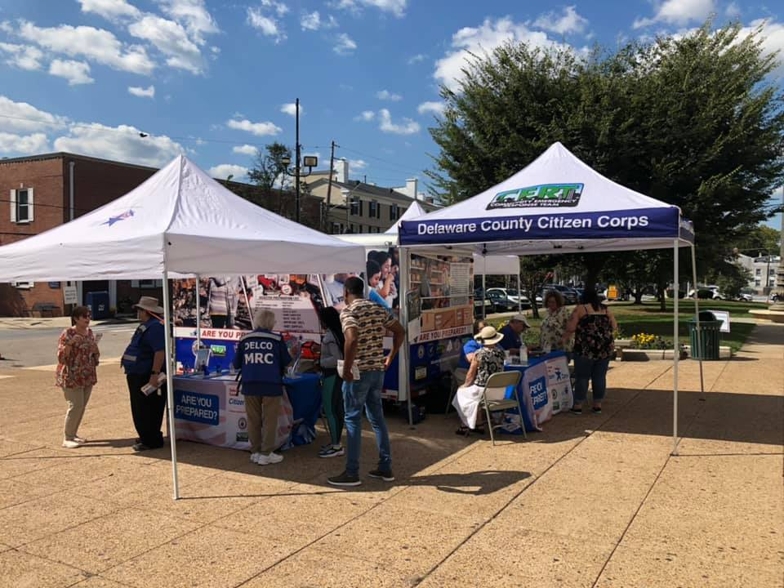
You Are Deployed! Now What?

Slide 2

Stages of Deployment

Slide 3
Ingredients of a Deployment
OUR BASE INGREDIENT IS
An Unmet need to be fulfilled
This could come from all levels of Government:
Local, County, State and Federal
This could also come from a non-profit organization such as Loaves and Fishes, Red Cross, Individuals Aiding in Emergencies Foundation

Slide 4
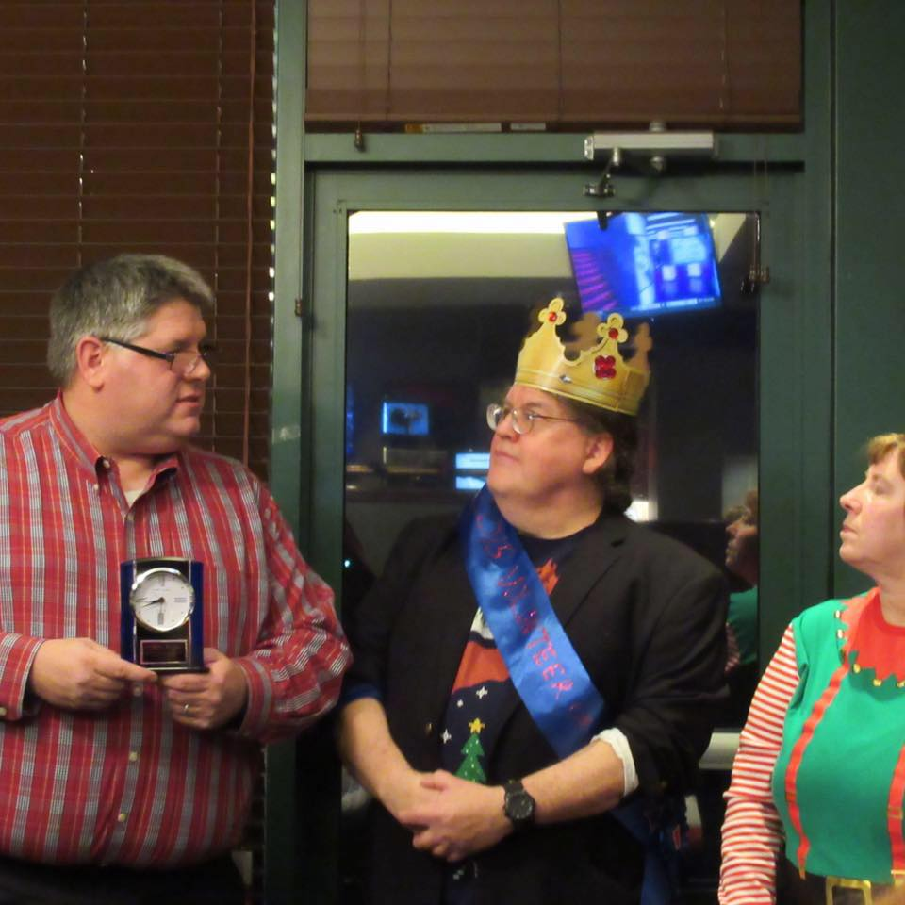

THE COORDINATOR gets details for the Deployment then starts to prepare perfect mix of ingredients to make this Mission a success

Slide 5
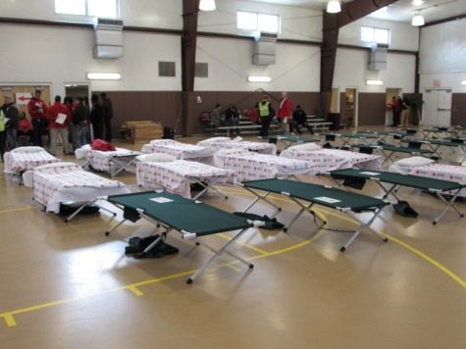
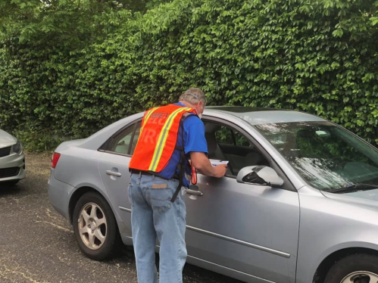
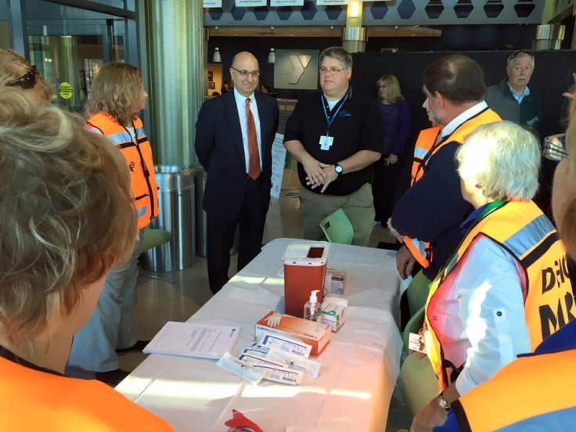
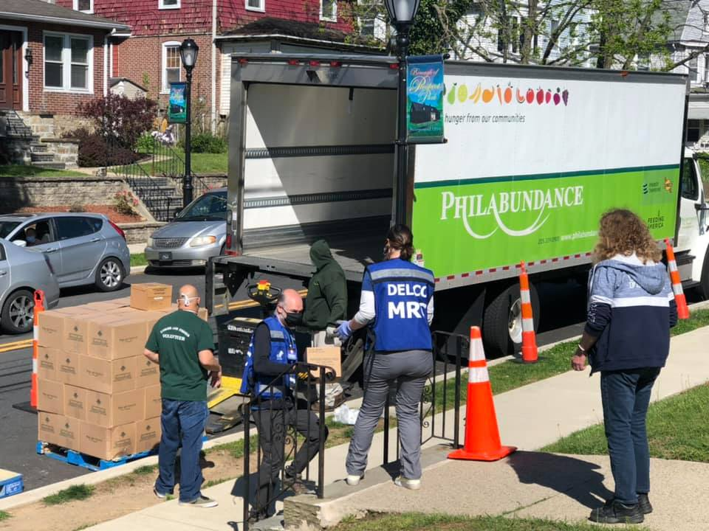
Examples of Deployments
Shelter Operations
Traffic Control
Damage Assessment
Medical Counter Measures Program
Covid-19 drive up testing site
FLU CLINICS
Feeding

Slide 6

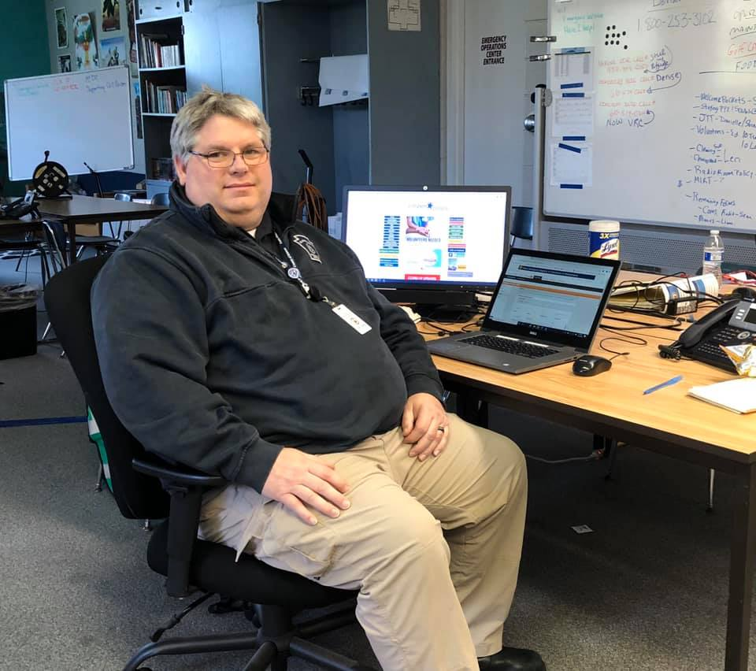
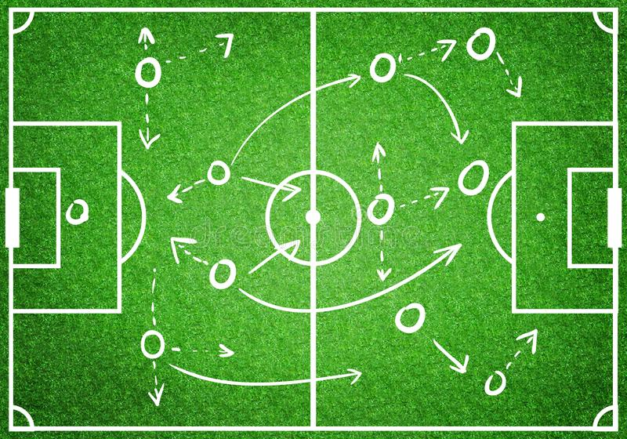
Let the Planning begin

Slide 7

DID YOU SIGN UP ON SERVPA?
(Insert photo here)

Slide 8
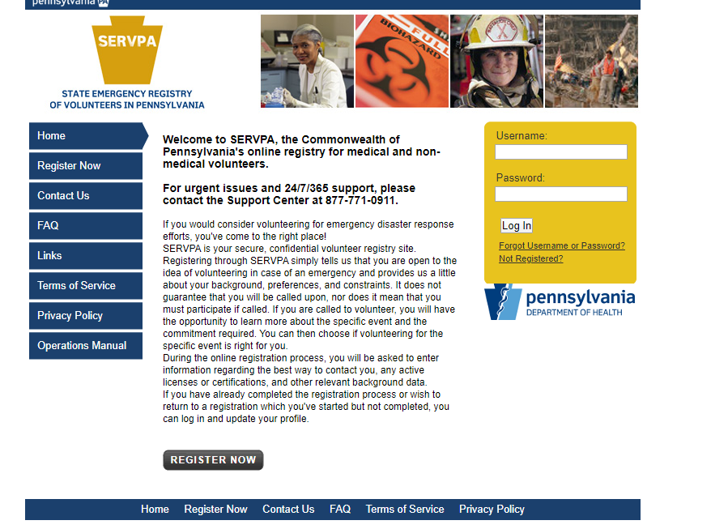
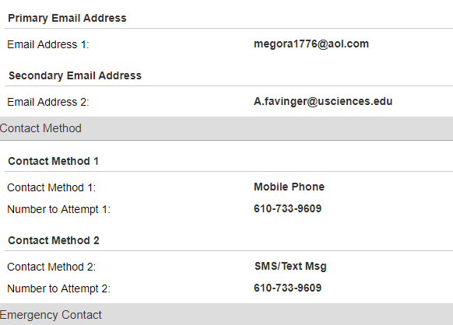
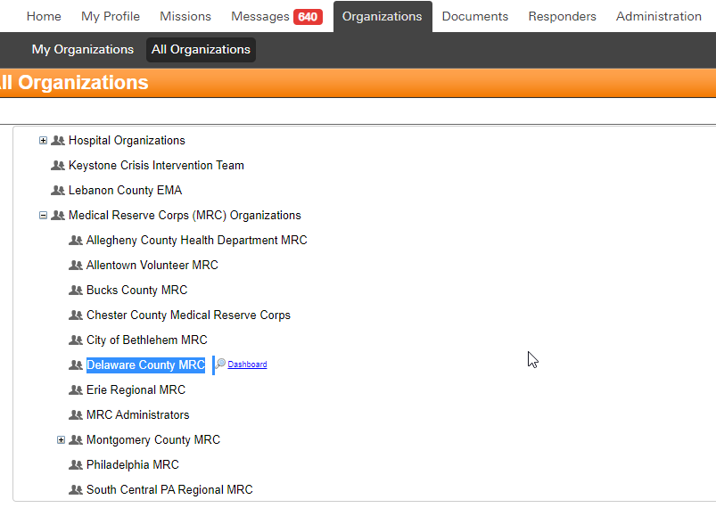
Select
Delaware County
MRC
Contact (complete)Your contact information and emergency contacts for use during a deployment.
https://www.serv.pa.gov
Is your cell phone is set up as a SMS text device?

Slide 9

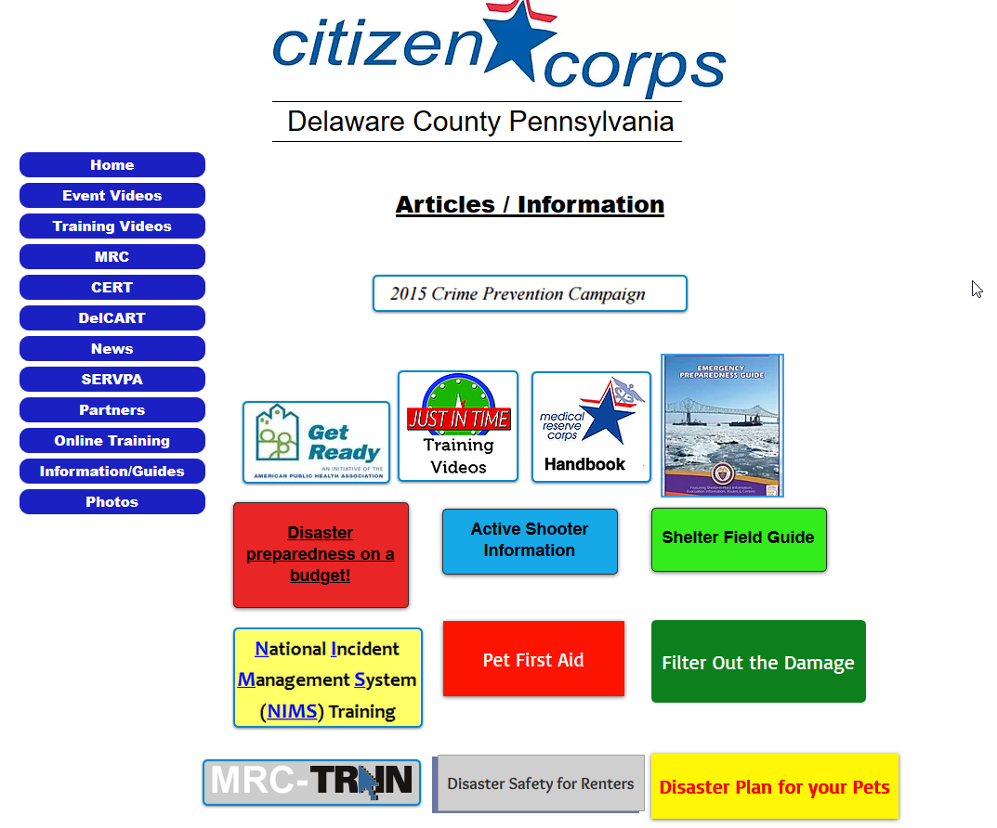


Slide 10

Situational Awareness …
“the ability to identify, process, and comprehend critical information about an incident.”
Understanding Hazards and threats in the area
Airport, Trains, Refineries, Industries
Pending weather
Be Informed

Slide 11
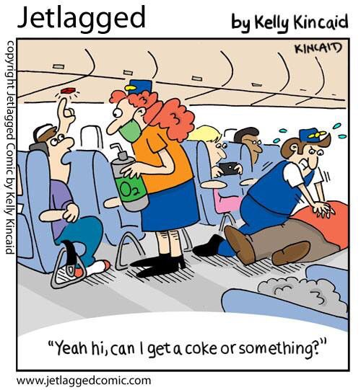
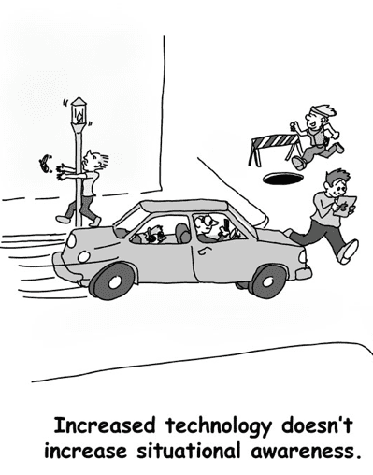


Slide 12
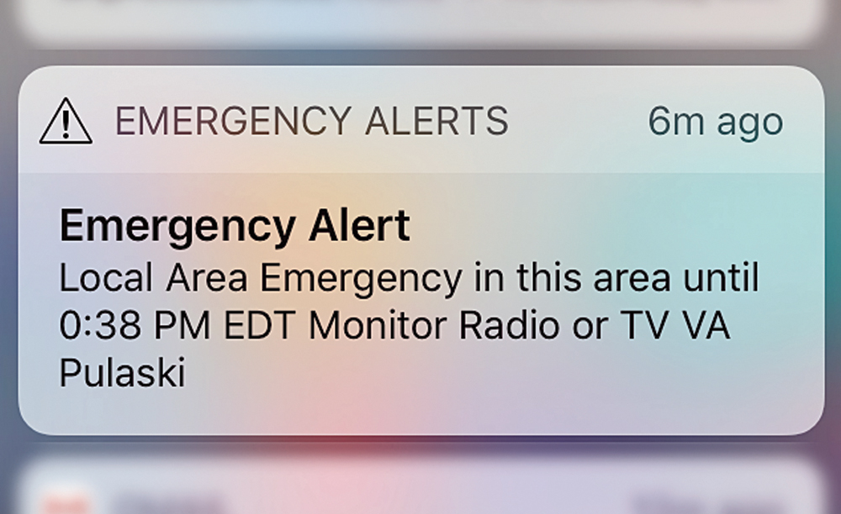






Slide 13
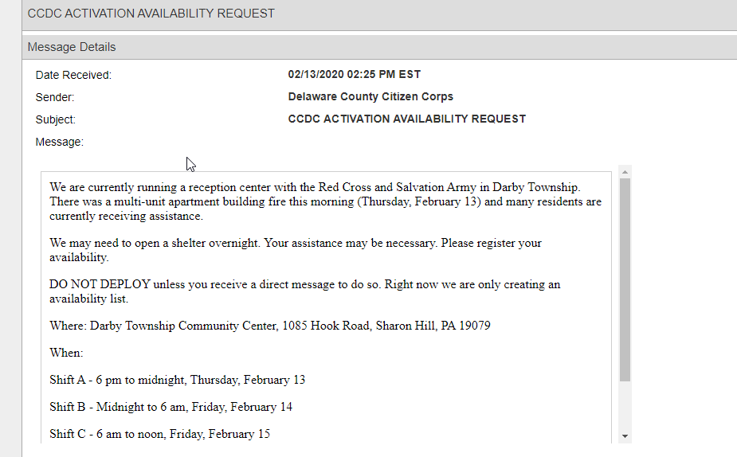
Receive an alert message from SERVEPA
Standby notification
Respond immediately to alert message “yes” or “no”
Availability by shift

Slide 14
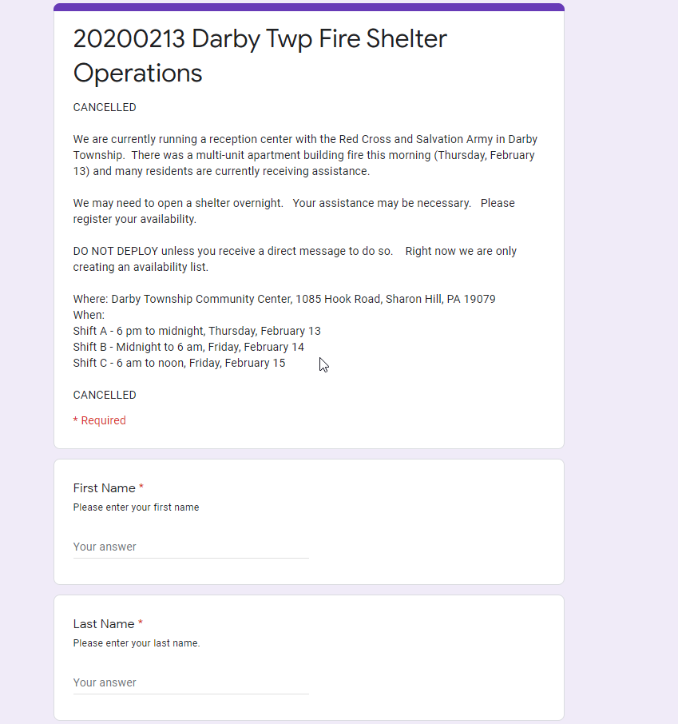
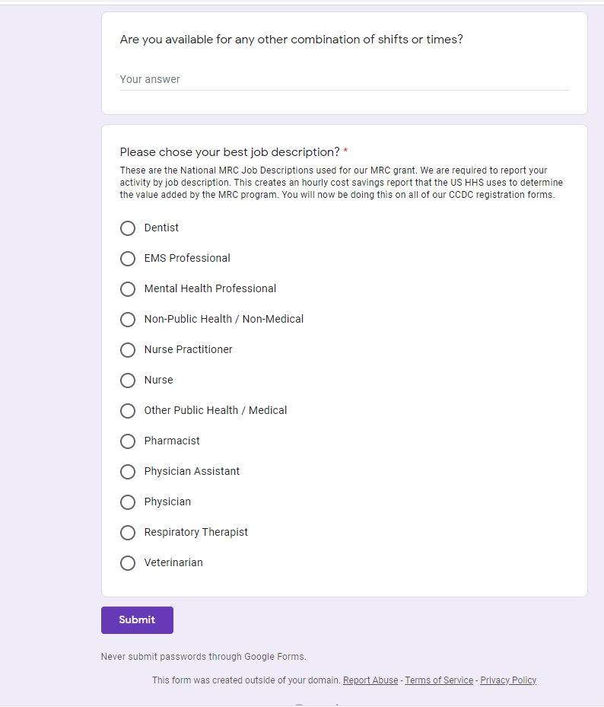
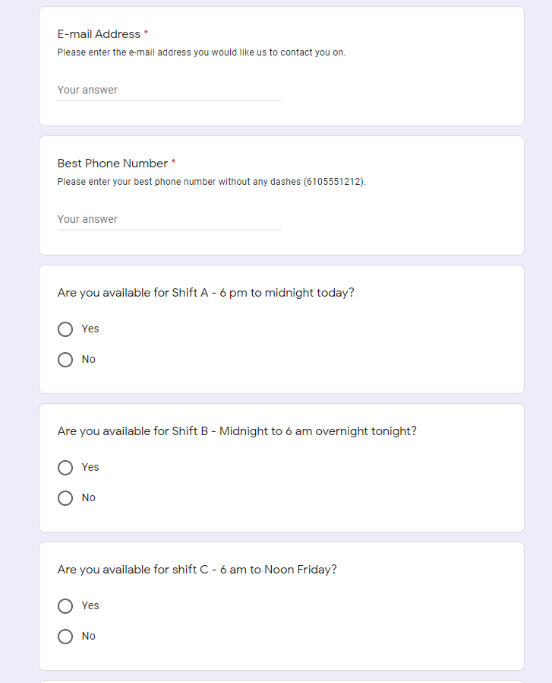

Slide 15
DO NOT SELF DEPLOY
Seeing images of disaster may compel you to head to the impacted area.
Spontaneous volunteers often arrive without appropriate shelter, food and water supplies, equipment or protective clothing. This puts a drain on resources that are needed for disaster victims.
You WILL be turned away by law enforcement
Volunteers may put themselves at risk of injury and even death in trying to rescue others
Volunteers coming from outside the disaster-affected region may not be culturally sensitive to the needs, practices and preferences of the communities they assist.
Be patient. Recovery lasts a lot longer than the media attention. There will be volunteer needs for many months, often years, after the disaster – especially when the community enters the long-term recovery period.

Slide 16

Family Prepared
Disaster Preparedness Plan
Situate your family- Who is watching the kids, husband, in laws, pets?
Call work and confirm with them you can take the time off
Enough Food to keep the folks at home happy
“Bread, milk and eggs” (Yes French Toast time)
Car ready – inspected & gas tank full

Slide 17
Pre- deployment – alert-standby
What Type of Situation + Length of Deployment = What type of GO BAG
Shelters
Medical Counter Measures
Reunification Centers
Vaccination Clinics
Damage Assessment
Traffic Control

Slide 18
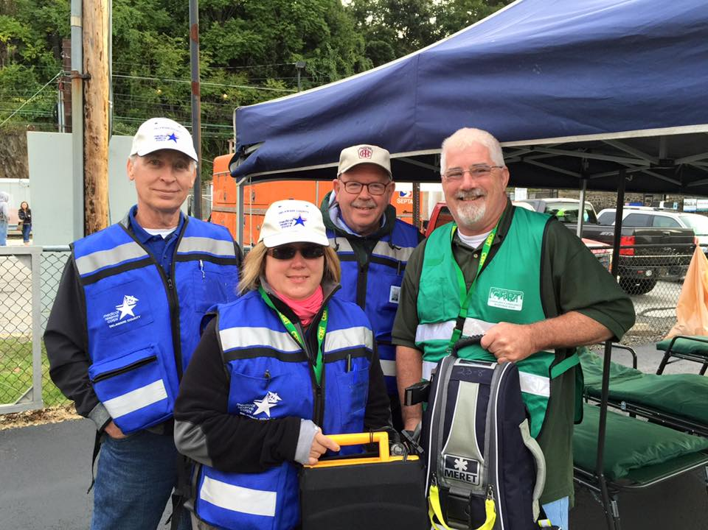
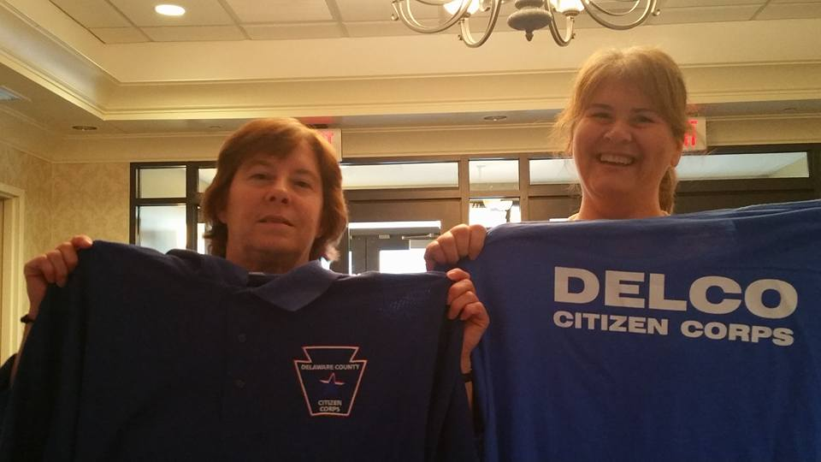
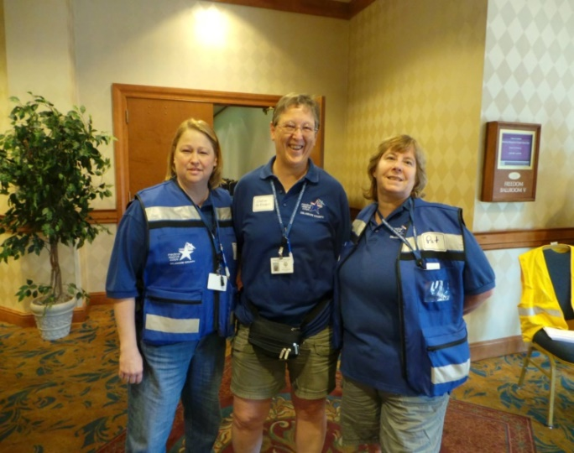
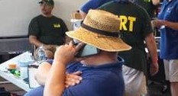
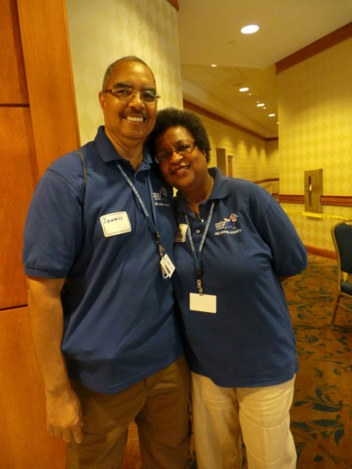
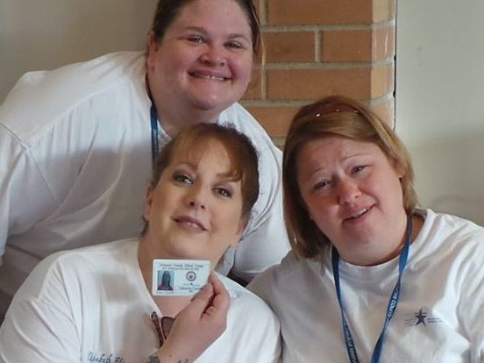
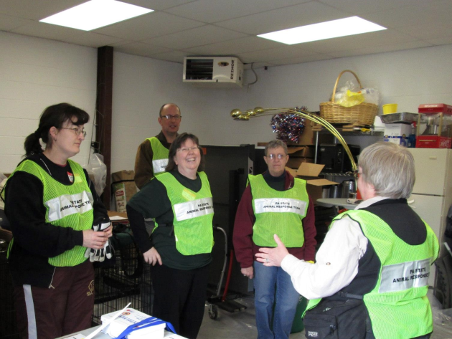
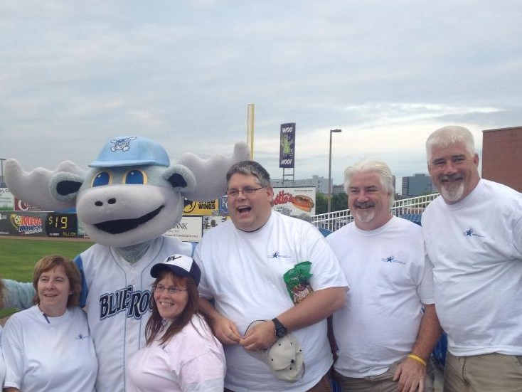
What you need to survive a Deployment:
Never leave home without your Delco Citizens Corps Uniform
VEST * SHIRT * NAME TAG * ED’S PHONE NUMBER

Slide 19
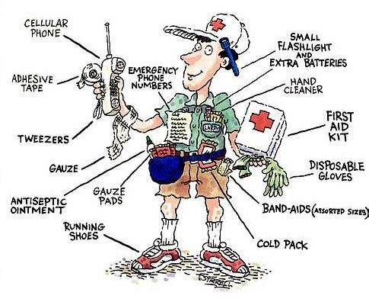
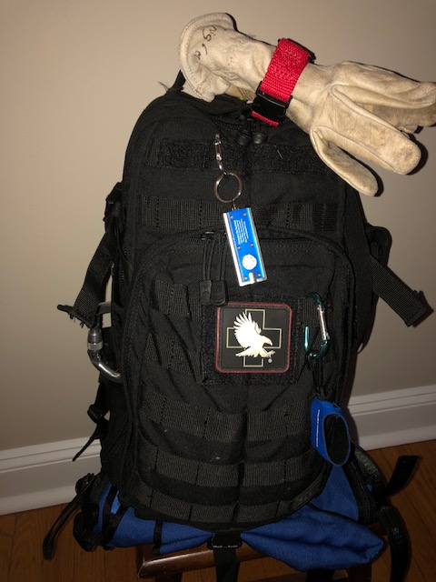
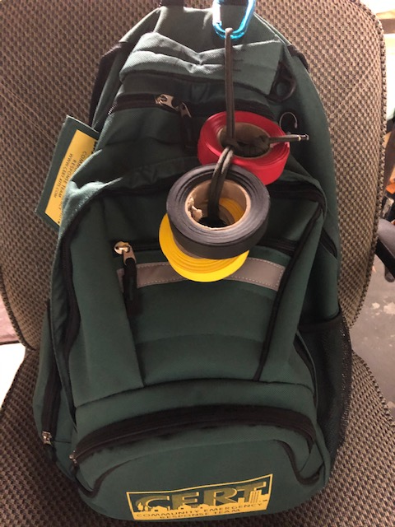
What type of situation + length of deployment = what type of GO BAG
This Packing List is a general example of things volunteers may need on deployment. Items may be added or deleted based on the specific requirements of the mission, and adapted to special environmental considerations, weather at the disaster area and personal needs.
Remember: Pack smart, as you will need to carry your own gear!

Slide 20
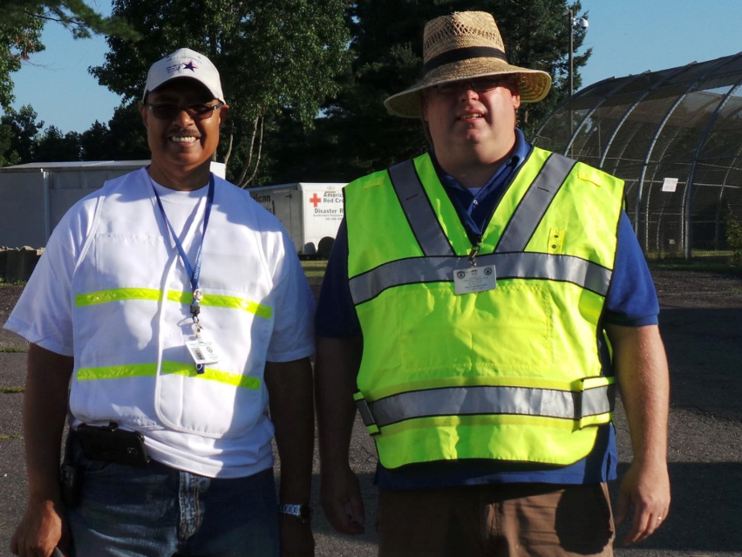
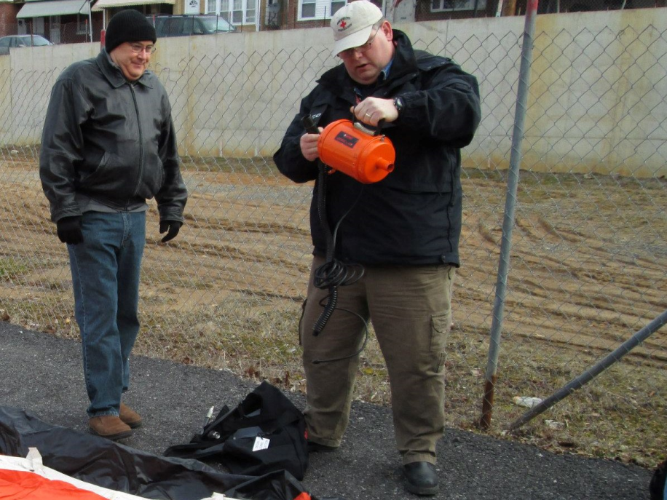
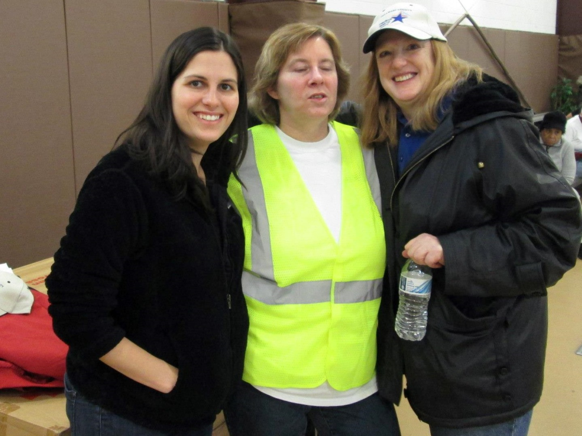
What you need to survive a Deployment
Clothing
Few Masks
Dress in Layers
Light rain jacket/gear
Functional shoes: comfortable, protective, closed toe
Hat w/ a brim (consider a stocking cap for cold weather

Slide 21
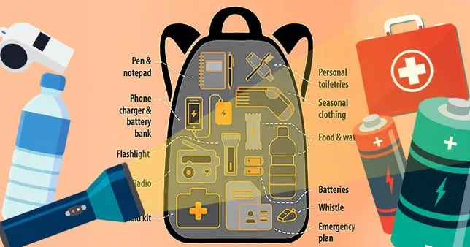
What you need to survive a Deployment
Eyeglasses
Cash for food and incidentals and one ATM/credit card
Small flashlight or headlight with extra batteries if needed
Work gloves
Cell phone and charger
Personal medication
Multipurpose tool
Insect repellent
Sunglasses in cases
Photo ID (Gov’t-issued such as a driver license.)
Clinical License/Certificate
Umbrella

Slide 22
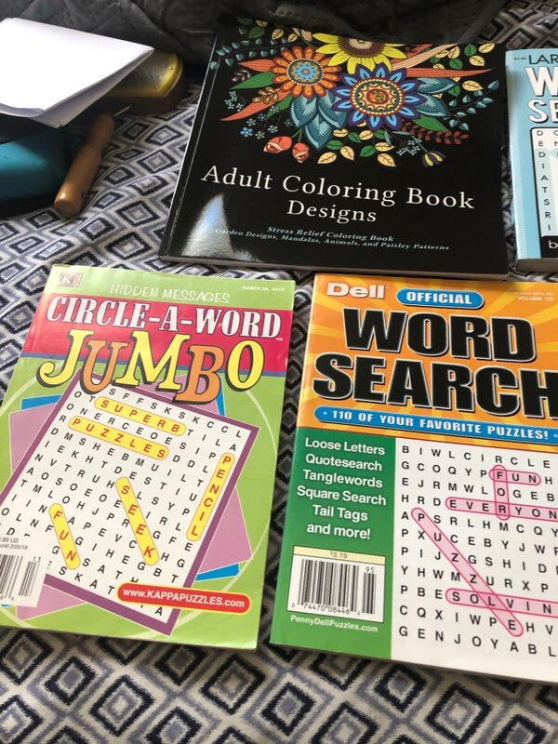
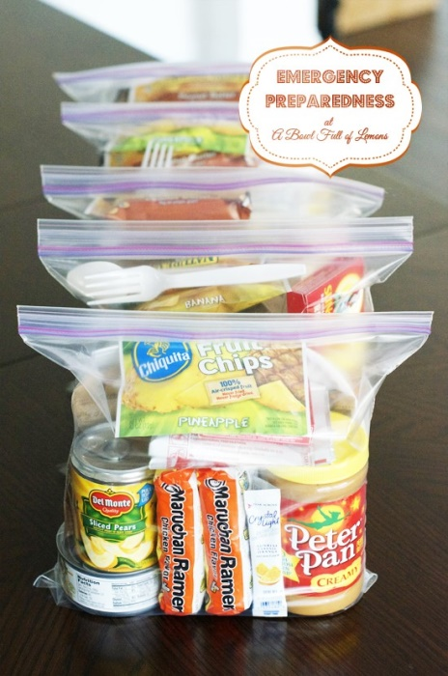



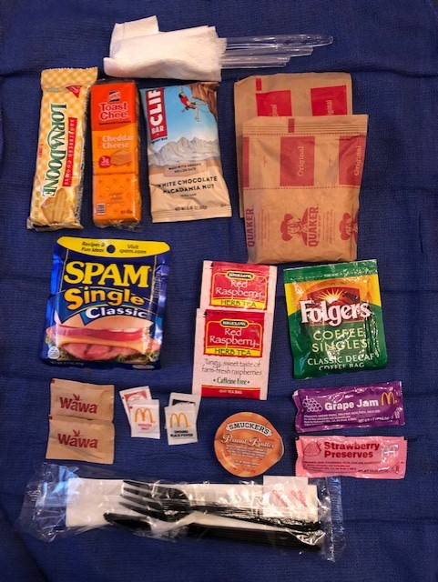
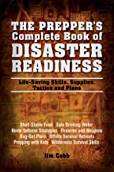
What You Need To Survive A Deployment
Snacks (such as power bars, granola bars, trail mix,
Water bottle
Hot Spot
Kindle, Books, Puzzles, Coloring
Reading material/playing cards
Pens/paper
Personal journal

Slide 23
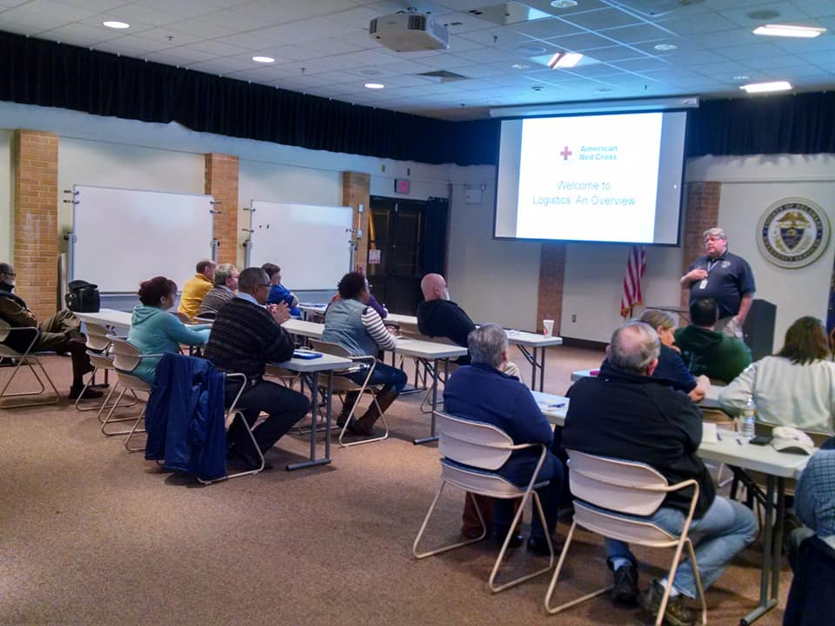
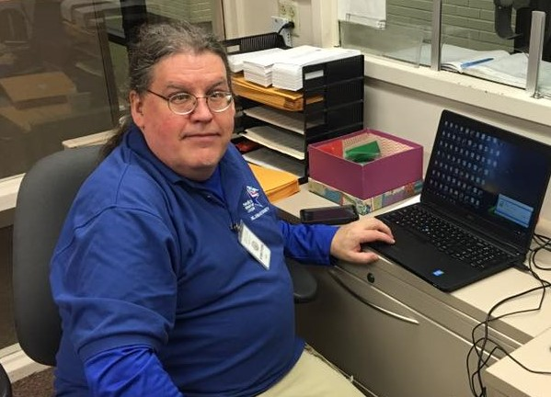
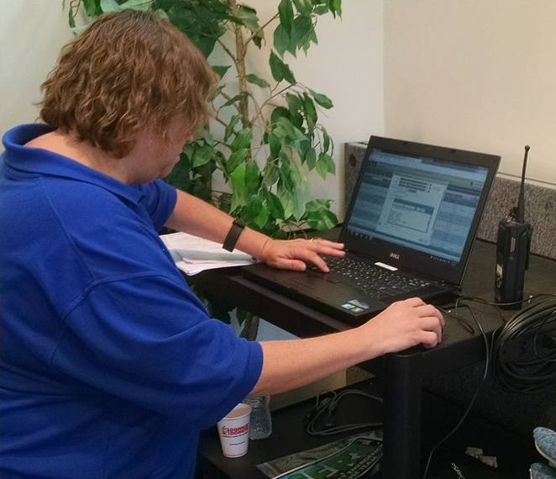
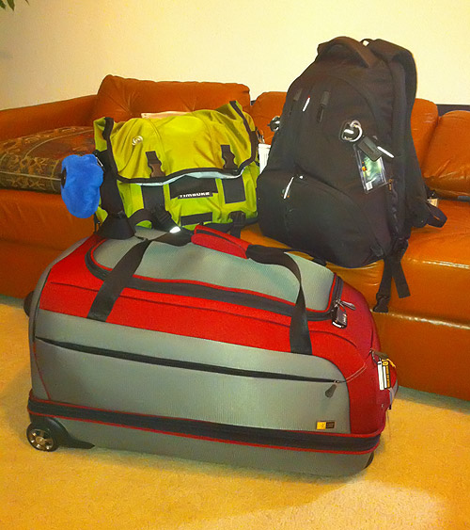
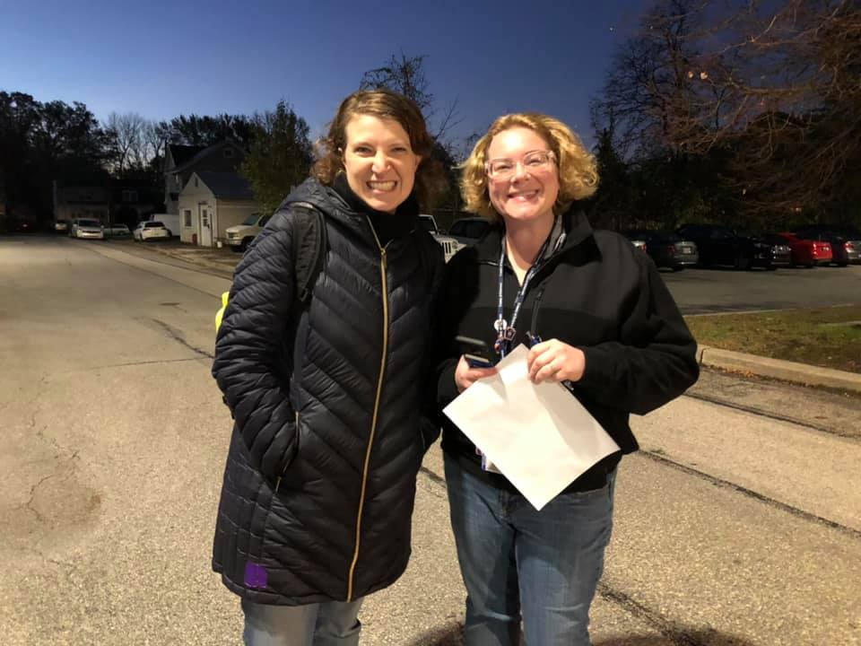
You have been trained!
You answered the activation notice!
ServPA has been updated!
Bags are packed!
You are Activated
Welcome to the Show!

Slide 24
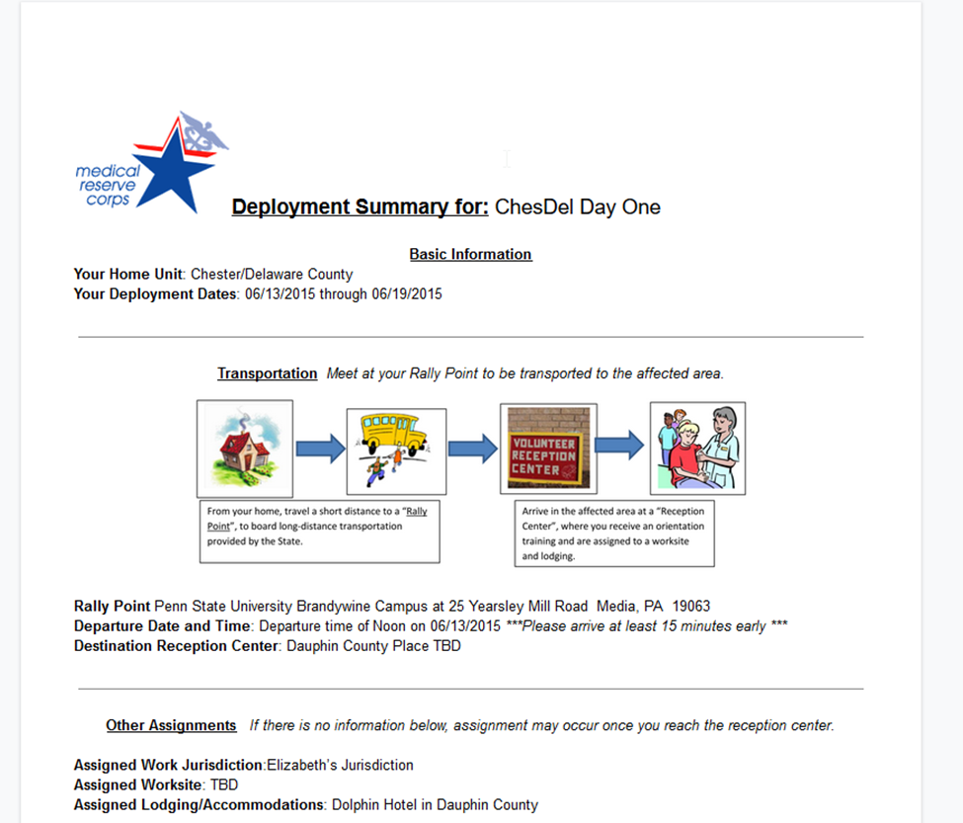
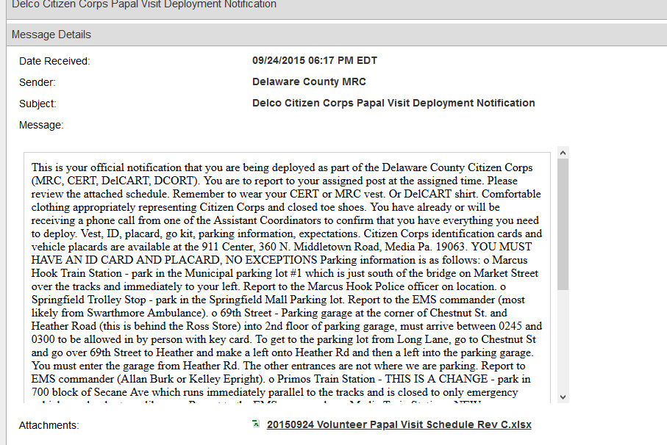
You will be provided details of the situation.

Slide 25
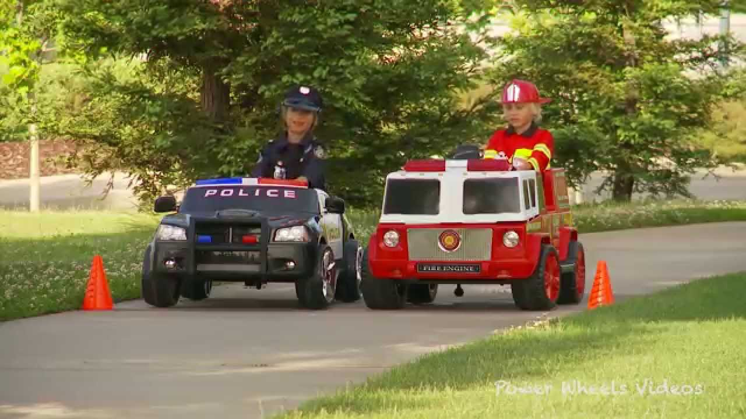





Deployment
Travel safely! You are not an emergency vehicle! Check PA511!
Transportation may be provided
Delco CC Going on a Mission
Parking Plaque
https://www.511pa.com/

Slide 26





vrc= Parking lot of a shelter
Volunteer Reception Centers
You may be the hands that set it up!
VRC = Lobby - Fancy Hotel
VRC = School cafeteria

Slide 27




I finally made it to my mission site….
Release of Liability Statement
CHECKED IN
Disaster Volunteer Registration Form

Slide 28



Deployment
I finally made it to my mission site….
Participate in Just In Time Training
Participate in Safety Briefings
Meet the Other Responders
Buddy system - take care of your fellow Citizen Corp members

Slide 29






Deployment
No more standing around…There is work to be done…..

Slide 30







Slide 31



Take proper breaks

Slide 32




Slide 33



We are in this together
No one VOLUNTEERS alone

