Slide 1


Emergency Preparedness 2020
Danielle R. Koerner, BS,PA-P
Community Outreach
AFN Coordinator
Delaware County Emergency Services Special Operations

Slide 2

Community Preparedness
We cannot do this alone.

Slide 3

About the Presenter
Danielle R. Koerner
Life-long Delaware County Resident & Mother of 2
20 years in the Emergency Services as an EMT, Paramedic, Coordinator
Patient care, Regulatory Compliance, Education, Whole Community Planning

Slide 4

Objectives
Have a Plan
Have a Kit
Be Informed

Slide 5
Emergency Preparedness
Have a Plan. Have a Kit. Be Informed.
 | Home | Work | Out & About | Vehicle
Evacuation
Shelter in Place
Communications
Have a Kit (72hrs.) | 72hrs. | 72hrs. | 24hrs. | 72hrs.

Slide 6

SAFETY IN THIS ORDER:
…at all times…
YOU.
YOUR FAMILY.
OTHERS.

Slide 7
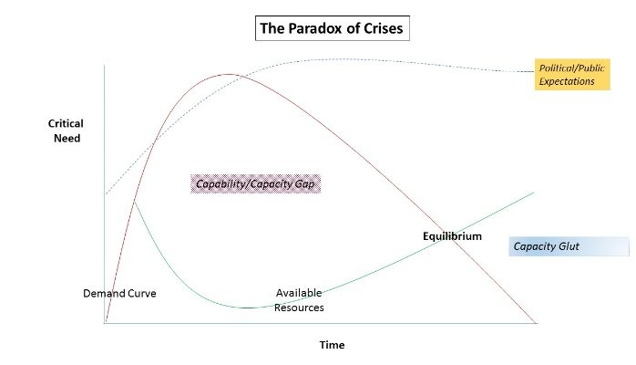
Response Ability Vs. Demand

Slide 8
Creating a Plan
Have it. Know it. Talk about it. Use it.
Risk/ Benefit Analysis
Ongoing, Active, Potential, or Probable?
Weigh the frequency & potential of an emergency against the cost of preparation.
Determine:
Priorities
Plans
Budget Expenditures

Slide 9
Ongoing, Active, Potential, or Probable Emergencies?
Knowing what type of emergencies you should prepare for is the first step!
Ongoing or Active??
Potential or Probable?
Ongoing Emergencies are long-term responses that occur over weeks, months, or years and require sustained responses, but that may always not be urgent. The COVID-19 Pandemic is an Ongoing Emergency.
Active Emergencies are situations that require an Urgent response, such as a fire, Hazard Material Release, or acute medical issue such as a heart attack.
A Potential Emergency is one that COULD happen but is unlikely to in your area. For instance, Delaware County COULD be impacted by a Volcanic eruption, but it is unlikely.
A Probable Emergency is one that is almost guaranteed to happen in your area. For instance, in Delaware County, we are likely to experience building fires, vehicle accidents, blizzards, and medical emergencies.

Slide 10
Creating a Plan
Potential
Probable
Flood
Fire
Chemical Emergency
Earthquake
Terrorism & Active Shooter
Pandemic
Weather Emergencies
Power Failure
Medical Emergencies
Vehicle Accidents
Damage to Property
Ongoing
COVID-19 Pandemic

Slide 11
Ongoing, COVID-19
COVID-19 is an ongoing Emergency and protecting yourself remains a top priority!
Social Distancing
Hand Hygiene
Cloth Mask Coverings for the general public
‘Supply Chain’ refers to the ability to deliver goods and services to the community. The Supply Chain was disrupted during the early part of the COVID-19 Response, causing items that are regularly available to the public to temporarily not be available.
It’s important to remember that this could happen again and keep some additional food and supplies in your home to be able to take care of yourself during the delays.

Slide 12
COVID-19
With the ongoing Pandemic Response it is important to factor in the following with all emergency plans:
  Social Distancing wherever possible
  Packing 3 clean cloth masks in your Go Kit
  Packing Hand Sanitizer in your Go Kit
  Factoring in possible Supply Chain Delays when stocking up for emergencies (Buy a little extra each time when it comes to shelf-stable foods, cleaners, and needed medications!)

Slide 13
Creating a Plan
Know what you DON’T KNOW.
Know your capabilities.
Know your limitations.
If the situation is beyond your control, get help.
Experts are ALWAYS closer than you think.

Slide 14
Evacuation Planning
Be ready to go
Know your destination ahead of time
Have a kit ready to go
Secure your residence
Close and lock exterior doors & windows
Shut off utilities ( Water/ Gas/ Electric)
Leave contact information in your mailbox.

Slide 15
Sheltering in Place
Be ready to stay due to bad weather, or hazards in the air.
Get household members & pets inside
Close & lock exterior doors & windows
Turn off air conditioners & ventilation systems
Get your kit
Go to your pre-selected safe room
Seal yourself in
https://www.youtube.com/watch?v=pWqCGYx9SGs

Slide 16
Sheltering in Place
Community Quarantine & Personal Quarantine
Community Quarantine is when a ‘Stay at Home’ Order is issued, and all non-essential workers are asked to remine home whenever possible. Personal Quarantine is when you are asked to stay home due to illness or exposure.
Be prepared to be told to stay home for 14 days with minimal assistance from others by keeping your food and medications stocked.
Have a plan for protecting yourself and your family if you will need to quarantine at home due to illness.

Slide 17
COVID-19 Quarantine Kit Planning
Be ready to support yourself & your family during Personal or Community Quarantine
Community Quarantine (Keep stocks of…)
Personal Quarantine (Keep stocks of…)
10-14 days worth of shelf stable food (Consider food for you, your family and pets)
Prescribed and Over The Counter (OTC) medications.
Household items such as paper products and cleaners.
Health & Hygiene Items for you, your family, and pets.
10-14 days worth of shelf stable food (Consider food for you, your family and pets)
Prescribed and Over The Counter (OTC) medications.
Household items such as paper products and cleaners.
Health & Hygiene Items for you, your family, and pets.

Slide 18
Communication Planning
Stay in touch
Create an accountability plan designating a local & “out of area” contact to check-in during an emergency.
Short range communications
- Community band radios
Citizen Band (CB)
Person to person (runners)
* Social Media ‘Check ins’

Slide 19
Communication Planning
A Note about Cell Phones
GPS is only as good as the user who turns or keeps it on.
Texts line up… calls do not.
Cell towers can get overloaded during active emergencies.
When calling 911, be clear about- Who. What. Where.

Slide 20
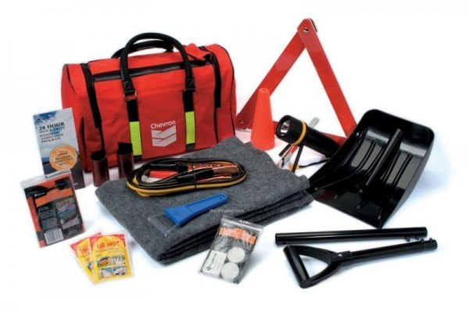
Building a Kit.
72hrs.
24hrs.
This Photo by Unknown Author is licensed under CC BY-NC

Slide 21
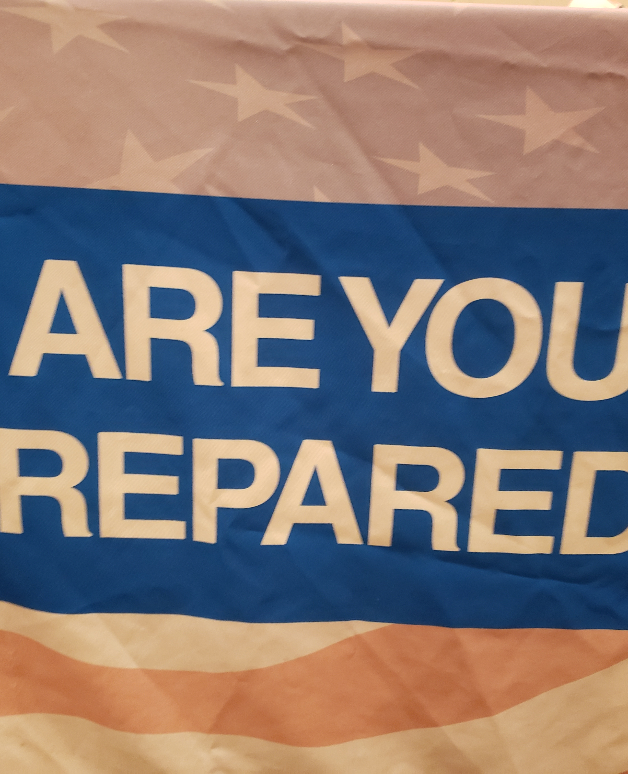
24hr. Kit
What do you need for 1 day & 1 night?
Water (2 quarts)
Food bar (4,800 calories total)
Emergency Medical Kit
Clothing & Emergency Blanket
Battery Powered Flashlight (batteries)
Work Gloves (one pair)
Light Sticks (3x12 hours)
Moist Towelettes (6)
A Breathing Mask (N95)
Plastic Sheeting (10' x 10')

Slide 22
72hrs. Kit (Includes Shelter-in-place)
Battery Powered Flashlight (batteries)
Battery Powered Radio (batteries)
Emergency Blanket
Food (3 meals per person, per day (4,800 Calories/person/day)
Water (2 gallons, per person, per day)
Work Gloves (one pair)
Light Sticks (3x12 hours)
Moist Towelettes (6)
A Breathing Mask (N95)
Plastic Sheeting (10' x 10')

Slide 23
72hrs. Kit
Rain Poncho
Personal First Aid Kit
Roll of Duct Tape
Whistle
First Aid/Preparedness Instruction Booklet
Matches & Multi-tool
Personal items…

Slide 24
72hrs. Kit
Prescription medications & feeding items
Non-prescription medications
Clothing
Cash or travelers checks (change & small bills!)
Important family documents
Spare eye glasses/ prosthetics/ orthotics
Individual items for children (diapers, baby food, formula)

Slide 25
72hrs. Kit
Ready to eat tuna/ chicken salad, Oatmeal, granola bars, peanuts, non-perishable juices, broth
Water ( 4 gallons per person per day)
Comfort items: Lollipops, hard candy, fruit snacks, hot chocolate
Plastic cups/ spoons/ forks.
Emergency Medical Kit

Slide 26
Be informed.
Getting the best, most correct information available is very important!
Turn to trusted sources of information.
Be wary of uncited information, especially on social medica.
Register to receive emergency communications.
Maintain situational awareness.

Slide 27

To Register for Delco Alert visit: https://www.delcopa.gov/delcoalert/delcoalert.html

Slide 28




Preparedness &
Training
Delaware County Opportunities
Citizen Corps of Delaware County
- MRC, DelCART, CERT
Red Cross
Salvation Army

Slide 29
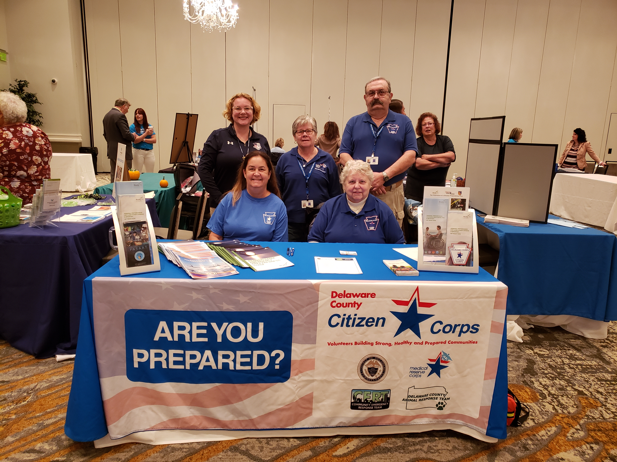
Volunteers Are the Answer.

Slide 30
Thank You.
Danielle R. Koerner
215 275 8581
koernerd@co.delaware.pa.us
www.citizencorps.gov

