Slide 1

Pa. Immunization Education
Vaccine Storage and Handling
Revised 7/2020

Slide 2
Proper Vaccine Storage
Proper vaccine storage and handling is an important factor in preventing and eradicating vaccine-preventable diseases.
Improper storage and handling can result in non-viable vaccines, patient revaccination, damage to public confidence in vaccines and significant financial loss. Patients refusing revaccination may not be protected from disease.

Slide 3
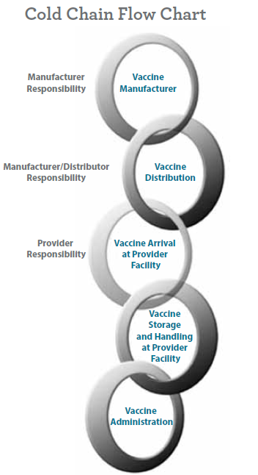
Maintaining the Cold Chain
The vaccine cold chain is a temperature–controlled environment used to maintain and distribute vaccines in optimal condition.
Too much exposure to heat, cold or light at any step in the cold chain n can damage vaccines, resulting r in loss of vaccine potency.
Vaccine appearance is NOT an
indicator that vaccines have been tored
stored in appropriate conditions.

Slide 4
Effective Cold Chain Elements
An effective cold chain relies on three main elements:
A well trained staff implementing vaccine viability preservation knowledge
Reliable cold storage and temperature monitoring equipment
Accurate vaccine inventory management

Slide 5
Staff Training
All staff members who receive deliveries and/or handle or administer vaccines should be familiar with storage and handling policies and procedures of your facility to preserve vaccine viability and required to follow them.
Keep plans and standard operating procedures for vaccine storage and handling near cold storage units and make certain staff knows where to find them.
Make certain plan is kept current. Keep emergency/disaster recovery plan and flashlight with vaccine transport supplies.

Slide 6
When to do Staff Training
As part of new employee orientation.
Annually as a refresher for all staff involved in immunization administration and vaccine storage and handling activities.
Whenever new vaccines are added to inventory.
When vaccine supplies are limited.
When vaccine products are changed or substituted.
Whenever recommendations for vaccine storage and handling are updated.
Whenever new equipment for vaccine cold storage and temperature monitoring is introduced.
When provider policies and procedures are changed.

Slide 7
Staff Training Resources
The Centers for Disease Control and Prevention (CDC) offers on-line training related to the Vaccines for Children (VFC) program including storage and handling requirements.
You Call the Shots is an interactive, web-based, immunization training course. Vaccine preventable disease education is also available. This continuing education (CE) is free of charge.
Visit www.cdc.gov/vaccines/ed/youcalltheshots.htm for more information.

Slide 8
Vaccine coordinator responsibilities
Designate 2 vaccine coordinators (primary, back-up)
Management needs to be aware of requirements for vaccine viability to validate they are implemented.
Vaccine coordinator responsibilities:
  Order vaccines
  Oversee proper receipt and storage of vaccine deliveries
  Document vaccine inventory information
  Organize vaccines within cold storage units
  Set up temperature monitoring devices
  Check and record current, minimum and maximum temperatures twice per day

Slide 9
More Coordinator Responsibilities
Check current storage unit temperatures prior to accessing and administering vaccines.
Download data logger temperatures at least weekly then do a review and analysis for any shifts in temperature trends.
Rotate stock at least weekly so vaccines with earliest expiration dates are used first.
Remove expired vaccine from cold storage units and return for credit per program or manufacturer protocol.
Keep vaccine delivery hours current in SIIS.
Clean and service vaccine storage equipment.

Slide 10
More Coordinator Responsibilities
Respond to temperature excursions.
Maintain all documentation such as inventory, temperature logs, policies and procedures.
Ensure staff is properly trained.
Monitor operation of storage equipment and systems.
Oversee proper vaccine transport when necessary.
Oversee emergency preparations including tracking weather with proper vaccine care during disasters.
Monitor operation of temperature monitoring devices.

Slide 11
CDC Storage Unit Recommendations
Purpose built refrigerators and freezers (designed to store medications and biologics) are CDC highly recommended. Standalone refrigerators and freezers are required. No household combo refrigerators/freezers are permitted for PA VFC providers.
Do NOT store any vaccine in a dormitory-style or bar-style combined refrigerator/freezer unit under any circumstance as all vaccine must be wasted and vaccine ordering privileges will be suspended. These units pose a significant risk to freeze vaccine.

Slide 12
More Storage Recommendations
Make certain the storage unit is large enough to store your largest inventory without crowding.
Storage units must be firm and level with good air circulation around the outside of the unit.
Studies indicate most units work best when placed in an area with standard indoor room temperatures (20 to 25°C or 68 to 77°F).
Check manufacturer supplied owner’s manual for additional placement and spacing instructions.

Slide 13
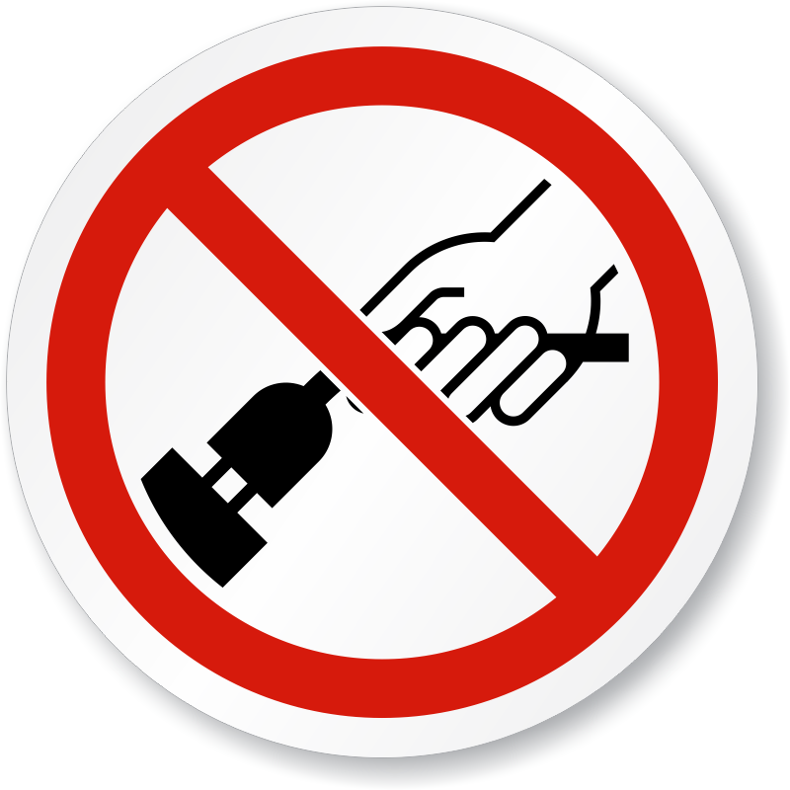
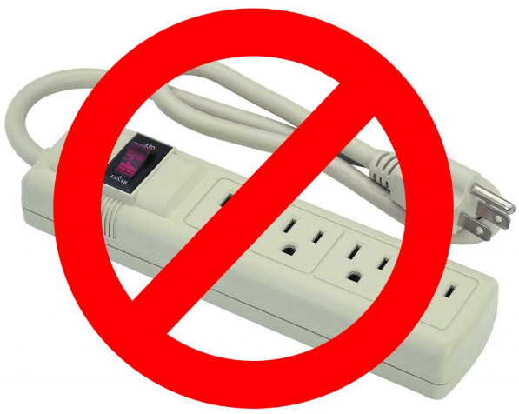
Cold Storage Unit Setup
Plug in only one storage unit per electrical outlet to avoid creating a fire hazard or triggering a safety switch that would turn off the power.
Use a safety-lock plug or outlet cover to prevent the unit from being unplugged.
Post “DO NOT UNPLUG” warning signs.
Label fuses and circuit breaker to alert people not to turn off power to storage units.
Extension cords/power strips are not permitted.

Slide 14
Cold Storage Unit Temperatures
Refrigerators should maintain temperatures between
2 to 8°C (36 to 46°F).
Set the thermostat at mid range to decrease the chance of temperature excursions affecting vaccine viability.
Freezers should maintain temperatures between -50 to -15°C
(-58 to +5°F).
It may take 2-7 days to stabilize the temperature in a newly installed or repaired refrigerator or 2-3 days for a newly installed or repaired freezer.

Slide 15
Organizing Cold Storage Units
Always consult vaccine manufacturers’ product information/package inserts for the most up-to-date storage and handling recommendations.
Always store vaccines in their original packaging with lids closed until ready for administration.
Never store loose vials or manufacturer-filled syringes outside of their packaging.
Never store diluent in the freezer. Whenever possible, store diluent with the corresponding refrigerated vaccine.

Slide 16
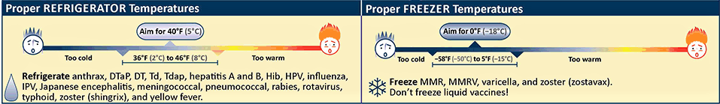
Organizing Cold Storage Units
Label VFC, 317, and private vaccine.
Review vaccine expiration dates and rotate vaccine stock weekly.

Slide 17
More Storage Unit Organization
Measles, mumps and rubella (MMR) vaccine may be stored in either refrigerator or freezer.
If medications and biological products must be stored in the same unit as vaccines, diluents and water bottles, they should be on a different shelf below the vaccines. This prevents contamination and reduces the likelihood of medication errors.

Slide 18
Water Bottles in Cold Storage Units
Unless the cold storage unit manufacturer recommends otherwise (check unit specifications), place water bottles (labelled with DO NOT DRINK on each bottle) on the top shelf, floor & in the door racks of the unit.
Water bottles help stabilize temperatures destabilized by frequent opening and closing of the unit door or during a power failure.

Slide 19
Best Practices in Vaccine Storage
Place vaccines in center refrigerator space, contained in original packaging, inside designated storage trays positioned 2 to 3 inches from refrigerator walls. To reduce errors, do NOT place similar looking vaccines next to each other in the storage unit.
Avoid storage on top shelf near the cooling vent. This location is likely to exceed the maximum allowed temperature during power outages.

Slide 20
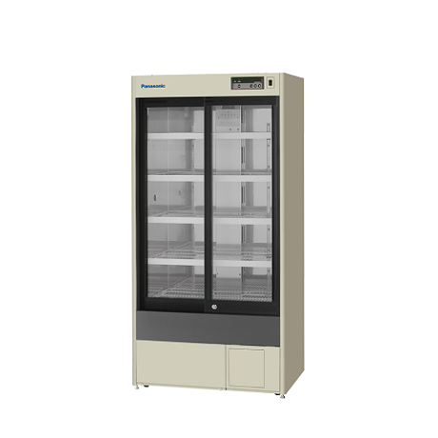
Storage Unit Set Up

Slide 21
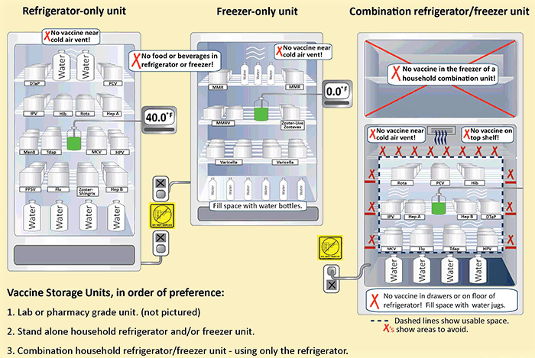
Storage Unit Set Up: Graphic

Slide 22
Provider Responsibilities Reviewed
Provider Responsibility
Receive all vaccine shipments to your location. Do not refuse a shipment. Receive shipment into SIIS inventory.
Inspect temperature tab in shipping carton on arrival.
Store vaccine in proper unit upon receipt.
Monitor and document temperatures.

Slide 23
Provider Responsibilities Reviewed
  Use purpose built or standalone storage units to house vaccine.
  Take immediate action when a storage unit temperature
  is out of temperature range.
  Submit an incident report if a cold chain failure lasts more
  than 30 minutes.
  (See VFC Provider Handbook, Section 6F)

Slide 24
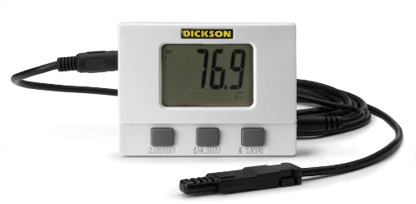
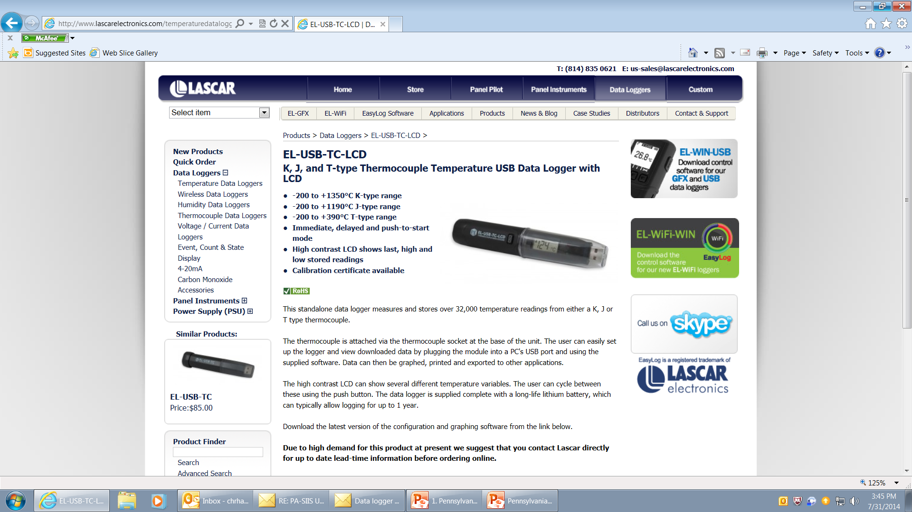
Temperature Monitoring
The CDC requires all federally funded vaccine providers to use digital data loggers (DDLs)/continuous temperature monitoring devices with an active current, minimum and maximum temperature display with at least a weekly download to a computer using special software or retrieval from a website.
The download must then be reviewed to monitor the vaccine temperatures.

Slide 25
Temperature Monitoring
DDLs must have: detachable probe of buffered material reflecting vaccine temperatures, alarms for out of range temperatures, low battery indicator and recommended uncertainty of +/- 0.5 degrees C (+/- 1 degree F), logging interval that can be programmed to measure and record temperatures every 30 minutes or more frequently.
All DDLs (including back ups) must have current and valid certificates of calibration testing that adhere to National Institute of Standards and Technology (NIST) standards.

Slide 26
Temperature Monitoring
VFC providers are required to have at least one backup DDL, at the provider site, with a valid and current certificate of calibration readily available, to ensure twice–a–day, current, minimum and maximum temperature assessment and recordings.
All DDLs should not have the same expiration date.

Slide 27
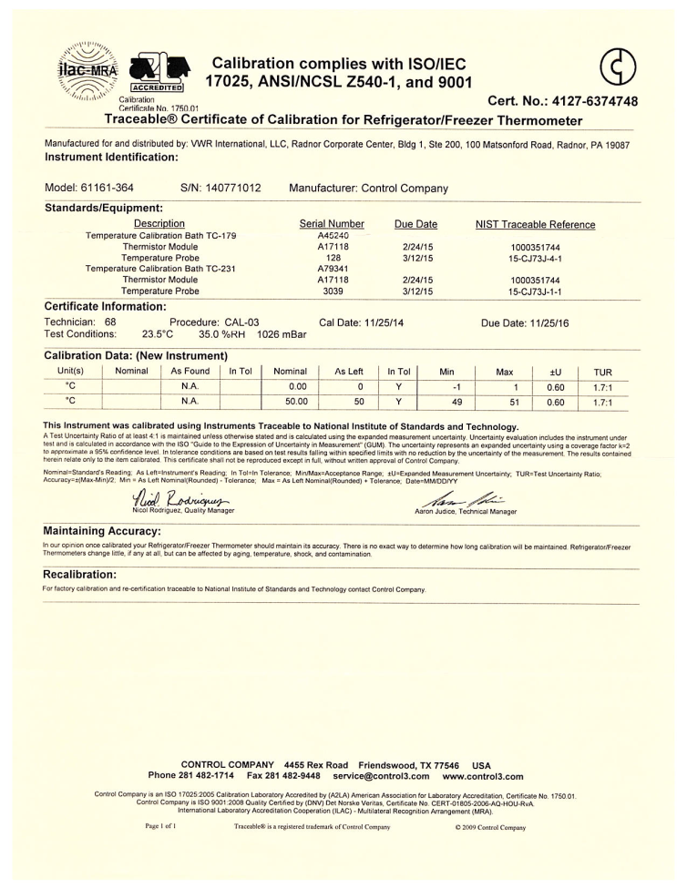
Calibration Certificate Requirements
Calibration certificates must have:
Model/device name or number
Serial number
Date of calibration (report or issue date)
Confirmation that the instrument passed testing (or instrument in tolerance)
Recommended uncertainty of +/- .5°C (+/-1°F) or less
Issued by
Certificate must have one or more of:
  International Organization for Standardization
  (ISO) 17025
  International Laboratory Accreditation Cooperation(ILAC)
  National Institute of Standards and Technology (NIST)
  American Society for Testing and Materials (ASTM) Standard E2877 Tolerance Class

Slide 28
Digital Data Logger Pre-Purchase Planning
Utilize PA VFC Pre-Purchase Worksheet
  Available on PA VFC website in the Provider Hand Book
Determine if DDL units meet PA VFC requirements
  Display available with current, min, max temps
  Alarm (visual/audible)
  Calibration certificate by an accredited laboratory
  Other requirements noted in DDL Policy
Note additional considerations
  Battery, software needed, ability to monitor >1 unit, etc.
Involve other departments
  Information Technology, Trainers, etc.

Slide 29
Digital Data Logger Considerations
Determine desired cost and features of the unit
  Basic, Multiple Sensor, Continuous Temperature Monitoring System
Consider provider benefits
  Easy setup, usable on multiple units, good for larger organizations
Learn key features of unit and your office needs
  Alarm preference, #storage units monitored, Wi-Fi, storage of data,
  Determine location for data storage (cloud, designated public files, data stick, discs)

Slide 30
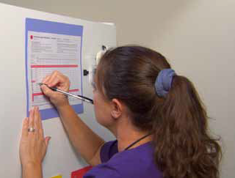
Continuous Temperature Monitoring
Read and document current, minimum and maximum temperatures twice each workday.
Make sure that no more than 72 hours passes between each temperature monitoring and documentation.
Out-of-range temperatures of more than 30 minutes require documentation of corrective action on the temperature log and an incident report.
Download and review data logger data weekly. Note temperature change trends
and make adjustments accordingly.

Slide 31
Monitor Temperatures, Respond to Excursions
Vaccines outside appropriate temperature range for more than 30 minutes should be marked “Do Not Use,” and manufacturers must be contacted to determine vaccine viability.
VFC Provider must complete an incident report. Reference: VFC Provider Handbook section 6F. The incident report, temperature logs, thermometer calibration certificates and vaccine accountability forms must be faxed for review to 717–214–7223 within five days.
Include your Provider Identification Number (PIN) on ALL documents and communications to the VFC program.

Slide 32
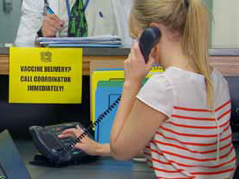
Vaccine Management Plan
PA VFC Management Plan, Disaster and Emergency templates can be found in Section 6 of the VFC Provider Handbook.
Provider quarterly review of these plans verifying alternate vaccine storage location and procedures are current and accurate is required.
Staff signatures and dates verifying the review are required.
It is important the plans are reviewed with all staff who handle VFC vaccine. Planning and education can save money, vaccine and prevent revaccination.
Changes in provider hours of operation
need to be communicated to the VFC
program for timely vaccine delivery.

Slide 33
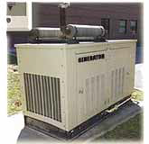
Disaster/Emergency Planning
Emergency Planning/ Disaster Recovery templates can be found in Section 6–E of the VFC Provider Handbook.
  Do you have a generator?
  Do you test the generator every quarter?
  Do you have a back–up vaccine storage site with procedures for vaccine transport?
  Do you check back–up storage site arrangements quarterly?

Slide 34
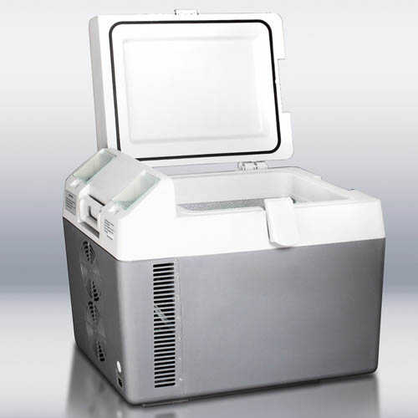
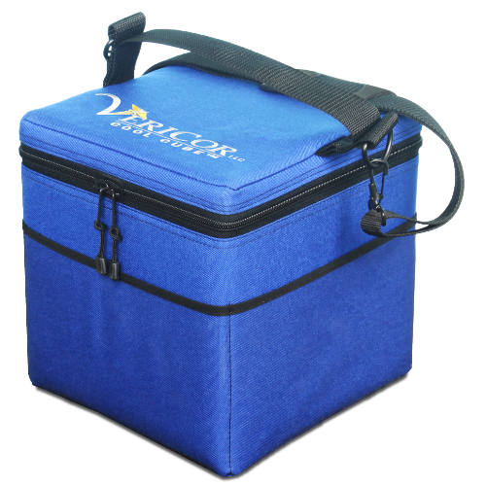
Transporting Vaccine
CDC recommendations:
Transport refrigerated or frozen vaccine in a portable refrigerator/freezer unit, not soft sided collapsible coolers. A hard sided or 2 inch Styrofoam cooler may be used. Purpose built vaccine transport devices are available and preferred.
When packing refrigerated vaccine for transport, place a barrier between conditioned frozen water bottles and vaccine. When packing frozen vaccine for transport, place an insulating barrier between frozen water bottles and vaccine. Transport diluents with corresponding vaccines.
Use a currently calibrated continuous temperature monitoring and recording capacity device (DDL), with temperature probe placed next to the vaccine.
Complete vaccine inventory transport sheet when moving vaccine.
Monitor and record temperatures at least every 30 minutes when vaccines are in the transport container.
Read and record storage unit temperature at off–site facility a minimum of two times during the workday with currently calibrated DDL.
Never transport vaccine in the trunk of a car.
Section 6–I of the VFC Provider Handbook

Slide 35
Transporting Refrigerated Vaccine
Coolant: The CDC recommends use of conditioned frozen water bottles. Frozen water bottles should be kept in freezer at all times in case of immediate need. Frozen water bottles are conditioned by placing in a sink of lukewarm water until the ice inside the bottle spins freely when rotated in your hand.
Insulating materials: Premeasure 2 pieces of corrugated cardboard and 2
one-inch layers of bubble wrap or packing foam above and below the vaccines in each cooler.

Slide 36
How to Pack Refrigerated Vaccine
1. Conditioned frozen water bottles should be spread over the bottom of the cooler.
2. Completely cover conditioned frozen water bottles with one sheet of corrugated cardboard.
3. Completely cover cardboard with at least one inch of bubble wrap or packing foam when using conditioned frozen water bottles.
4. Vaccine is placed on top of insulating materials with the refrigerated buffered probe of the monitoring device nestled between the layers of vaccine, and the temperature display is placed outside the cooler.
5. Completely cover vaccine with at least one inch of bubble wrap or packing foam.
6. Completely cover bubble wrap with one sheet of corrugated cardboard.
7. An additional layer of conditioned frozen water bottles are added to the cooler.
8. If there is excess space, fill the cooler to the top with packing materials to prevent shift.
9. Close lid and secure the temperature display to the lid of the container.
10. Temperatures between 36.00° F and 46.00° F will be maintained up to eight hours using this method if container is not opened or closed repeatedly.
11. At end of transfer, assure appropriate storage to a refrigerator that has maintained a temperature between 36.00° F and 46.00° F for at least 5 days.

Slide 37
Frozen Vaccine Transport
CDC does not recommend transporting frozen vaccine.
If transport is necessary, use a portable freezer.
Do NOT use dry ice to transport frozen vaccine; use frozen water bottles.
Monitor and document time and temperature of transport unit every 30 minutes.
Do NOT use frozen vaccine after transport until guidance is received from Merck at 1–800–637–2590.

Slide 38
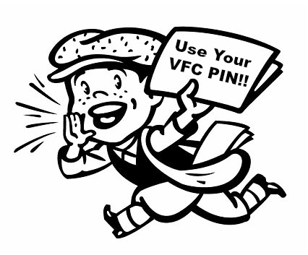
Provider Identification Number (PIN)
Providers are required to include their Provider Identification Number (PIN) on all correspondence and documents sent to the Vaccines for Children program.
The PIN assigned to your site is a unique identifier. Use your PIN for all communications with the VFC program.
Please note this includes voicemails and emails.

Slide 39
Vaccine Adverse Event Reporting System
Report vaccine adverse events following vaccination to the Vaccine Adverse Event Reporting System (1-800-822-7967), http://vaers.hhs.gov/contact.htmli.Secure

Slide 40
References
CDC.gov
CDC 2020 Storage and Handling Tool Kit;
these are the CDC’s scientifically researched best Practices in preserving vaccine viability
PA Department of Health website
Vaccines for Children program

Slide 41
On site presentation resources
2019 Vaccine Coordinator Roles & Responsibilities, on VFC website under VFC Training
2019 temperature excursion instructions, on VFC website
2019 Physician Agreement responsibilities checked
Parents’ Guide to Childhood Immunizations revised 10/2017
VFC website, including VFC Provider Handbook revised for 2019

