Slide 1



Traffic and Crowd Management
Community Emergency
Response Team

Slide 2
Participant Introductions
Introduce yourself to the class by providing your:
  Name
  Reason you want to learn more about traffic and crowd management
Notes:
1

Slide 3
Administrative Announcements
Breaks
Emergency exits
Restrooms, smoking policy, cell phones silent
Module completion
Notes:
2

Slide 4
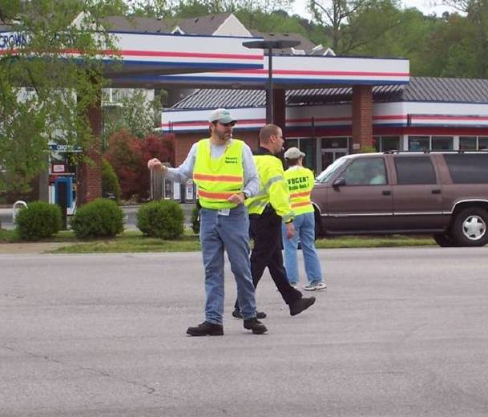
Module Purpose
To provide CERT members with the skills needed to manage traffic and crowds in planned and emergency situations.

Slide 5
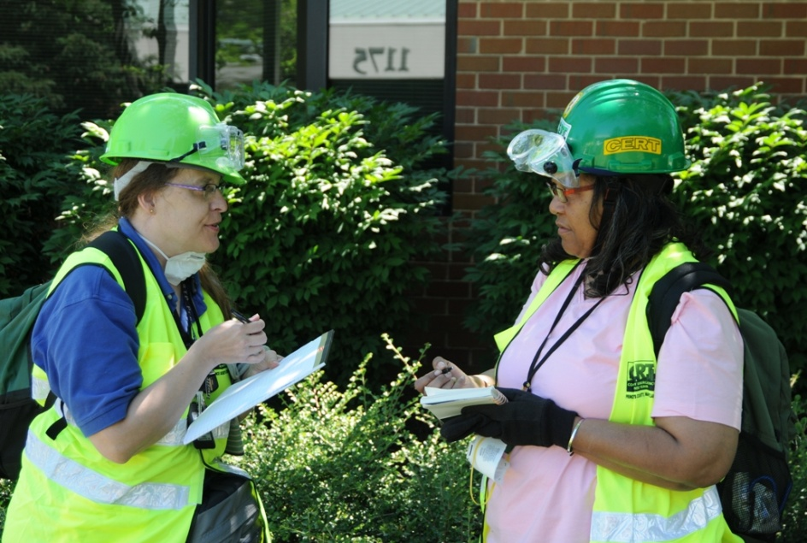
What You Will Learn
CERT Basic Training Concepts That Apply to Traffic and Crowd Management
Communicating Effectively
Crowd Management
Traffic Management
Notes:
4

Slide 6
Module Objectives
Identify possible CERT roles in traffic and crowd management
Explain CERT Basic Training concepts that apply to traffic and crowd management
Demonstrate standard hand signals for directing traffic and crowds
Describe skills for effective verbal communication with the public

Slide 7
Module Objectives (cont’d)
Explain how to use radios and verbal communication skills to communicate with team members and chain of command
Recognize and respond to various types of crowd behavior
Identify safety concerns for managing crowds
Develop basic crowd management plan for an emergency situation

Slide 8
Module Objectives (cont’d)
Demonstrate correct use of traffic control devices
Recognize safety concerns for managing traffic
Read and write basic traffic management plan

Slide 9
What Do You Think?
When would a CERT assist in the direction or management of crowds or traffic?
Notes:
8

Slide 10
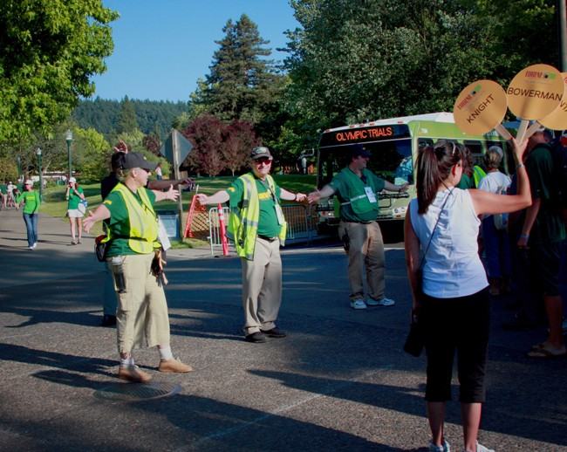
Planned Events
Parade
Festival
County fair
Rush hour traffic
Funeral procession
Training exercise
Traffic checkpoint
Point of distribution (POD)
Other special event
Notes:
9

Slide 11
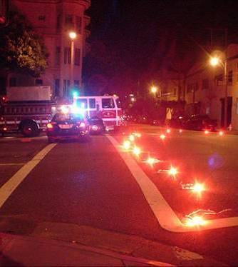
Unplanned Incidents
Traffic accident
Weather hazard
Roadway defect
Traffic signal failure
Natural or manmade disaster
Terrorist incident
Notes:
10

Slide 12
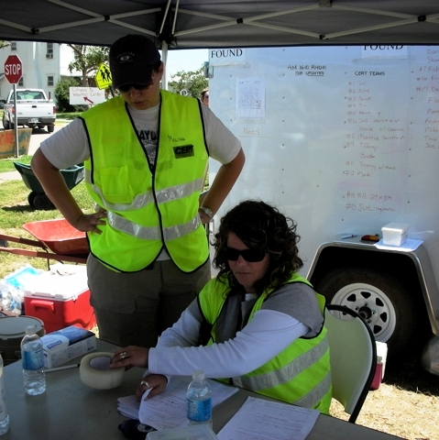
CERT Role in Crowd Management
Direct flow of people
Provide directions and assistance
Communicate with team leaders and chain of command
Maintain orderly scene
Notes:
11

Slide 13
CERTS May Assist with Crowds By …
Calming crowds
Providing security
Distributing medication, food, or other items at POD
Managing shelter crowds
Coordinating people at activities
Setting up, adjusting, and manning barricades
Managing people at site(s) where professionals-CERTs are responding
Managing unhurt survivors while conducting triage at large-scale incidents
Notes:
12

Slide 14
CERT Should NEVER …
Deal with unruly or aggressive crowds
Use force or violence to manage a crowd
Notes:
13

Slide 15
CERT Role in Traffic Management
Direct flow of traffic with hand signals and traffic control devices
Provide directions and assistance
Communicate with team leaders and chain of command
Maintain orderly scene
Notes:
14

Slide 16
CERT Members Only Assist Traffic If …
They activate to assist at planned event and operate under direction of government agency
Their assistance is requested by law enforcement or fire service responders at unplanned incident
They encounter a specific traffic problem during CERT response to a large-scale unplanned incident
Notes:
15

Slide 17
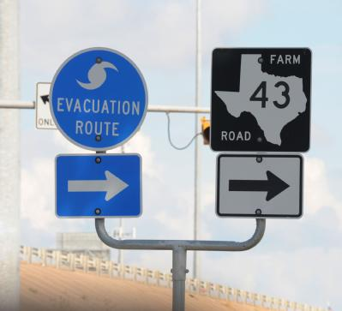
Local Evacuation Plan
Notes:
16

Slide 18
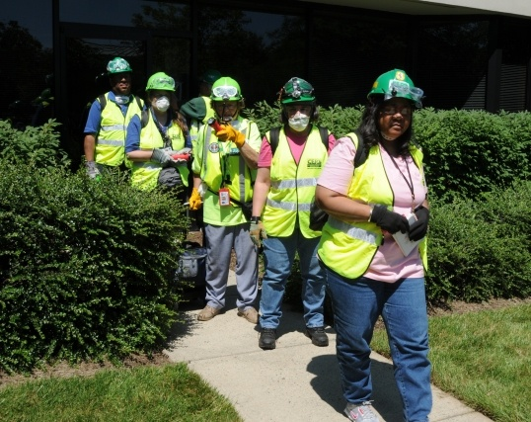
A CERT Member’s Duty
Make sure you do not jeopardize:
  Your own safety
  Safety of others
  Credibility of CERT Program
Notes:
17

Slide 19
Personal Safety
Dealing with traffic and crowds can be challenging and dangerous
Maintain personal safety by:
  Wearing correct attire
  Behaving appropriately
  Recognizing personal limits
  Asking for assistance or relief
  Backing away from dangerous situations
Notes:
18

Slide 20
Management vs. Control
CERT members manage traffic and crowds
CERT members do not control traffic or crowds
Notes:
19

Slide 21
Local Ordinances and State Statutes
Insert local ordinances and state statutes that pertain to traffic and crowd management here.
Notes:
20

Slide 22
Review of CERT Basic Training
Incident Command Structure (ICS)
CERT sizeup
Maintaining scene safety
Team communication
Notes:
21

Slide 23
Onscene Management
Purpose of onscene management is to:
  Maintain safety of responders
  Provide clear leadership and organizational structure
  Improve effectiveness of rescue efforts
Notes:
22

Slide 24
Incident Command System (ICS)
CERTs are part of ICS
Basic ICS structure is established by person who arrives first on scene
CERT members always defer to professional responders
If no professional responders on scene, CERT Incident Commander/Team Leader (IC/TL) is in charge
Notes:
23

Slide 25
What Do You Think?
What are the command positions of the ICS?
Notes:
24

Slide 26
Team Organization
CERT may operate in two ways
  One team performing all tasks
  Smaller teams performing specific tasks
In all situations, each unit must have an identified leader
  To supervise tasks being performed
  To account for team members
  To report information to his or her leader
Notes:
25

Slide 27
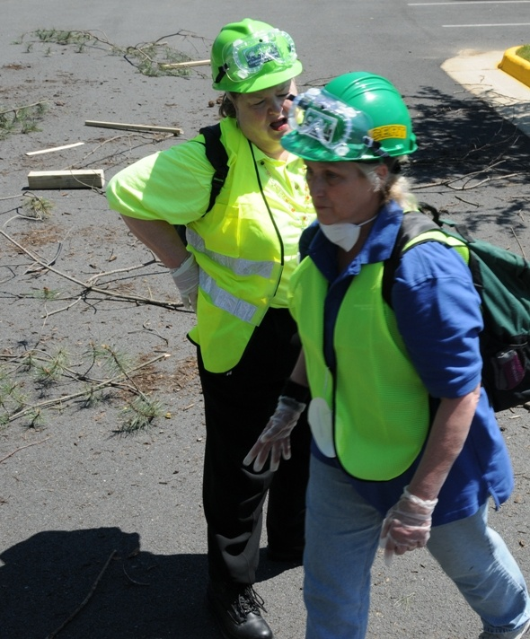
CERT Sizeup
Use sizeup whenever CERT is deployed for crowd or traffic incident without professional responders to direct actions

Slide 28
What Do You Think?
What are the steps of CERT sizeup?
Notes:
27

Slide 29
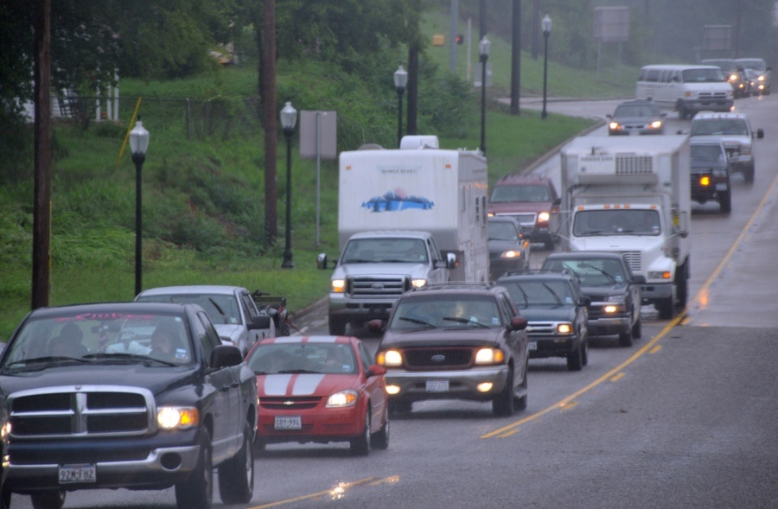
CERT Sizeup Steps
Gather facts
Assess and communicate the situation or damage
Consider probabilities
Notes:
28

Slide 30
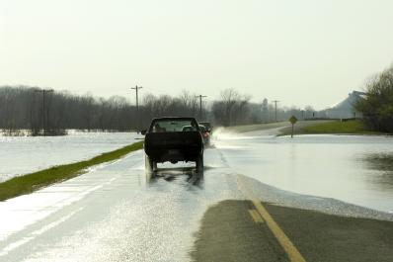
CERT Sizeup Steps (cont’d)
Assess your own situation
Establish priorities. Remember, life safety is the first priority!
Make decisions
Notes:
29

Slide 31
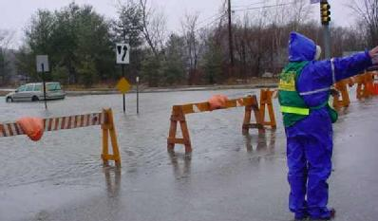
CERT Sizeup Steps (cont’d)
Develop a plan of action
Take action
Evaluate progress
Notes:
30

Slide 32
Maintaining Scene Safety
Work with a buddy
Communicate frequently with team members
Keep IC/TL informed
Wear appropriate attire
Make sure communication devices are working
Notes:
31

Slide 33
Maintaining Scene Safety (cont’d)
Recognize signs of a dangerous situation
Have backup available
Relieve team members regularly
Be respectful
Pay attention to intuition and personal limitations
Notes:
32

Slide 34
Team Communication
Team communication is vital to safety
Radios are generally used for team communication
Team members inform each other of changes in situation
Team leader makes decisions based on team input
Notes:
33

Slide 35
Communicating Effectively
In this topic, you will learn about:
  Standard hand signals for directing cars and pedestrians
  Communication skills for interacting effectively with the public, your team, and the chain of command
Notes:
34

Slide 36
Demonstration
Hand Signals
Notes:
35

Slide 37
Exercise
Practicing Hand Signals
Stop
Proceed
Go slow
Move to the right
Notes:
36

Slide 38
Communication with the Public
Be ready to answer questions from drivers and pedestrians
Agency in charge should explain
  How people or traffic are expected to move
  What pedestrians or drivers may want to know
Clear, respectful communication can prevent negative encounters
Notes:
37

Slide 39
Be Assertive
You are the person in charge
  You must manage the operation to avoid confusion and chaos
Do not be intimidated
  Directing crowds and traffic relies on common sense, good judgment, and good communication
  With practice, traffic and crowd operations will come naturally
Notes:
38

Slide 40
Be Decisive
People need direction
Be clear and precise
Do not be hesitant or indecisive about what you want people to do
Notes:
39

Slide 41
Be Courteous
Remain calm and polite at all times
Provide information quickly and concisely
Keep crowds informed of changes
Remain aware of your surroundings
You represent the agency in charge and the CERT Program
Notes:
40

Slide 42
Exercise
Determining Your Comfort Level
Notes:
41

Slide 43
Radio Communication
Most traffic and crowd events require use of radios
  Team members spread throughout large events can communicate by radio
  Team members on either end of a traffic incident can communicate by radio
Notes:
42

Slide 44
Radio Communication (cont’d)
Radio communication allows team members to:
  Call for help
  Know when traffic or pedestrians may proceed
  Report potential safety concerns
Radio communication also allows IC/TL to keep track of team members and situation
Notes:
43

Slide 45
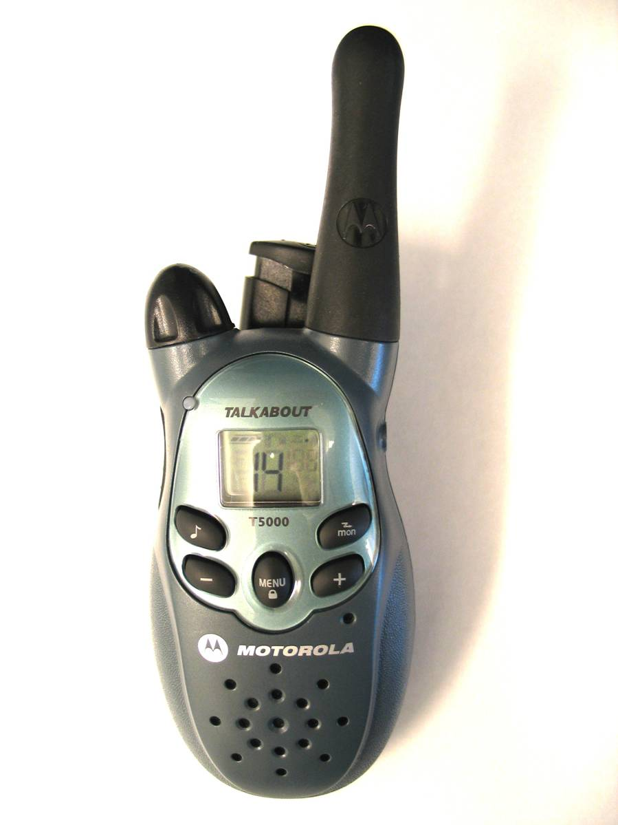
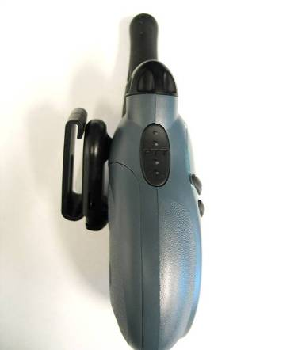
Operating a Two-Way Radio
Volume & On/Off Switch
Antenna
Microphone
Speaker
Push-to-Talk Button (PTT)
Notes:
44

Slide 46
Operating a Two-Way Radio (cont’d)
Always carry extra batteries
SAFETY NOTE: Never attempt to recharge alkaline batteries!
Agency in charge should issue radios
Notes:
45

Slide 47
Radio Communication Tips
Hold PTT button down for at least 1 second before speaking
Know what you are going to say before you push PTT button
Talk across face of microphone
Speak slowly, distinctly, and clearly
Identify unit you are calling first and then your unit
Always acknowledge calls and instructions
Notes:
46

Slide 48
Demonstration
Two-Way Radio Communication
Notes:
47

Slide 49
Communicating Up Chain of Command
CERT members need to communicate professionally up the chain of command
Agency in charge should provide these
  Communication plan
  Protocols for communicating up chain of command
  Who to report to
Notes:
48

Slide 50
Crowd Management
In this topic, you will learn about:
  Applying communication techniques and CERT sizeup to crowd scenes
  Basics of crowd behavior
  Responding to crowd situations
  Developing a basic crowd management plan for an unplanned incident
Notes:
49

Slide 51
CERT Role in Management of Crowds
Direct flow of people
Provide information and referral
Communicate and coordinate with team members
Monitor scene
Report to chain of command
Maintain personal safety
Notes:
50

Slide 52
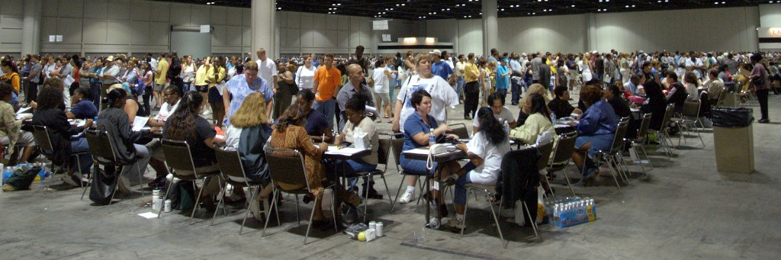
Crowd Psychology
A crowd can assume a personality of its own
“Herd” mentality may cause members of crowd to follow each others’ actions
Notes:
51

Slide 53
Safety Concerns
Most crowds at planned events are law-abiding and compliant
Crowds are potentially dangerous
  Actions of one individual can shape dynamics of entire crowd
  Anonymity increases odds of unacceptable behavior
  Once in action, crowd behavior is difficult to stop or slow
Notes:
52

Slide 54
Behavior to Report
Noncompliance
Rumors
Hostility
Aggression
Excitability
Overcrowding
Rushing
Pushing
Notes:
53

Slide 55
Dangerous Situations
Unruly crowd behavior may turn into:
  Looting
  Projectiles
  Fighting
  Trampling
  Panics
  Crazes
Once crowd panic and trampling begins, it is uncontrollable
Little can be done to prevent death and injury
Notes:
54

Slide 56
Unruly Crowds
CERT members should never deal with unruly or out-of-control crowds
CERT member actions
  Have a planned escape route
  Recognize signs of an unruly crowd
  Communicate up chain of command
  Call for backup
  Back away from situation
Notes:
55

Slide 57
Exercise
Responding to Crowd Behavior
Notes:
56

Slide 58
Crowd Management Plan
In planned events, CERT members do not manage crowds without direction from professional responders
In a disaster, CERT members may need to develop a basic crowd management plan
CERT members can use CERT sizeup and Incident Action Plan to develop plan
Notes:
57

Slide 59
Exercise
Developing a Crowd Management Plan
Notes:
58

Slide 60
Traffic Management
In this topic, you will learn about:
  Using traffic control devices to manage various traffic situations
  Safety concerns for traffic management
  Reading and developing a basic traffic management plan
Notes:
59

Slide 61
CERT Role in Traffic Management
Direct flow of traffic
Provide safe passage for pedestrians
Communicate and coordinate with team members
Monitor scene
Report to chain of command
Maintain personal and scene safety
Notes:
60

Slide 62
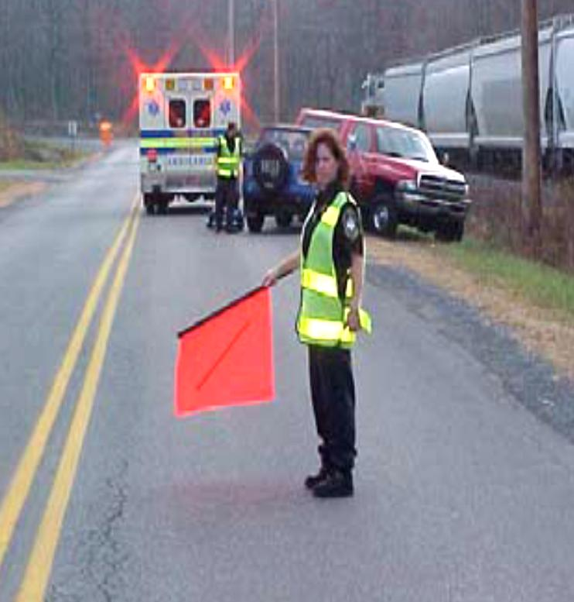
Flag Persons
When to use flag persons
  Travel lanes are partially blocked
  Shoulder must be used to pass by incident
  Only one direction of traffic is available
One person must be in charge
Notes:
61

Slide 63
Equipment for Directing Traffic
Proper equipment essential
  Makes flag person more visible
  Helps drivers recognize you as person directing traffic
Equipment needed
  Reflective vest: Required by Federal law
  Stop paddle
  Flags
  Radio
  Flashlight
  Road flares or traffic cones
  Warning signs
Notes:
62

Slide 64
Demonstration
Paddle Method
Notes:
63

Slide 65
Demonstration
Flag Method
Notes:
64

Slide 66

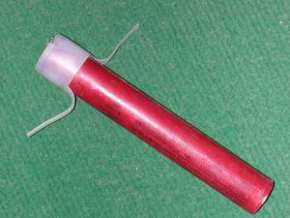
Using Flares and Cones
Uses for flares and cones
  To funnel traffic
  To direct it along alternate routes
  To separate vehicles from incident
Notes:
65

Slide 67
Flare and Cone Patterns
Set flare and cone patterns
  20-25 feet apart in straight line
  At gradual angle when directing lane change
  To one side of incident
  With flag person at each end
Caution: Be alert for vehicles driving through patterns

Slide 68
Benefits and Limitations of Flares
Benefits
Gain driver’s attention
Automatically indicate emergency
Work day and night
Limitations
Can cause fire
Can burn user
Limited to 15-30 minutes
Notes:
67

Slide 69
Igniting Flares
Point flare away from your body and down
Turn face away from flare and strike down away from your body
After lighting flare, do not push cap onto end of flare with palm of your hand, as the striking surface may hold hot residue
Notes:
68

Slide 70
Extinguishing Flares
Pick up flare and tap lit end on ground until flare goes out
Do not throw or step on flares to put them out
Notes:
69

Slide 71
Flare Safety Tips
Always wear protective equipment such as gloves and goggles
Do not light flares near fire hazards such as leaking gas, butane, hazardous materials, or wind
Never hold flare above your head and shoulders, as molten material drips from end of flares and can cause burns
Notes:
70

Slide 72
Benefits and Limitations of Cones
Benefits
More practical than flares if incident will last long
Don’t burn out
Require little attention
Limitations
Can not be seen from as far a distance as flares
Are bigger than flares and harder to transport in large amounts
Notes:
71

Slide 73
Personal Safety
Be highly visible
Remain alert at all times
Keep an eye out for impaired or out of control vehicles
Take a safe position
Notes:
72

Slide 74
Personal Safety (cont’d)
Do not have unnecessary conversation with workers, pedestrians, or drivers
Once oncoming traffic stops, stay aware of the traffic at your back
Take breaks away from moving traffic
Don’t wave the flag other than to signal
Don’t give flagging directions against a traffic signal
Notes:
73

Slide 75
What Do You Think?
While managing traffic, what can you do to keep your team safe?
Notes:
74

Slide 76
Keep Your Team Safe
Remain alert for any situation that may endanger your team members
Keep team members aware of what is going on around them
Warn others of changing situation and impending hazards
Notes:
75

Slide 77
Keep Your Team Safe (cont’d)
Keep your chain of command aware of changes in the situation
Consult your chain of command if you have questions
Notes:
76

Slide 78
What Do You Think?
What can you do to help maintain scene safety while directing traffic around an incident?
Notes:
77

Slide 79
Scene Safety at Traffic Incident
Make sure there is one person in charge of the situation
Don’t start traffic until you communicate with other end of traffic control point
Don’t leave your station until properly relieved
Keep traffic slow past incident
Look out for inattentive drivers
Give clear, concise hand signals
Be polite and courteous to drivers
Use verbal orders as little as possible
Notes:
78

Slide 80
Traffic Situations
CERT members may help manage traffic on:
  Straight roads
  Curved roads
  Intersections
CERT members should NEVER direct traffic on freeways
Notes:
79

Slide 81
Straight Roads
Flagger
Incident
Notes:
80

Slide 82
Straight Roads (cont’d)
Flagger
Flagger
Incident
Notes:
81

Slide 83
Curved Roads
Flagger
Incident
Flagger
Notes:
82

Slide 84
Intersections
Most hazardous traffic operation that CERT members may be asked to perform
Causes
  Power outage
  Evacuation

Slide 85
General Guidance at Intersections
Stand where you can see all traffic; drivers can see you
Never turn your back to oncoming traffic
Signal drivers in time to stop before reaching crosswalk
Clear intersection before allowing opposite traffic to proceed
Don’t let too many cars build up in any direction

Slide 86
Intersection with One Person
Flagger
Incident
Notes:
85

Slide 87
Intersection with More Than One Person
Flagger
Flagger
Flagger
Flagger
Incident
Notes:
86

Slide 88
Exercise
Directing Traffic
Notes:
87

Slide 89
Exercise
Develop a Traffic Management Plan
Notes:
88

Slide 90
Module Summary
In this module, we reviewed:
CERT Basic Training Concepts That Apply to Traffic and Crowd Management
Communicating Effectively
Crowd Management
Traffic Management
Notes:
89

