Slide 1



Flood Response for CERTs
Community Emergency
Response Team

Slide 2
Participant Introductions
Introduce yourself to the class by providing your:
  Name
  Reason you want to learn more about flood response
Notes:
1

Slide 3
Administrative Announcements
Breaks
Emergency exits
Restrooms, smoking policy, cell phones silent
Module completion
Notes:
2

Slide 4
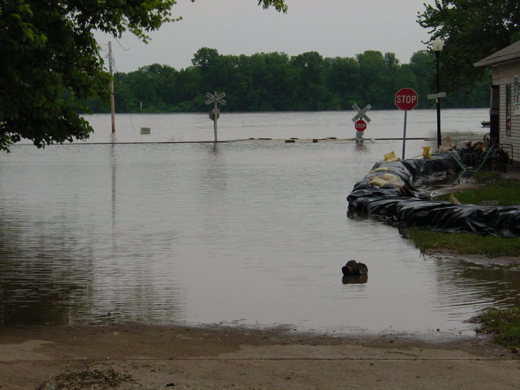
Module Purpose
To teach CERT members how to respond to a flood in a safe and efficient manner.

Slide 5
What You Will Learn
CERT Basic Training Concepts That Apply to Flood Response
Overview of Flood Response
Personal Safety Around Floodwaters
Working With Sandbags
Building a Sandbag Barrier Activity
Notes:
4

Slide 6
Module Objectives
At the end of this module, participants will be able to:
  Identify the CERT role in responding to floods
  Explain CERT Basic Training concepts that apply to flood response
  Describe how to know when a flood response will be needed and how the emergency management system responds to floods

Slide 7
Module Objectives (cont’d)
At the end of this module, participants will be able to:
  Explain the dangers of floodwaters and how to work safely around them
  State how to work safely with sandbags
  Demonstrate how to fill and move a sandbag correctly and construct a sandbag barrier correctly

Slide 8
What Do You Think?
What experience do you have with floods or flood response?
Notes:
7

Slide 9
Local Flooding History
Event
Response
Lessons learned
Future threats
Notes:
8

Slide 10
Review of CERT Basic Training Concepts
Onscene Management and ICS
Maintaining Personal Safety
Typical Flood Response Injuries

Slide 11
Onscene Management
Purpose of onscene management is to:
  Maintain safety of responders
  Provide clear leadership and organizational structure
  Improve effectiveness of rescue efforts
Notes:
10

Slide 12
Incident Command System (ICS)
CERTs are part of ICS
Basic ICS structure is established by person who arrives first on scene
CERT members always defer to professional responders
If no professional responders on scene, CERT Incident Commander/Team Leader (IC/TL) is in charge
Notes:
11

Slide 13
What Do You Think?
What are the command positions of the ICS?
Notes:
12

Slide 14
Team Organization
CERT may operate in two ways
  One team performing all tasks
  Smaller teams performing specific tasks
In all situations, each unit must have an identified leader
  To supervise tasks being performed
  To account for team members
  To report information to his or her leader
Notes:
13

Slide 15
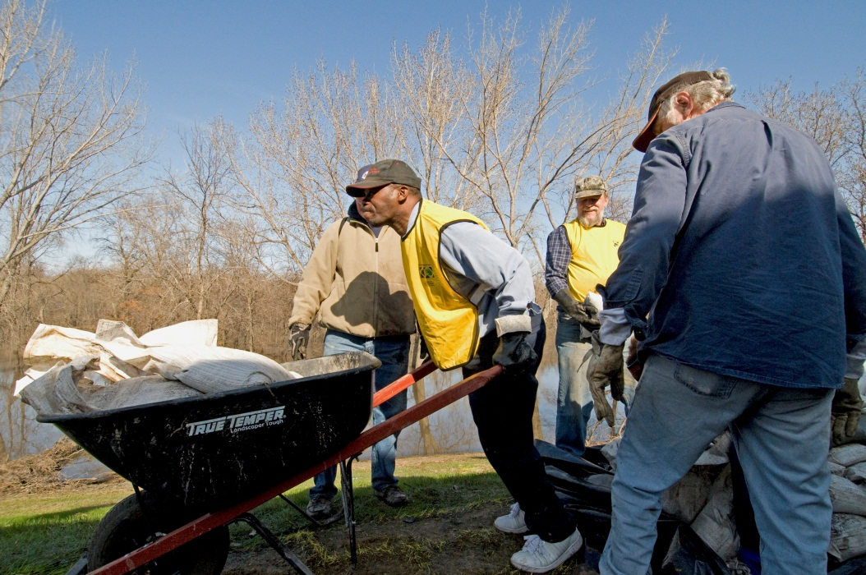
Maintaining Personal Safety
Personal safety is CERT member’s #1 priority
Know your limitations
  Don’t engage in
  activities that are
  uncomfortable
Use buddy system
Notes:
14

Slide 16
What Do You Think?
What safety concerns do you have about flood response?
Notes:
15

Slide 17
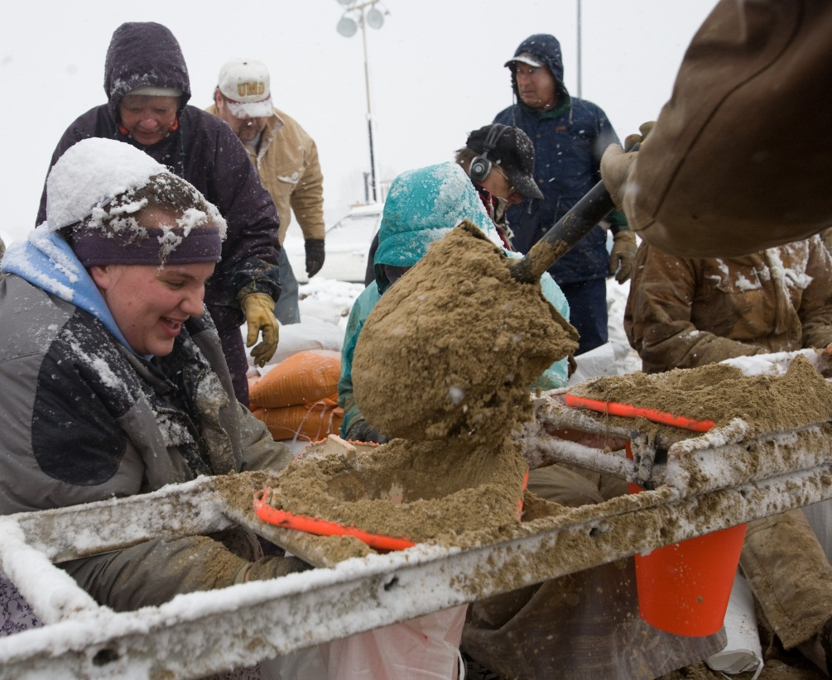
Typical Flood Response Injuries
Working in and around floodwaters is dangerous
Reminder: Safety precautions limit injuries
Typical injuries
  Heat- and
  cold-related injuries
  Sprains
  Strains
  Lacerations
  Blisters
Notes:
16

Slide 18
Cold-Related Injuries
Causes
  Exposure to cold air or water
  Inadequate food combined with inadequate clothing and/or heat
Signs and Symptoms
  Body temperature of 95° Fahrenheit (37° Celsius) or lower
  Redness or blueness of the skin
  Numbness accompanied by shivering
Older people particularly at risk

Slide 19
Treating Cold-Related Injuries
Remove wet clothing
Wrap in blanket or sleeping bag; cover head and neck; protect from weather
Conscious survivor: warm, sweet drinks and food; warm bath if possible
Unconscious survivor: recovery position
Do not use massage
Keep survivor from walking around
Notes:
18

Slide 20
Heat-Related Injuries
Heat cramps
  Muscle spasms from over-exertion in extreme heat
Heat exhaustion
  Loss of body fluids through heavy sweating while working in extreme heat
  Blood flow to skin increases, blood flow to vital organs decreases
  Result: mild form of shock
Heat stroke
  Life-threatening
  survivor's temperature control system shuts down; possible brain damage and death

Slide 21
Treating Heat-Related Injuries
Place survivor in cool environment
Cool body slowly with cool, wet towels or sheets
Have survivor drink water slowly: ½ glass every 15 minutes
If vomiting, cramping, or loss of consciousness: NO food or drink; alert medical professional ASAP
Notes:
20

Slide 22
Treating Sprains and Strains
Signs
  Tenderness at injury site
  Swelling and/or bruising
  Restricted use, or loss of use
Treatment
  Immobilize and elevate
  Treat it as if it were a fracture
Notes:
21

Slide 23
What Do You Think?
What did you learn in CERT Basic Training about immobilizing a sprain or strain?
Notes:
22

Slide 24
Splinting a Sprain or Strain
Support injured area above and below site of injury, including joints
Assess PMS in extremity before initiating splint
Try to splint injury in position that you find it
Don’t try to realign bones or joints
Fill voids to further stabilize and immobilize injury
Immobilize above and below injury
After splinting, reassess PMS and evaluate against initial PMS assessment
Notes:
23

Slide 25
Treating Lacerations and Blisters
Keep blisters clean and intact
Control bleeding
  Direct pressure
  Elevation
  Pressure points
Dress and bandage wound
  Irrigate wound with clean, room temperature water
  Apply dressing and bandage to keep wound clean and control bleeding
Notes:
24

Slide 26
Overview of Flood Response
What Is a Flood?
The Emergency Management Response
Flood Response Supplies, Operations, and Tools

Slide 27
What Is a Flood?
One of most common hazards
  May be confined or widespread
  May develop slowly or quickly
Types
  Coastal flooding (from storms)
  Overland (from rain, snow melt)
  Flash floods (from heavy rain in short time)
  Ice jams (from rapid warming and snow melt)
  Dam and levee failure
Notes:
26

Slide 28
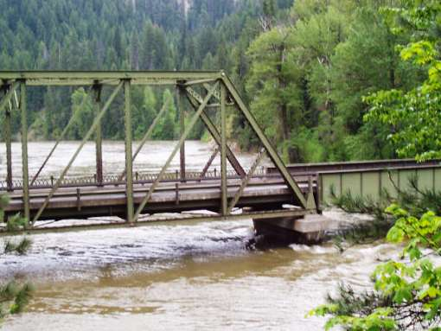
Scenario
Notes:
27

Slide 29
What Do You Think?
How do you know if a flood is coming?
Notes:
28

Slide 30
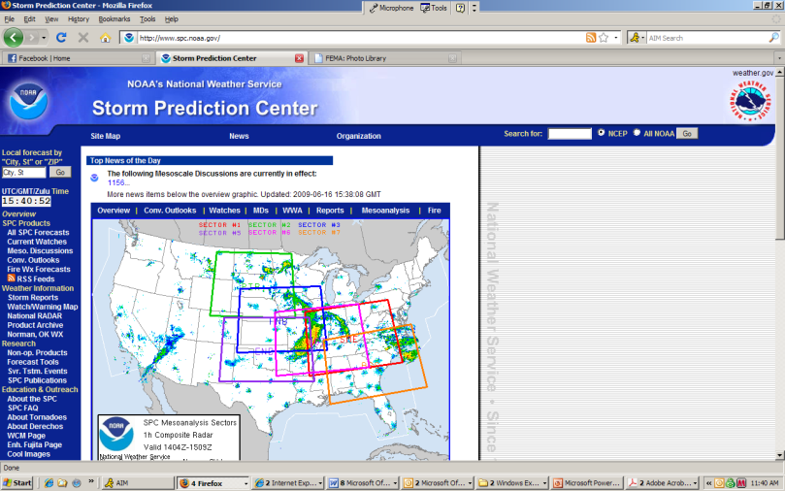
National Weather Service
Storm Prediction Center issues watches and warnings
CERT members should monitor these alerts during severe thunderstorms and coastal storms
Notes:
29

Slide 31
Flood Watch
Indicates that flooding is possible and situation could worsen
During a flood watch, you should:
  Watch water levels
  Stay tuned for further advisories
  Alert neighbors
Notes:
30

Slide 32
Flood Warning
Issued when flooding is expected
Flash flood warning issued after few hours of locally heavy rainfall, a dam or levee failure, or water released from ice jam
Notes:
31

Slide 33
Flood Warning (cont’d)
During a flood warning, you should take action
  Alert neighbors
  Listen to radio or television for further instruction
  If any possibility of flash flooding, move to higher ground immediately
  Prepare to evacuate
  Evacuate
Notes:
32

Slide 34
The Emergency Management Response
Response protocols vary by community
  Protocols are described in community’s Emergency Operations Plan
Roles and responsibilities
  Many public and private partners contribute to flood response
  Roles and responsibilities are determined by local jurisdiction and may change
Notes:
33

Slide 35
CERT Roles and Responsibilities
CERT roles will vary by type of incident
Adhere to protocols for that incident
Do not self-activate
Remember personal safety
  Don’t take on more than you can handle
  CERT Safety Officer and IC/TL will help monitor individual and team safety and well-being
Notes:
34

Slide 36
Flood Response Supplies
Sandbags
Polyethylene: commonly called “Poly”
Lumber and planking
Shovels, wheelbarrows, etc.
Other basic supplies
  Drinking water and sanitation supplies
  First aid kit and gloves

Slide 37
Flood Response Operations
Supply and transportation
Filling sandbags
Moving sandbags
Building a sandbag barrier
Flood patrols
Support services
Notes:
36

Slide 38
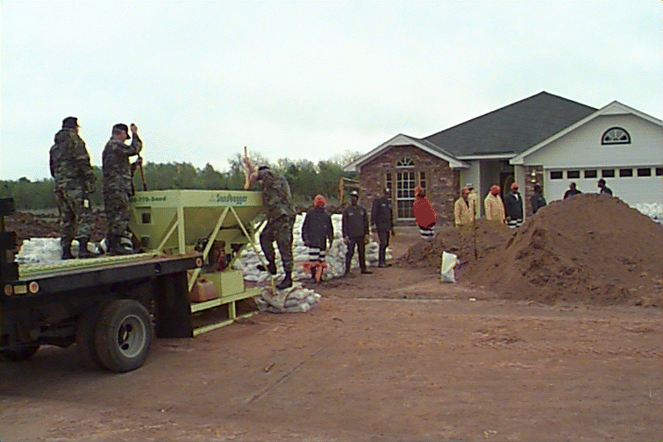
Flood Response Equipment
Pumps
Trucks
Forklifts
Front-end
loaders
Sandbag-filling
machines
Notes:
37

Slide 39
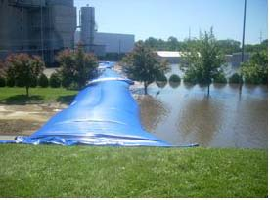
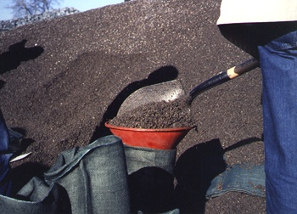
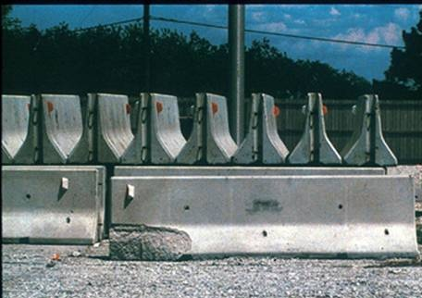
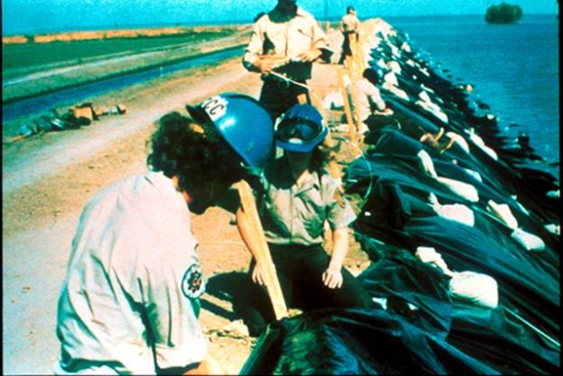
Flood Response Barriers
Tubes filled with water
Sandbags filled with sand, dirt, gravel
Jersey wall
Hay bales or wood covered with poly
Notes:
38

Slide 40
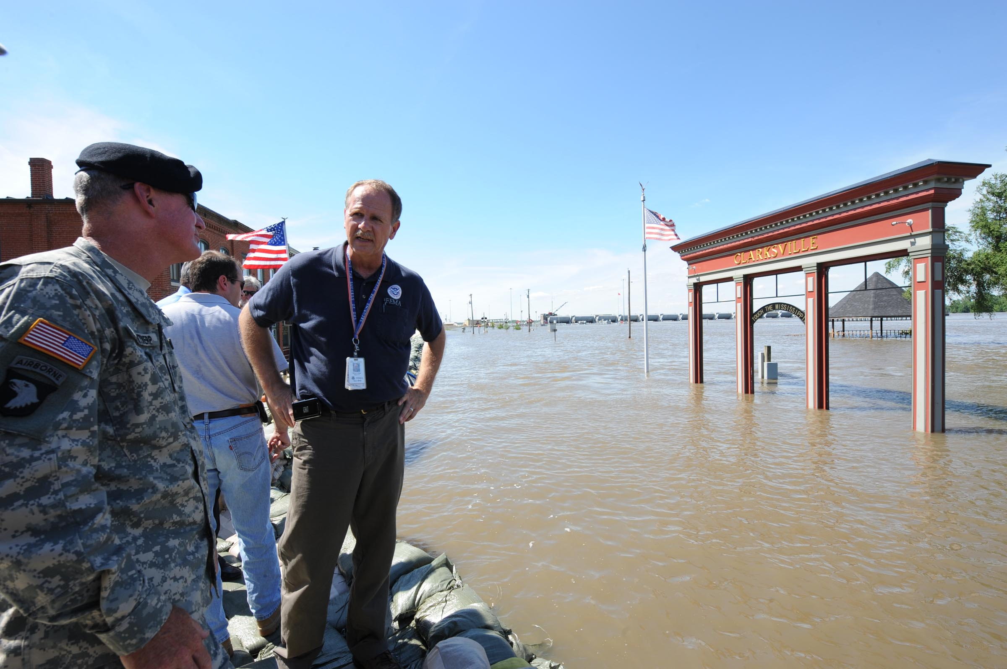
Personal Safety Around Floodwaters

Slide 41
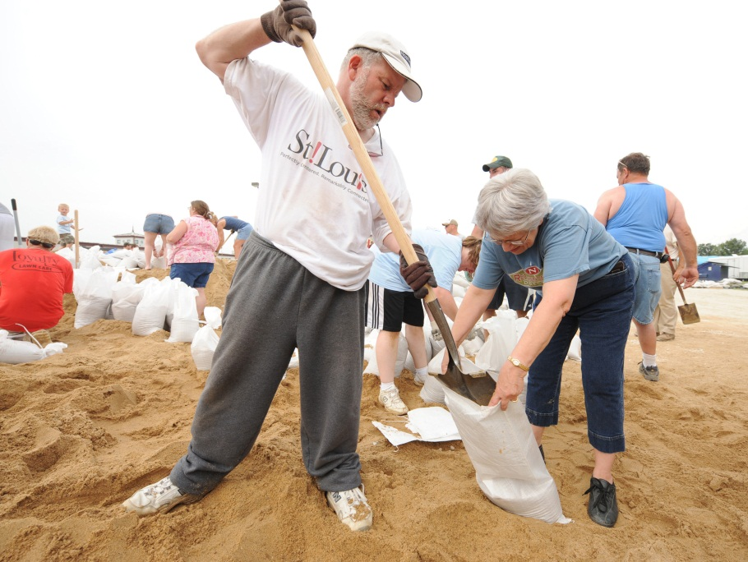
Realities of Flood Response for CERTs
Mentally and physically demanding
Personal safety is top priority
You know your limitations better than anyone
Notes:
40

Slide 42
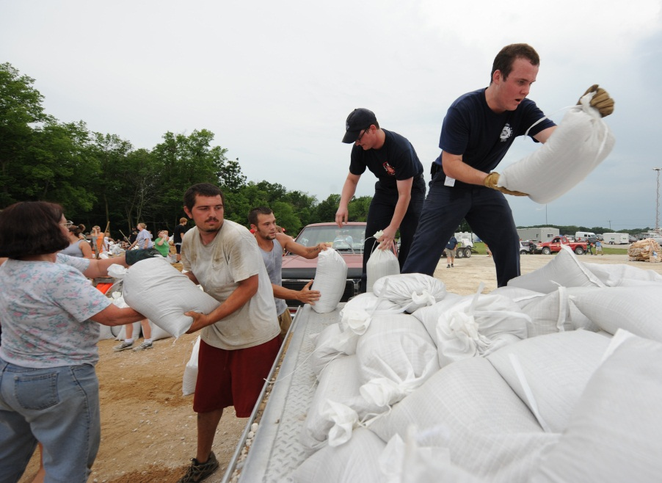
Fatigue
Work is exhausting
Listen to your body
Take breaks as needed,
especially when
working extended
hours
Notes:
41

Slide 43
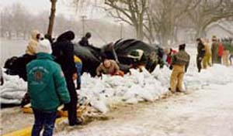
Weather
Weather conditions can affect a flood response by making tasks more difficult
Dress appropriately for weather
Dress in layers
Notes:
42

Slide 44
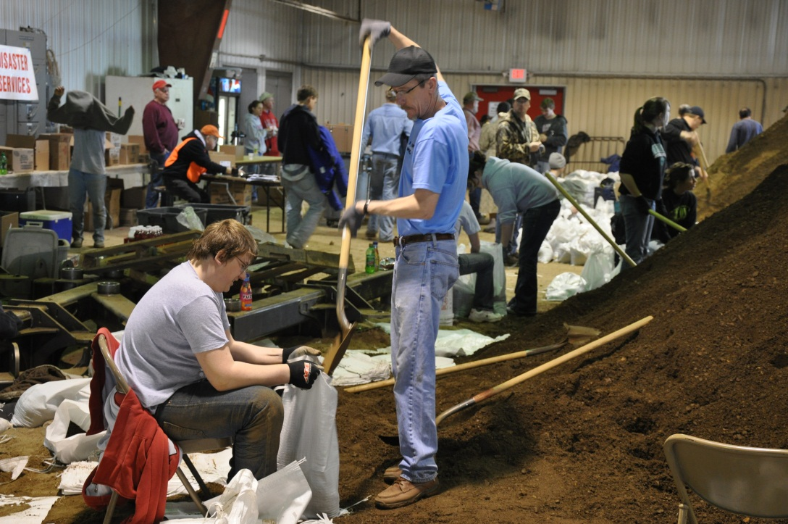
Mental Preparation
Flood response is long process
  Work is repetitive
  Signs of progress
  are limited
  Experience can
  be frustrating
Take breaks to
keep yourself
alert
Notes:
43

Slide 45
What Do You Think?
What are some of the most common dangers during a flood response?
Notes:
44

Slide 46
Dangers of Flood Response
Icy/muddy conditions
Electrical equipment and machinery
Swift water movement
Contaminants
Temperature (hot and cold)
Debris
Sand boils
Notes:
45

Slide 47
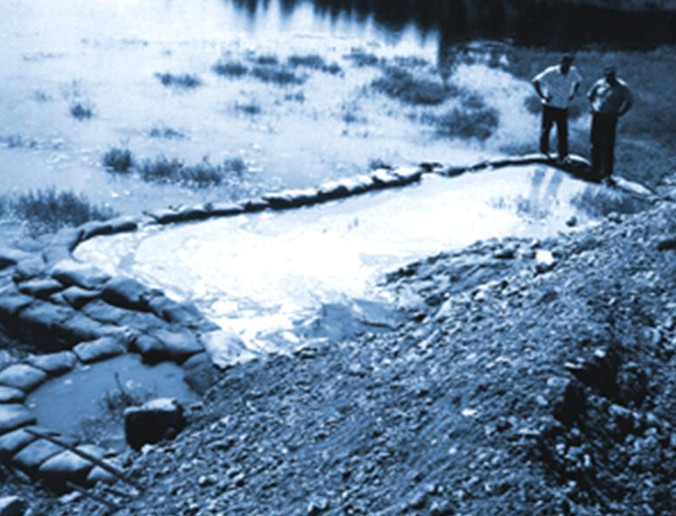
Sand Boils
Occur when pressure of floodwater causes water to bubble up on dry side of sandbag barrier
Generally harmless if contain clean, clear water
Extremely dangerous if contain sand (“dirty”)
  May lead to eventual
  barrier failure
Treat all sand boils
as “dirty”
  Do not ignore
  Surround with
  ring of sandbags

Slide 48
Common Ailments and Injuries
Hyperthermia
Hypothermia
Sprains and strains
Raw hands
Blisters
Lacerations
Notes:
47

Slide 49
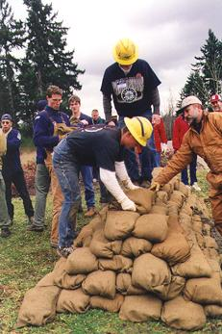
Work Smart
Take care of yourself
Stay healthy
Practice safety
Watch out!

Slide 50
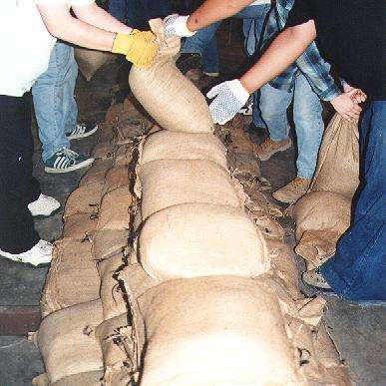
Working with Sandbags
Operation 2
  Filling sandbags
Operation 3
  Moving sandbags
Operation 4
  Building sandbag barrier

Slide 51
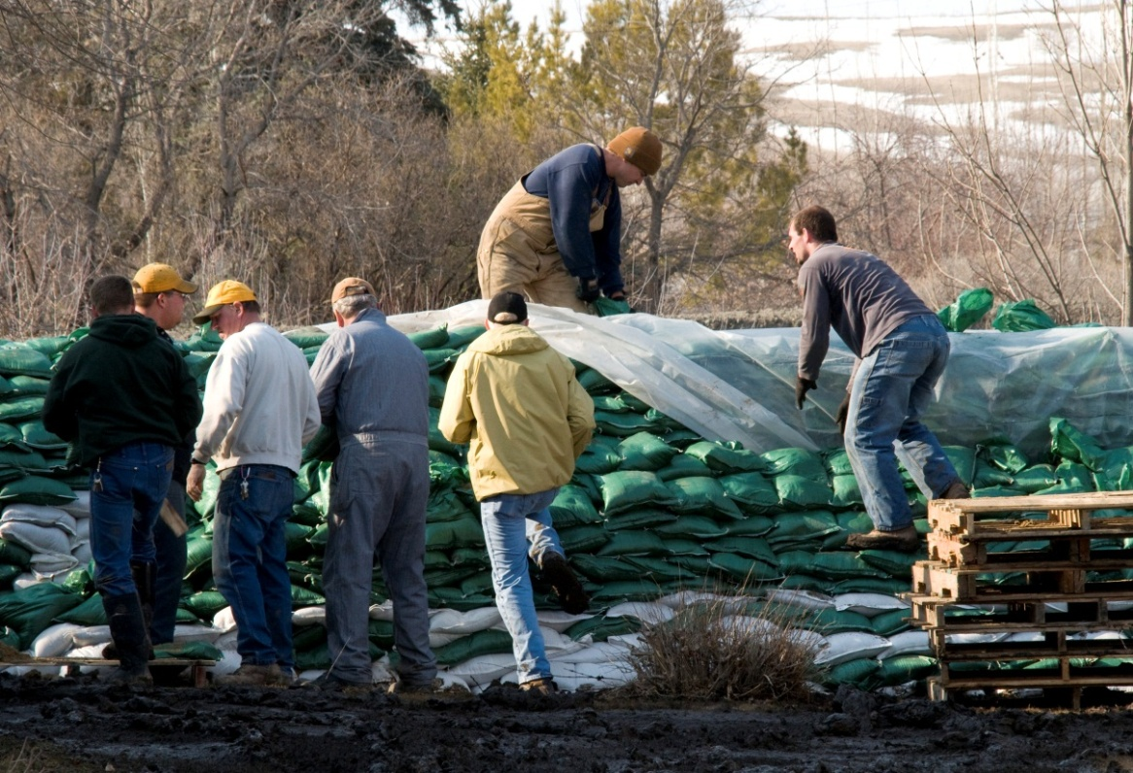
Sandbagging Tools
Sand (or dirt)
Bags
(cloth or plastic)
Shovel

Slide 52
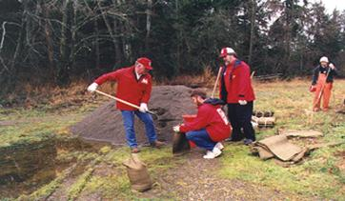
How to Fill a Sandbag
Two- or three-person operation
#1. Holds empty bag on ground
#2. Fills 1/2 to 2/3 full
#3. Stacks and
stockpiles
Notes:
51

Slide 53
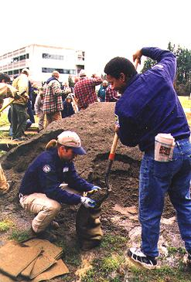
General Sandbagging Tips
Keep elbows in when
filling sandbags
Rotate duties
  Holding
  Shoveling
  Stacking
Wear gloves
Do not tie sandbags
Notes:
52

Slide 54
Move a Sandbag Correctly
Lift with your knees, not your back
Use a passing line to move sandbags
  Diagonal-pass formation is most effective
General rule: When constructing barrier on incline, taller volunteers should be at end of line farthest from barrier
Notes:
53

Slide 55
Exercise
Diagonal-Pass Formation
Notes:
54

Slide 56
Filling and Moving Safety Concerns
Maintain situational awareness
If large vehicles are in the area, listen for the sound of them backing up
Be careful when working around power-loading equipment
Notes:
55

Slide 57
How to Build a Sandbag Barrier

Slide 58
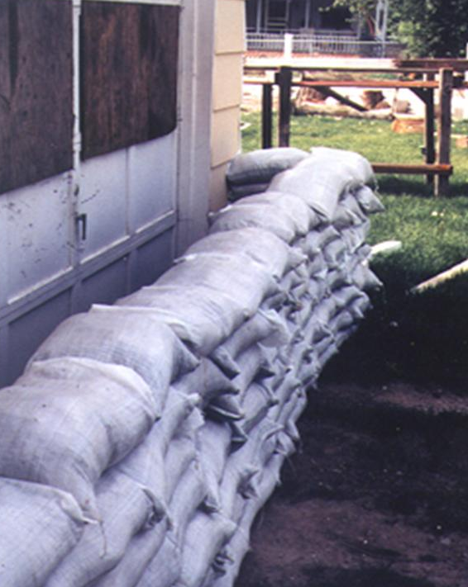
Pyramid or Vertical?
General rule: Do not stack sandbags vertically
May be placed one on
top of another if
floodwater:
  Is not fast moving
  Is up to a foot high
  with no debris
Notes:
57

Slide 59
Building a Barrier Safety Concerns
Maintain situational awareness
Treat all sand boils as dirty
Be cautious when working on levees; barriers may break
Notes:
58

Slide 60
Summary
Types of floods common in the local area
Review of relevant concepts from CERT Basic Training
  Remember onscene management and ICS structure
  Personal safety is paramount
  Conduct medical assessment and treatment
Types of floods and flood watches and warnings
Emergency management system response to floods

Slide 61
Summary (cont’d)
Flood response supplies, operations, equipment
Flood realities and dangers
How to fill and move sandbags safely and correctly
How to build a sandbag barrier safely and correctly

Slide 62
Additional Resources
www.ag.ndsu.edu/disaster/flood.html
www.redcross.org/en/prepare/events
OSHA Fact Sheets: Flood Hazards and Flood Cleanup
Notes:
61

