Slide 1



Firefighter Rehab
Community Emergency
Response Team

Slide 2
Participant Introductions
Introduce yourself to the class
Notes:
1

Slide 3
Administrative Announcements
Breaks
Emergency exits
Restrooms
Smoking policy
Silence cell phones
Module completion requirements
Notes:
2

Slide 4
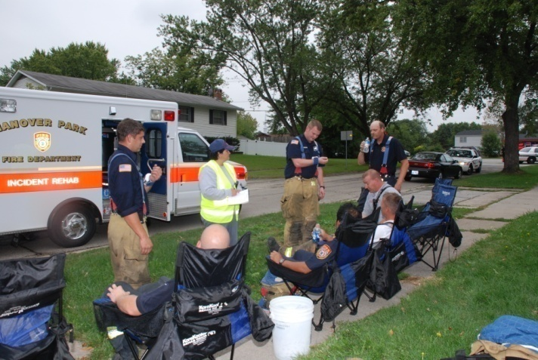
Module Purpose
To train CERT members to recognize signs of physiological distress in firefighters
To train CERT members to safely set up and perform the
non-medical functions
of firefighter
rehabilitation

Slide 5
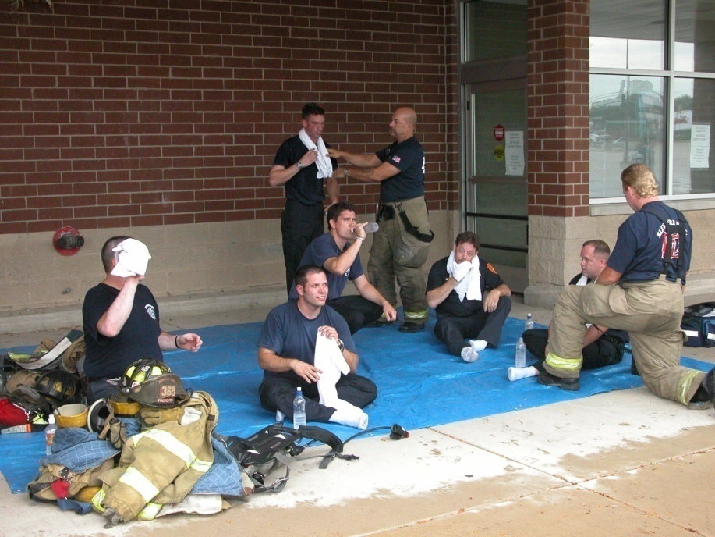
What You Will Learn
Physiological Threats
to Firefighters
The Incident Scene
The Rehab Area
The Rehab Process
Training is consistent with and based on NFPA 1584: Standard on the Rehabilitation Process for Members During Emergency Operations and Training Exercises. 2008 Edition
Notes:
4

Slide 6
Module Objectives
At the end of this module, you will be able to:
Define firefighter rehab
Identify the purpose of firefighter rehab
Describe the physiological threats to firefighters
Describe the primary components of firefighting
Set up a rehab area
Conduct rehab operations

Slide 7
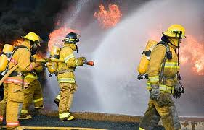
What Do You Think?
What is firefighter rehab?

Slide 8
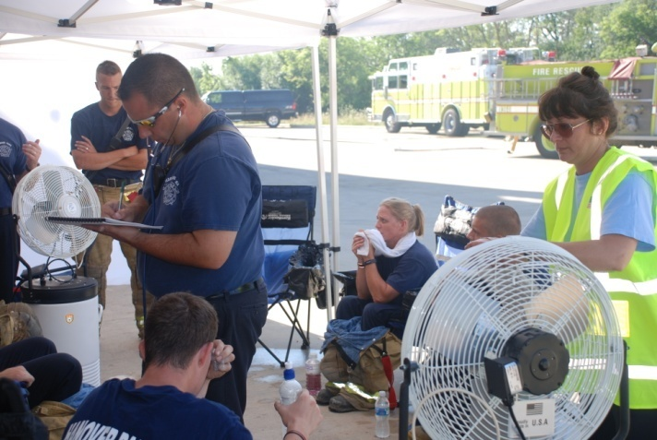
Firefighter Rehabilitation
Firefighter rehabilitation is the process of providing rest, rehydration, nourishment, and medical evaluation to members who are involved in
extended or
extreme incident
scene operations

Slide 9
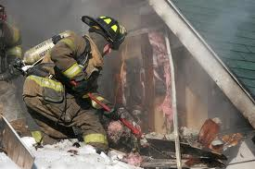
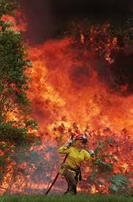
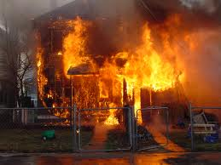
Why Is Rehab Needed?
Firefighting is hot and strenuous work!
Leads to dehydration and heat stress

Slide 10
Effects of Heat Stress
Fatigue
Overexertion and strain
Reduced situational awareness
Slips
Trips
Falls
Cardiac (heart attack) Cerebrovascular (stroke)

Slide 11
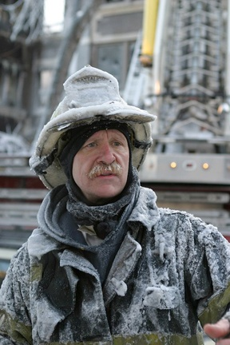
Additional Stress Factors
Sometimes this hot work is done in very hot or very cold conditions
Fitness of the firefighter:
  Hypertension
  High lipids
  High blood glucose
  Overweight/obesity
  Inactivity
  Smoking

Slide 12
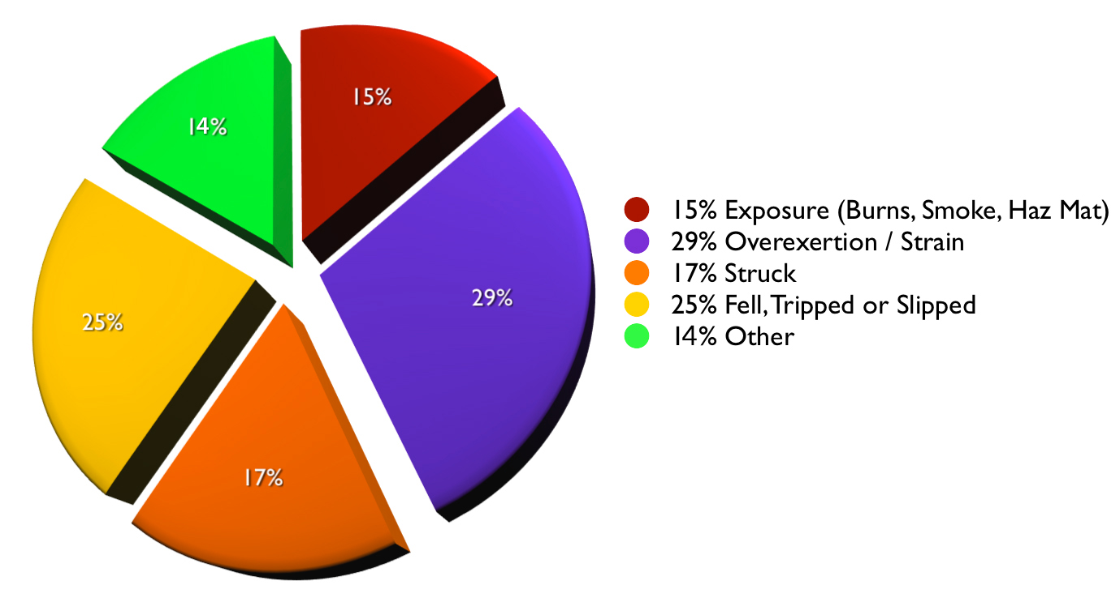
The Facts
About 80,000 firefighters are injured every year
Karter, M.J., Patterns of Firefighter Fireground Injuries, NFPA 2009

Slide 13
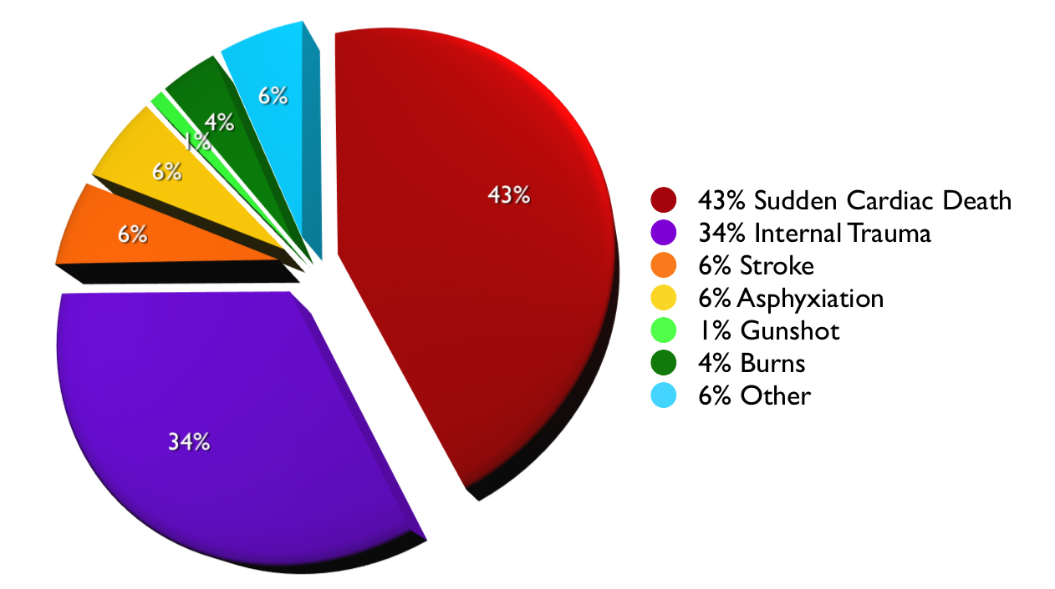
The Facts (cont’d)
About 100 firefighters die each year
  Cardiac or cerebrovascular events are approximately 50% of all annual line of duty deaths
National Fire Protection Association 2009

Slide 14
Purpose of Rehab
Improves performance
Decreases likelihood of onscene injury or death
Ensures that physical and mental condition of members does not deteriorate to point that affects safety of each member or that jeopardizes safety and integrity of operation

Slide 15

NFPA 1584 Guidelines
Two guidelines for company or crew rehabilitation in terms of work-to-rest ratio and/or self-contained breathing apparatus (SCBA) usage

Slide 16
NFPA 1584 Guideline #1
The company or crew must self-rehab (rest with hydration) for at least 10 minutes following:
  Depletion of one 30-minute SCBA cylinder
  Or after 20 minutes of intense work without wearing an SCBA
Company Officer (CO) or crew leader must ensure that all members are fit to return to duty before resuming operations

Slide 17
NFPA 1584 Guideline #2
Company or crew must enter formal rehab area, drink appropriate fluids, be medically evaluated, and rest for minimum of 20 minutes after any of the following:
  Depletion of two 30-minute SCBA cylinders
  Depletion of one 45- or 60-minute SCBA cylinder
  Whenever encapsulating chemical protective clothing is worn
  Following 40 minutes of intense work without SCBA

Slide 18
Variation on Guidelines 1-2
If members enter rehab area prior to going through two 30-minute SCBA cylinders (or any other of the criteria listed in Guideline #2):
  Still must be medically evaluated and drink fluids
  However, rest period may be lowered to only 10 minutes, if they are fit to return to duty

Slide 19
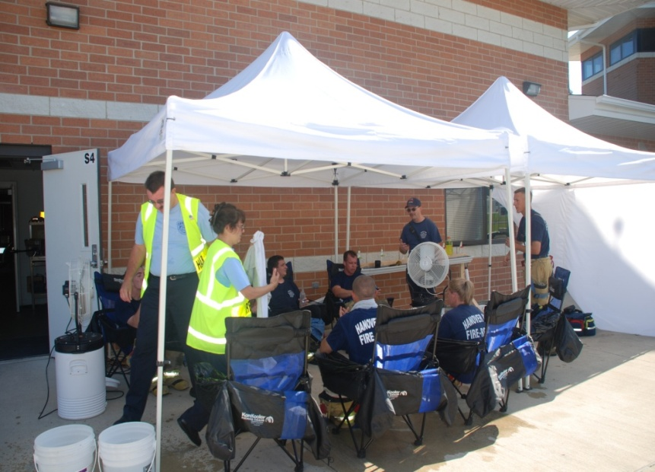
CERT Members and Rehab
CERT members will provide critical service that directly affects health and safety of firefighters
  Rest and recovery
  Relief from incident,
  environmental conditions
  Rehydration
  Nourishment
  Documentation
  May assist with medical
  monitoring

Slide 20
What Do You Think?
What are some other situations where rehab could be necessary?

Slide 21
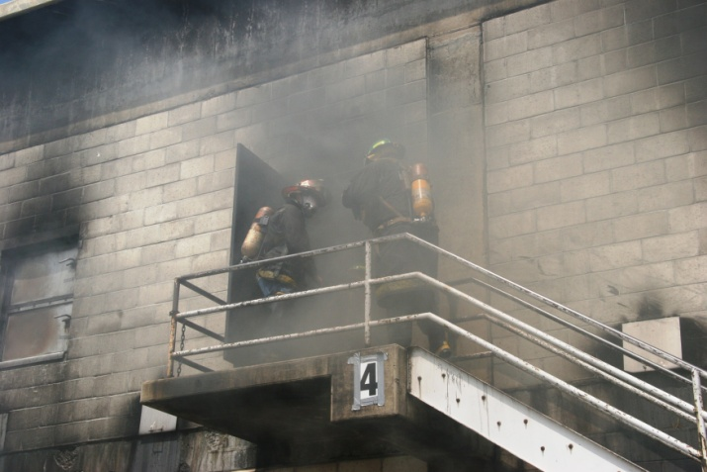
Physiological Threats to Firefighters
Prolonged exposure to thermal conditions
  Heat
  Cold
Firefighter
PPE

Slide 22
Heat Stress
Heat cramps or muscle spasms
Heat exhaustion
  Heavy sweating and loss of body fluids
  Increased blood flow to skin, decreased blood flow to vital organs
Heat stroke
  Temperature reaches over 104°F. or higher
  Brain damage and death may result

Slide 23
Is Heat Stress Possible?
What is the outside temperature?
How humid is it?
How windy is it?
Are they working in direct sunlight?
How close are they to the flame front?
Are they kneeling or crawling on hot surfaces?
Is this a chemical or flammable fuel fire?

Slide 24
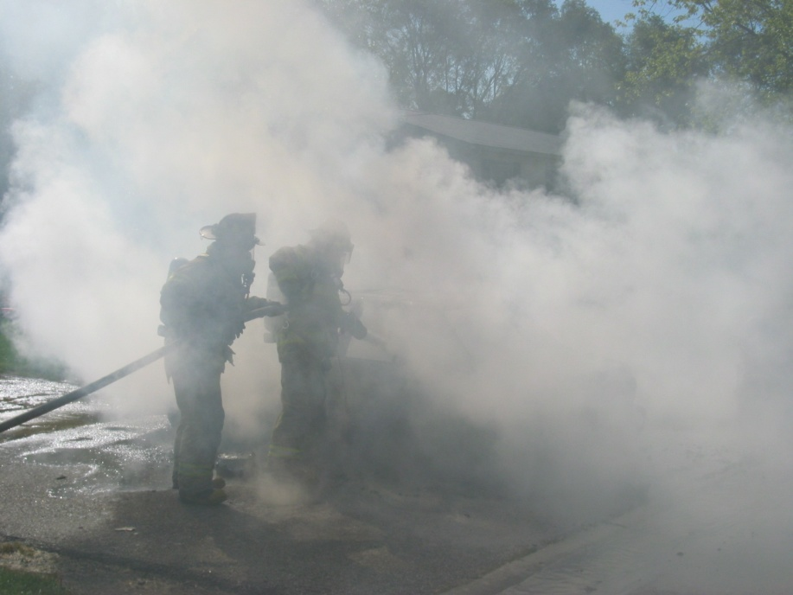
Water and Steam
Water and steam transfer heat many times faster than air

Slide 25
What Do You Think?
How might you know that someone is suffering from heat stress?

Slide 26
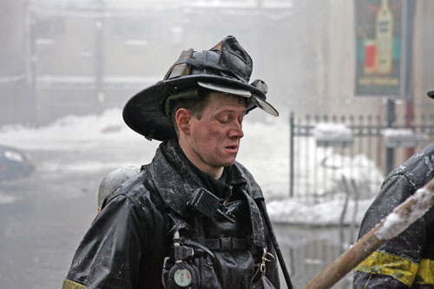
Is Cold Stress Possible?
What is the outside temperature?
How windy is it?
Temperatures between 32°F and 55°F can cause cold injuries.

Slide 27
What Do You Think?
How might you know that someone is suffering from cold stress?

Slide 28
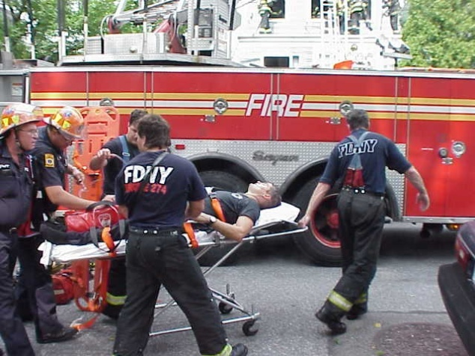
Three Other Conditions
Dehydration
Altered mental state
Cardiac event

Slide 29
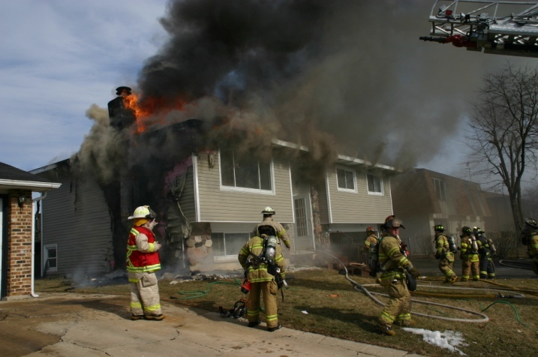
The Incident Scene
Notes:
28

Slide 30
Fire Factors
Type and extent of incident
Length of time to fight fire
Environmental elements

Slide 31
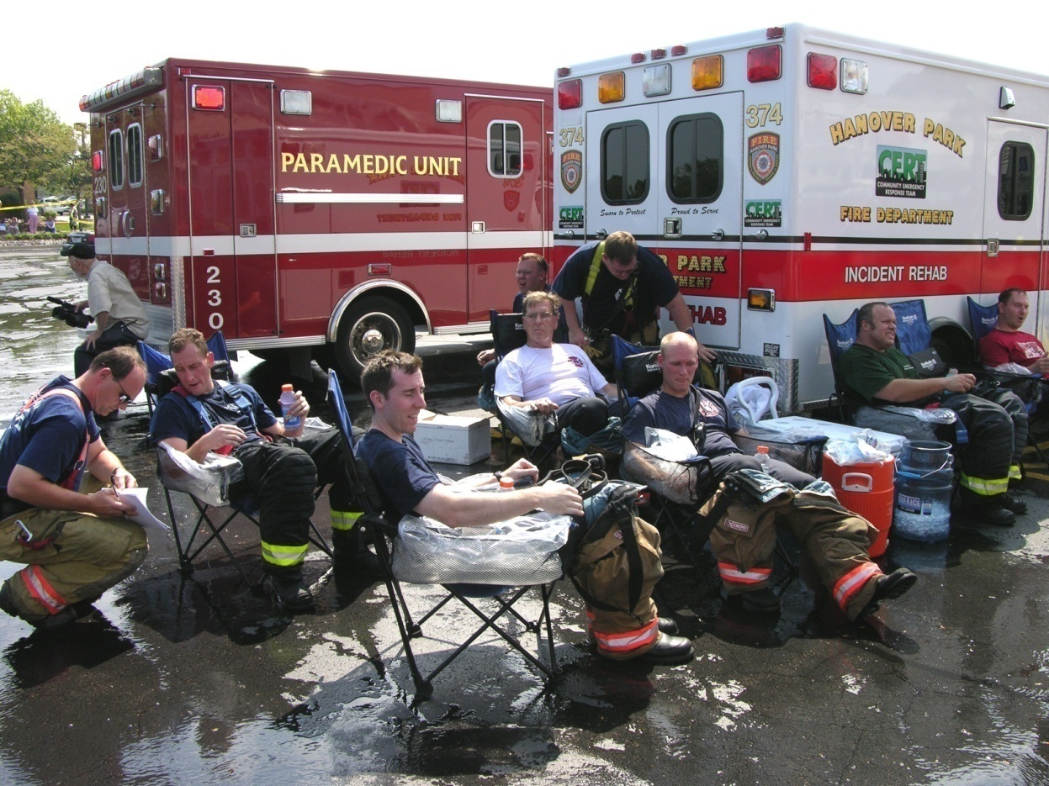
The Rehab Area
Location
Facilities
Equipment
and Supplies
Setup

Slide 32
Location Approved by IC
Protects from the elements (hot and cold)
Provides refuge from the incident
Provides protection from the prevailing environmental conditions (exhaust, smoke, toxins)
Is large enough to accommodate multiple crews and rehabilitation personnel
Is located near or with EMS

Slide 33
Multiple Locations
If location becomes inundated with smoke
  IC alerted and location changed
If need more than one location
  Incident is big
  There are barriers to accessing rehab area
Naming convention
Rehab North
Incident
N
Notes:
32

Slide 34
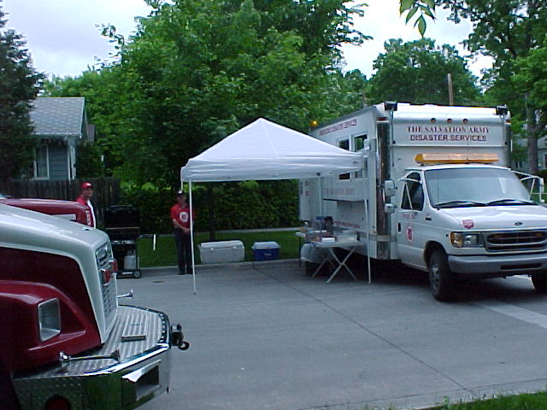
Facilities

Slide 35
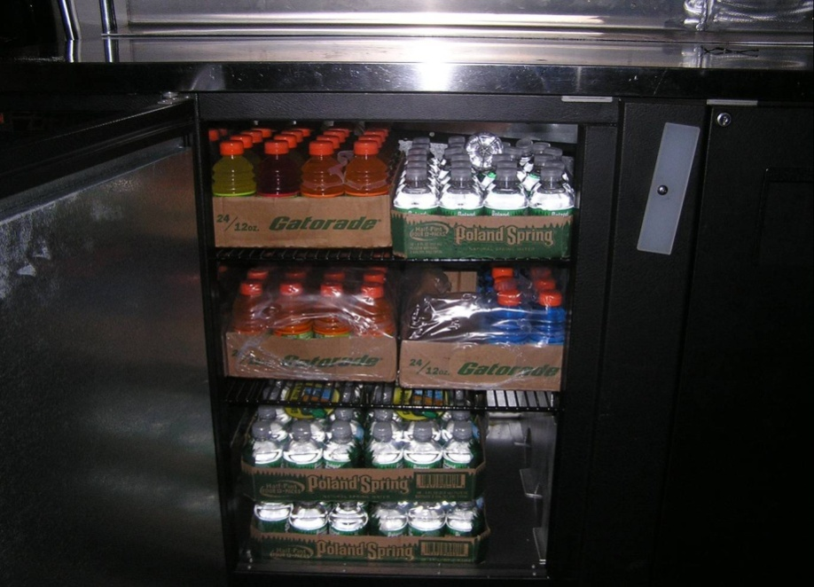
Equipment and Supplies

Slide 36
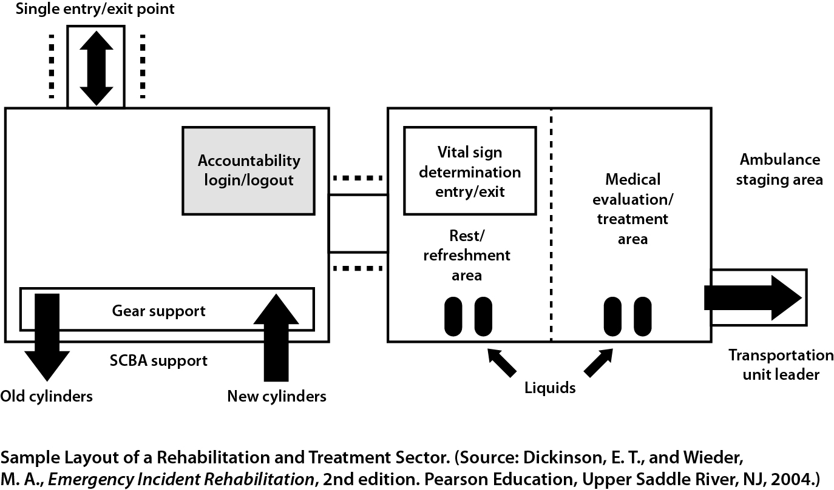
Sample Setup

Slide 37
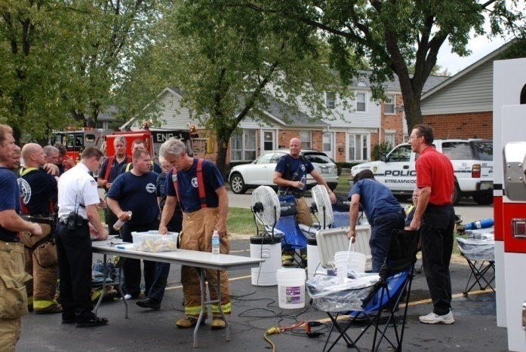
Activity
Establishing a Rehab Area
25 minutes:
As a group, consider four scenarios
Discuss responses to questions about scenarios
Notes:
36

Slide 38
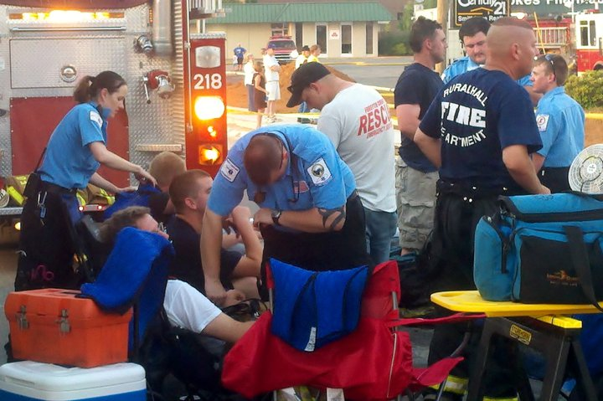
Rehab Operations
Review of training up to this point
  Why firefighters need rehab
  What rehab area looks like
Final section
  What happens in each
  part of rehab area
  CERT members’ roles

Slide 39
CERT Safety
PPE
  Reflective vests and gloves
  Hard hats not needed, but keep nearby
Avoid smoke; may contain chemicals
Wear exam gloves to remove firefighter’s gear
  Gear may contain hazardous material
Rehab yourselves

Slide 40
Overview of Rehab Operations
Reminder
  Training based on NFPA 1584, Standard on the Rehabilitation Process for Members During Emergency Operations and Training Exercises. 2008 Edition

Slide 41
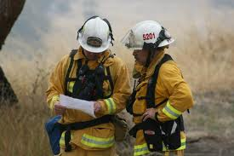
1. CERT members are mobilized
CERT never self-deploys for rehab
CERT will be notified by Incident Command through local protocol when it is needed for firefighter rehab

Slide 42
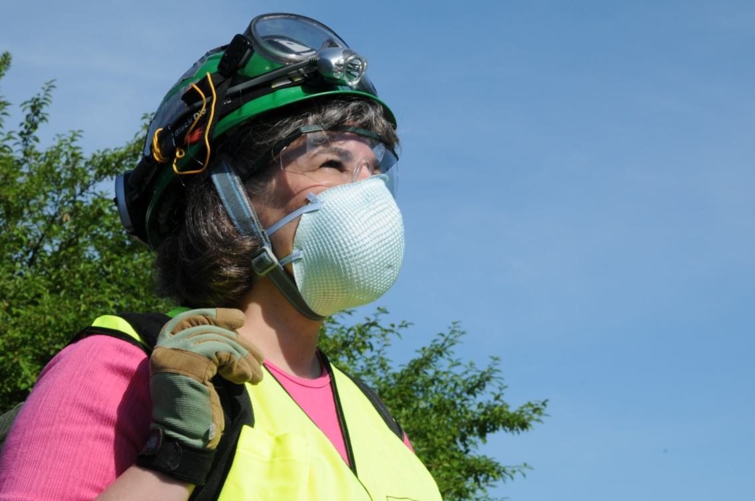
2. CERT members arrive in PPE
Report to Incident Command Post

Slide 43
3. IC chooses a rehab leader
Best if it is firefighter, for credibility with firefighters
Responsibilities
  Safety of rehab team
  Setup, operations, and stand down
  Notifying EMS when firefighter needs additional assistance
  Handling logistics; ensuring sufficient supplies
  Having plan for replenishing water and supplies
Notes:
42

Slide 44
Rehab Team Accountability
Accountability is key component of NFPA 1584 standard operating guideline
Accountability system for rehab team
  Rehab leader knows who to report to
  Names of all team members are recorded
  Rehab leader briefs team members on roles and tasks
  All documentation is returned to rehab leader at end of operation

Slide 45
4. Rehab location chosen
Protects from the elements (hot and cold)
Provides refuge from the incident
Provides protection from environmental conditions (exhaust, smoke, toxins)
Is large enough to accommodate multiple crews and rehabilitation personnel
Is located near or with EMS
Is approved by IC

Slide 46
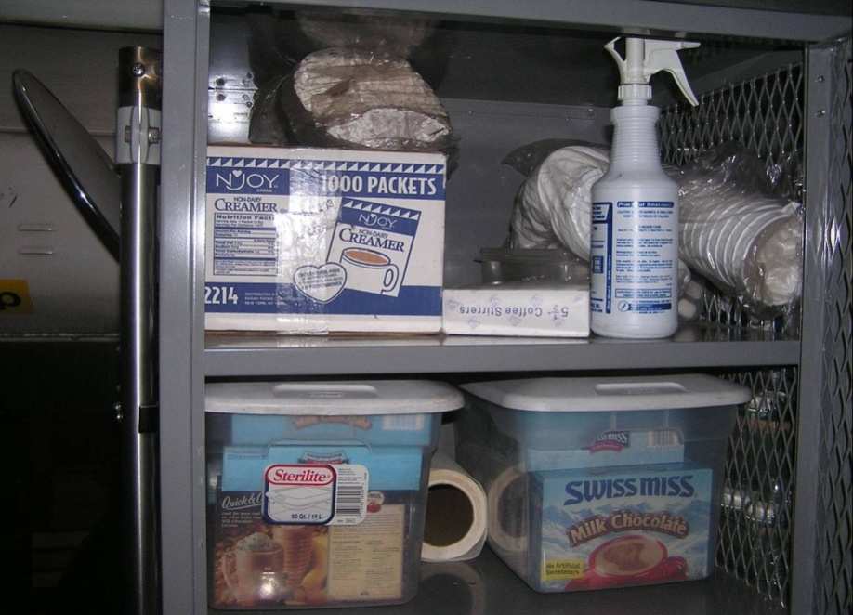
5. Set up rehab area
What separate areas are needed?
What are the critical supplies to have?

Slide 47
6. Firefighters sign in
Establish clear directions to point of entry
All firefighters must sign in
  Names and arrival times are recorded on Rehab Area Check-In/Check-Out Sheet

Slide 48
7. Gear is removed; water is offered
Offer water immediately
Provide help with removing gear
  Firefighters should “dress down” by removing bunker coats, helmets, and hoods, and by opening bunker pants to promote cooling
Direct firefighters to wash or sanitize hands and face before moving into rest and recovery area
Notes:
47

Slide 49
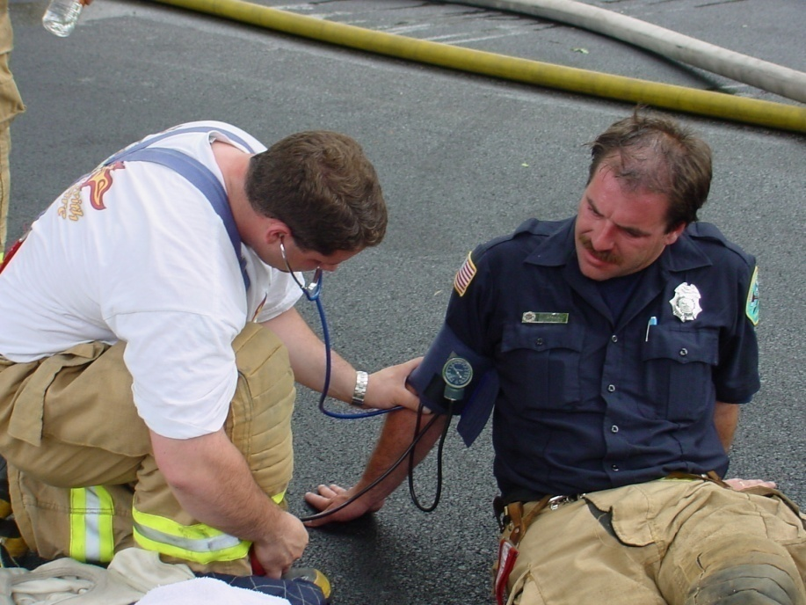
8. EMS provides medical assessment
As firefighter enters rest and recovery area, EMS personnel will check vitals (heart rate, blood pressure, respiration, and pulse)
CERT member may
be asked to assist
by recording vitals

Slide 50
9. Rest and recovery activities
Firefighters need to rest in rehab area for at least 10-20 minutes
They should sit, if at all possible
Three CERT tasks:
  Offer beverages and nutrition
  Provide cooling and warming as appropriate
  Monitor for signs of distress

Slide 51
Offer Beverages and Nutrition
Rehydration
  Have fluids available at all times
  Always offer water
  After first hour of firefighting, provide a sports drink containing electrolytes
Nourishment
  Have appropriate food available in rehab area
  During long operations, encourage firefighters to eat

Slide 52
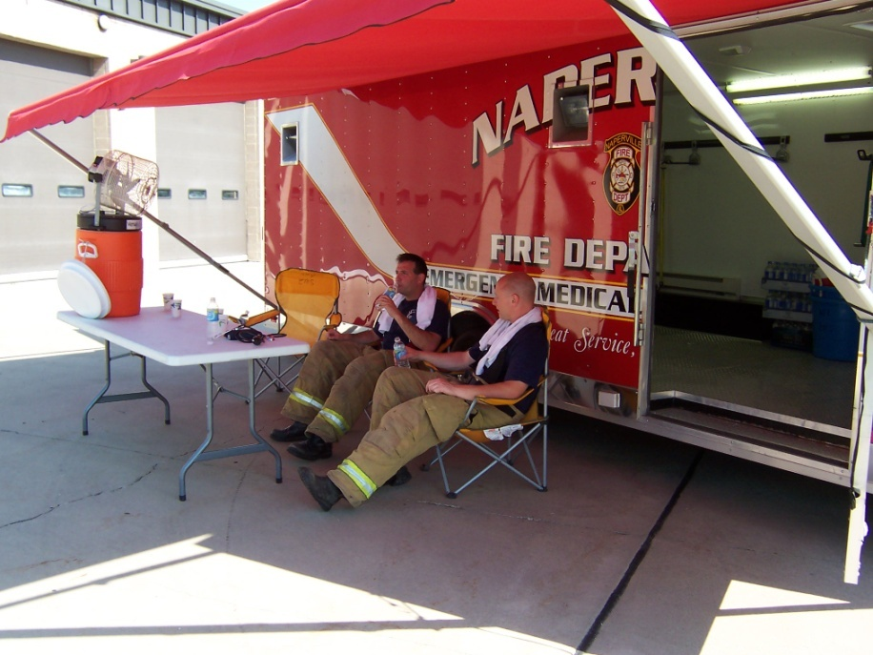
Provide Cooling - Passive
Remove gear and allow the body to cool naturally
Sit in shaded area
Drink cool or
iced fluids

Slide 53
Provide Cooling - Active
Active cooling situations
  Whenever there is potential for heat stress
  After second and each subsequent SCBA tank
Guidelines
  Put wet towels on head and neck
  Sit in front of misting system/fan or in air-conditioned area
  Submerge hands and arms in water

Slide 54
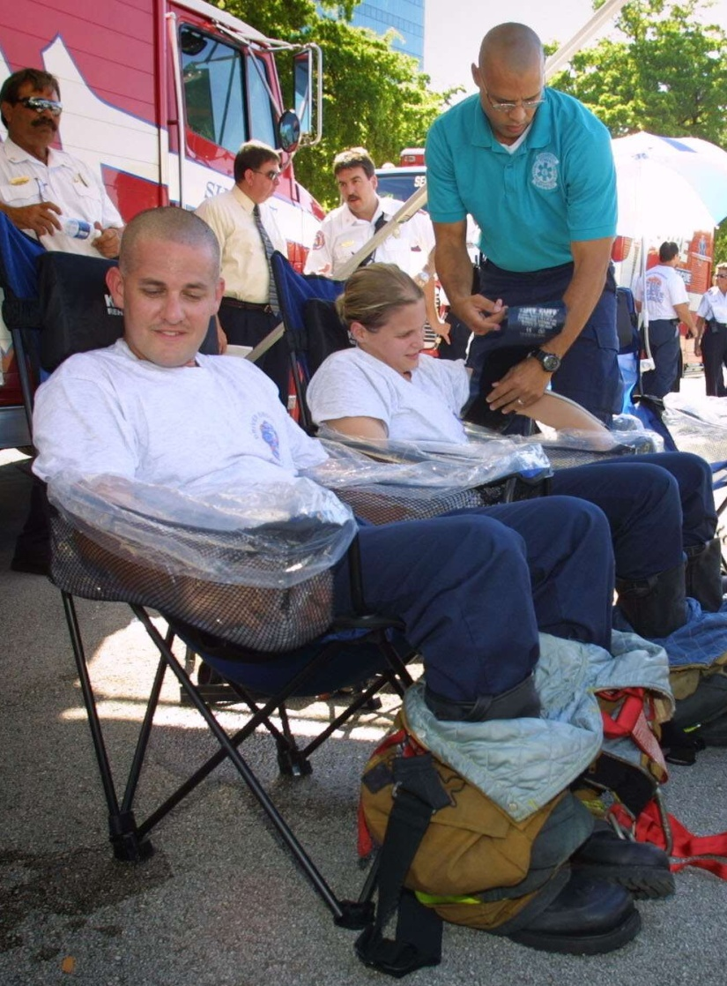
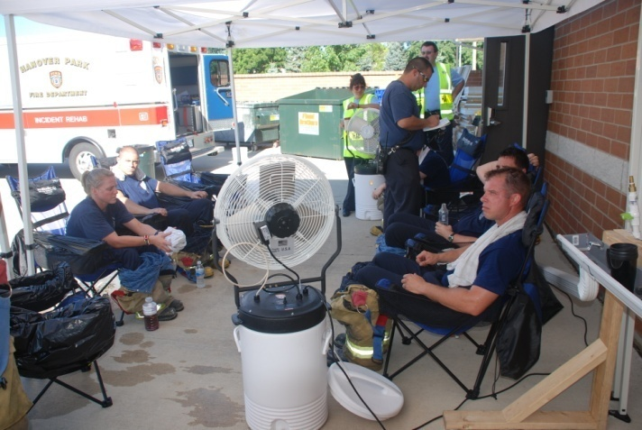
Provide Cooling – Active (cont’d)

Slide 55
Provide Warming
Have firefighters move to dry, heated area protected from elements (wind, snow, rain)
ONLY remove wet gear if there is heated area and warm, dry clothing available
  Offer dry socks or clothing if gear is removed
Encourage firefighters to drink warm fluids

Slide 56
Monitor Physical Status
Expect firefighters to be hot, flushed, sweaty, and tired
  Conditions should improve pretty quickly
Get sense of how firefighter looks when first leaving fire in order to gauge improvement

Slide 57
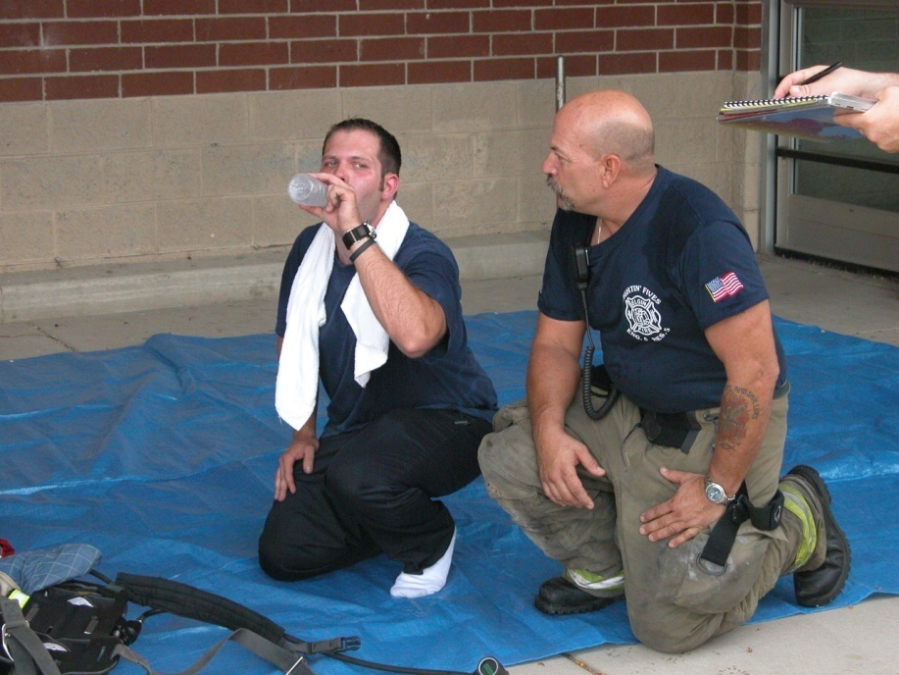
Check Mental Status
Can firefighter make eye contact?
Is firefighter oriented to person, place, and time?
Can firefighter
respond
coherently and
logically?

Slide 58
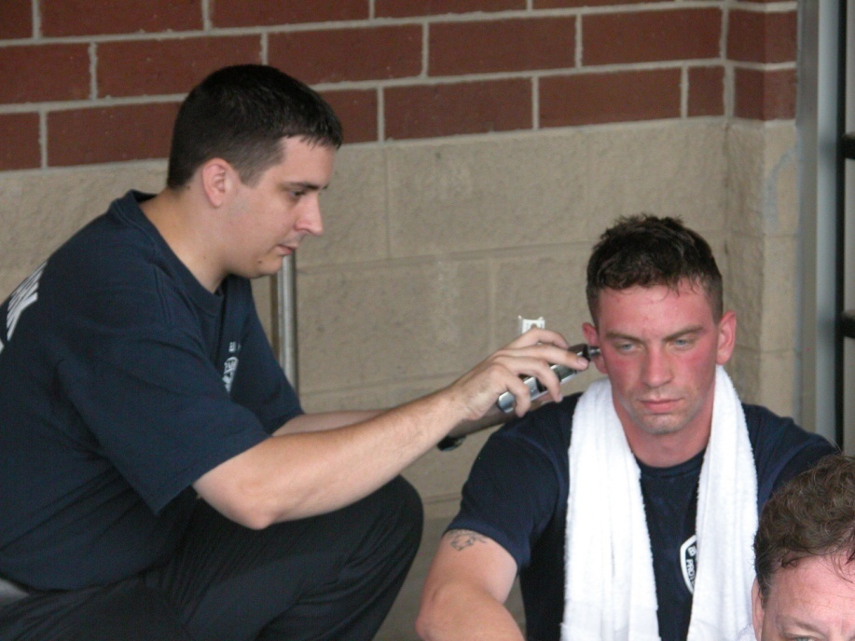
Watch for Signs of Distress
Look for signs of heat stress/dehydration
In cold weather, look for signs of cold stress
Watch for signs
of a cardiac event

Slide 59
10. If a firefighter is distressed
If you see any indication that firefighter is in trouble, notify rehab leader immediately
  Indication may be as simple as “I don’t feel good”
Rehab leader will notify EMS; may alert Incident Command
EMS will then be responsible for treatment

Slide 60
11. Firefighters sign out
All firefighters must sign out
  Departure times are recorded on Rehab Area Check-In/Check-Out Sheet

Slide 61
One Exception
Some jurisdictions may allow member of the rehab team to leave the rehab area
If so, CERT members should provide water closer to the fire scene to assist firefighters with self-rehab

Slide 62
Activity
Rehab Area Operations
55 minutes:
Detailed instructions are provided in Participant Manual.
  Identify initial roles: 3-4 minutes
  Set up rehab area: no more than 5 minutes
  Process firefighters: about 25 minutes
Notes:
61

Slide 63
Module Summary
Introduction and Overview
Physiological Threats to Firefighters
The Incident Scene
The Rehab Area
The Rehab Process

