Slide 1



Exercise Swaps
Community Emergency
Response Team

Slide 2
Participant Introductions
Introduce yourself to the class
Notes:
1

Slide 3
Administrative Announcements
Breaks
Emergency exits
Restrooms
Smoking policy
Silence cell phones
Module completion requirements
Notes:
2

Slide 4
Module Goals
To prepare CERT members to design and conduct a full-scale exercise for another team
To allow each team to make substantial progress on the development of an exercise plan that meets the needs of its partner team

Slide 5
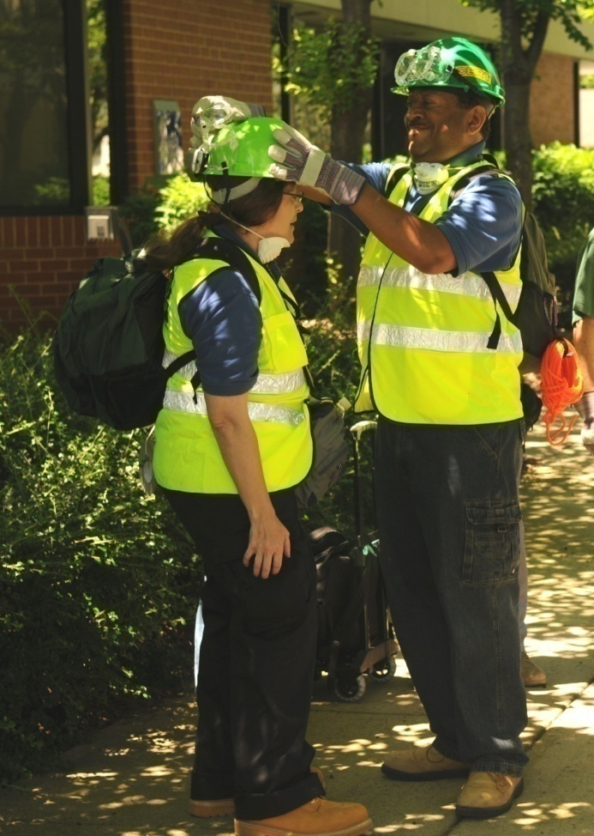
What You Will Learn
FEMA Exercise Guidance
Criteria for a Well-Designed Exercise
Steps and Documents
Best Practices
Notes:
4

Slide 6
Module Objectives
At the end of this module, you will be able to:
Explain the value of designing, conducting, and evaluating exercises in a systematic way
Explain the value of exercise swapping
Explain that FEMA has developed national guidance for the design, conduct, and evaluation of exercises

Slide 7
Module Objectives (cont’d)
At the end of this module, you will be able to:
Identify the basic steps in the exercise process
Create an operations-based exercise that meets the criteria of good exercise design
Explain how to conduct an exercise
Explain how to evaluate an exercise

Slide 8
Module Materials
Participant Manual
  To use during the training
  For later reference
Appendix
  All the documents and forms needed to plan and conduct an exercise
  Teams will complete much of it during training

Slide 9
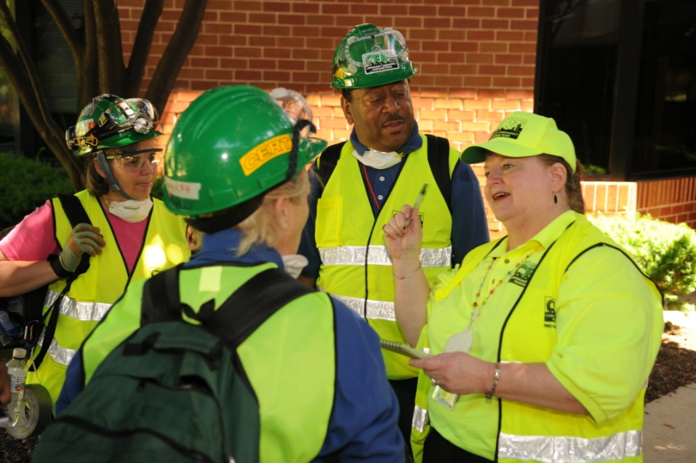
What Do You Think?
Think about a full-scale training exercise
  What was valuable?
  What could have been improved?

Slide 10
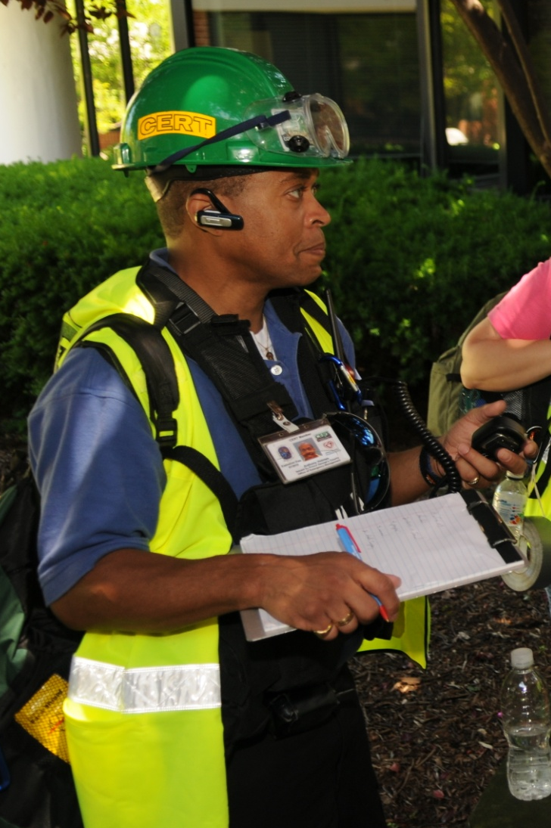
Exercise Types
Discussion-based
  Tabletop
  Functional
Operations-based
  Drill
  Competitive event
  Full-scale

Slide 11
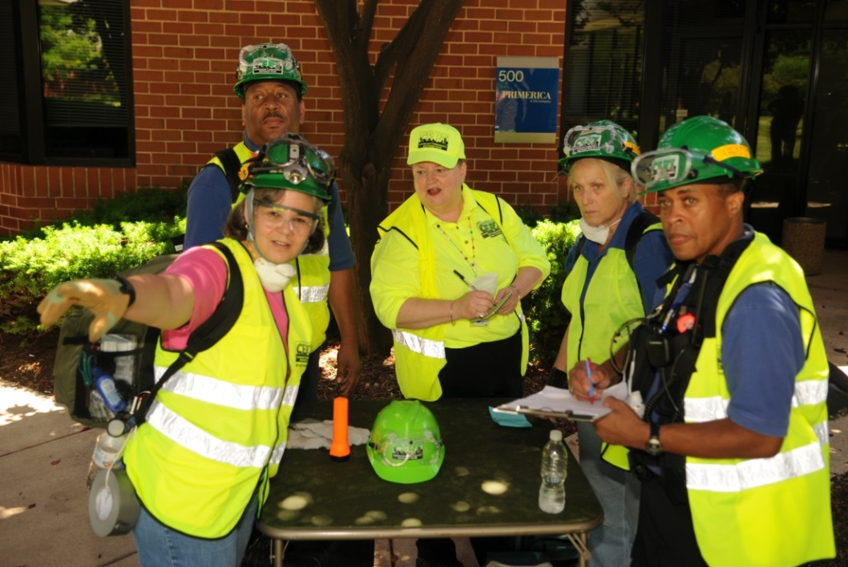
Exercise Participants
Facilitator
Evaluator
Safety Officer
Players
Volunteer actors
Volunteer survivors
Other volunteers

Slide 12
What Do You Think?
Think about your team. What are some advantages for your team to conducting an operations-based exercise?

Slide 13
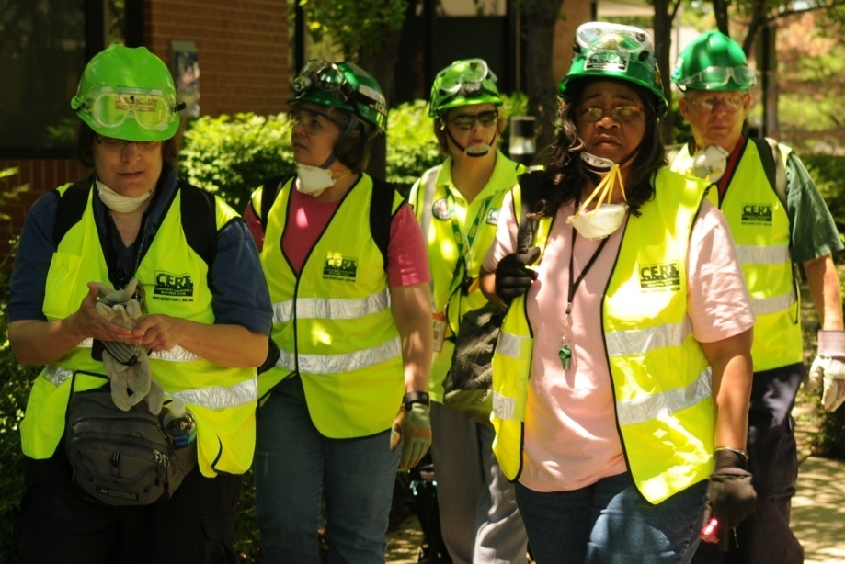
Operations-Based Exercises: Advantages
Test effectiveness of plans and procedures
Test new plans
and procedures
Practice existing skills
Learn new skills
Build effectiveness
and efficiency in executing plans
Identify strengths, areas for improvement

Slide 14
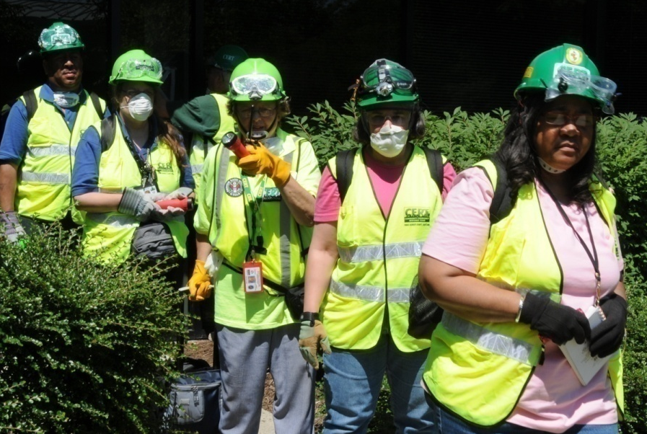
Indirect Benefits
Builds team coherence
Engages volunteers
Demonstrates CERT’s value to community and stakeholders

Slide 15
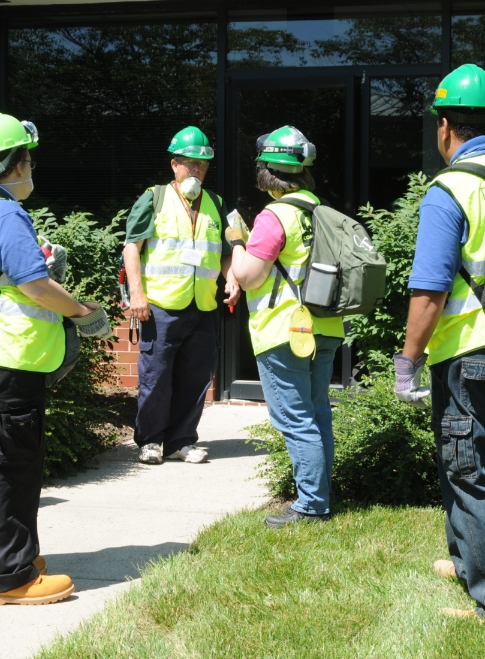
Exercise Swap Defined
Two teams work together to:
  Develop exercise plan for partner team
  Conduct the planned exercise for partner team
A systematic way to partner locally

Slide 16
What Do You Think?
What are some benefits to a team of swapping exercises with another team?

Slide 17
Benefits of Exercise Swaps
CERT program will be able to conduct more exercises for its members
CERT members will be able to exercise in their own service area
Exercise designers will learn about another team’s organization and operations

Slide 18
FEMA Exercise Guidance
  DHS provides framework for conducting and evaluating exercises in a systematic way: Homeland Security Exercise and Evaluation Program (HSEEP)
National CERT Program uses this guidance to develop materials and templates

Slide 19
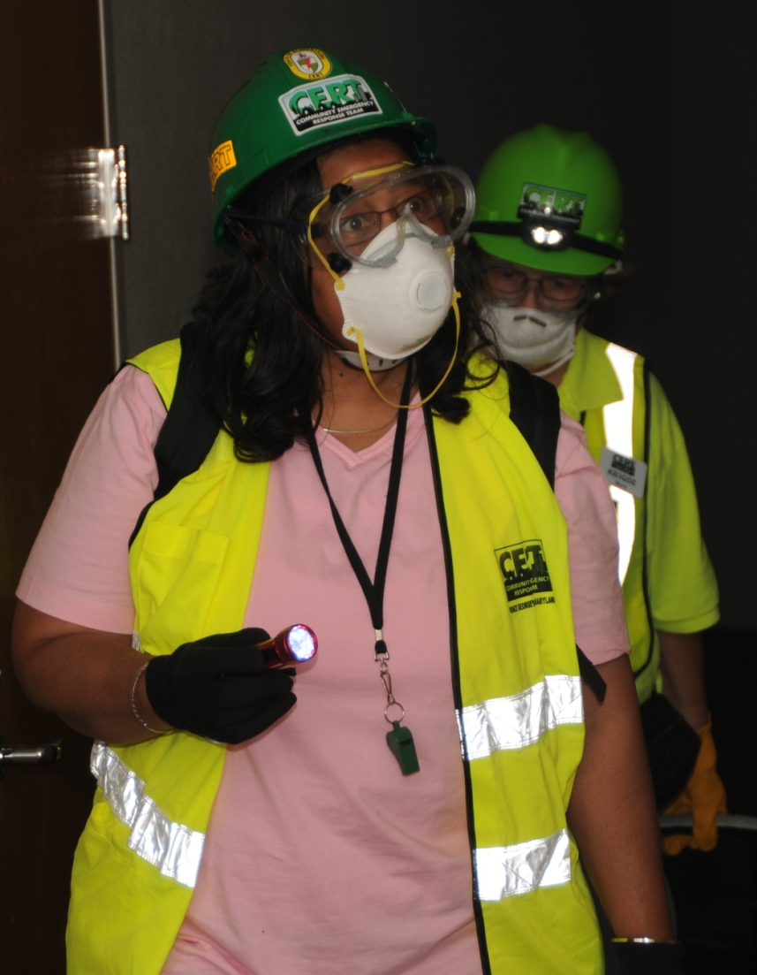
Advantages Of Being Systematic
Improves planning
Lends rigor and structure to exercises
Creates a common vocabulary with other emergency planners

Slide 20
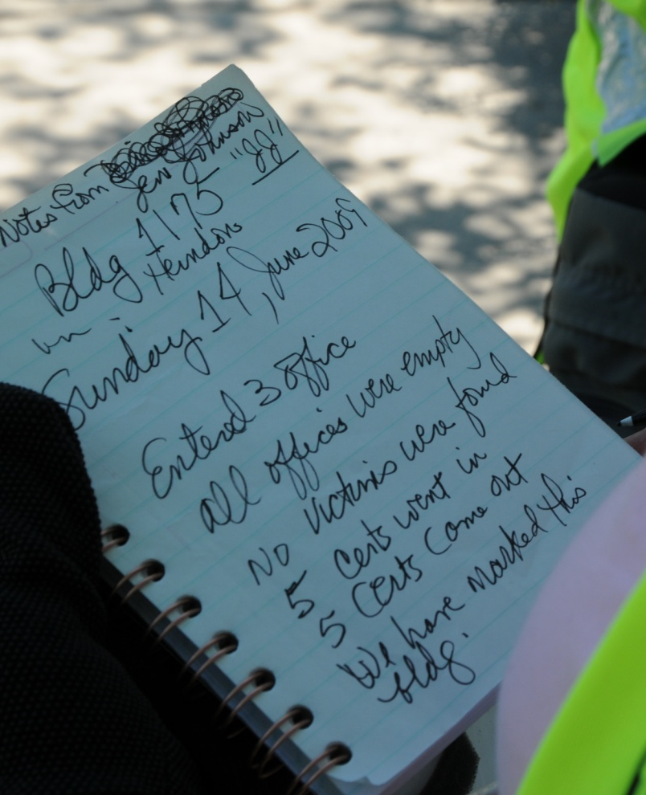
Advantages Of Being Systematic (cont’d)
Creates data that can be collected and used by partners
Identifies skills requiring additional training
Allows for uniformity and easy swapping

Slide 21
Activity
List the Criteria for a
Well-Designed Exercise
Notes:
20

Slide 22
Steps In The Exercise Process
  Step 1: Assess Needs
  Step 2: Design an Exercise
  Step 3: Plan for the Exercise
  Step 4: Conduct the Exercise
  Step 5: Debrief the Exercise
  with a Hot Wash
  Step 6: Write an After Action
  Report
Do Not Skip Steps

Slide 23
Step 1: Assess Needs
Hazards
  What are the hazards in our community?
  What hazard(s) are most likely to occur?
  What is the impact a particular hazard may have on our community?
Plans and procedures
  What procedures need to be practiced?
  What procedures have caused difficulty in the past?

Slide 24
Step 1: Assess Needs (cont’d)
“Needs” are the highest priority hazards that CERT might respond to and the procedures most in need of practice
Needs Assessment

Slide 25
Activity
Conduct a Needs Assessment
30 minutes:
Each team completes sections 1, 2, 3, and 4
40 minutes (20 minutes each):
Partner teams share and discuss two Needs Assessments
Notes:
24

Slide 26
Step 2: Design an Exercise
Exercise plan provides details for the exercise:
  What will be tested
  How it will be tested
Exercise Plan

Slide 27
Step 2: Exercise Objectives
Objective is statement of what procedure exercise will test
  Should directly involve procedures that partner team identified in Needs Assessment as needing practice
Should be clear, concise, and observable
  Objective that meets those criteria is easy for Evaluator to assess

Slide 28
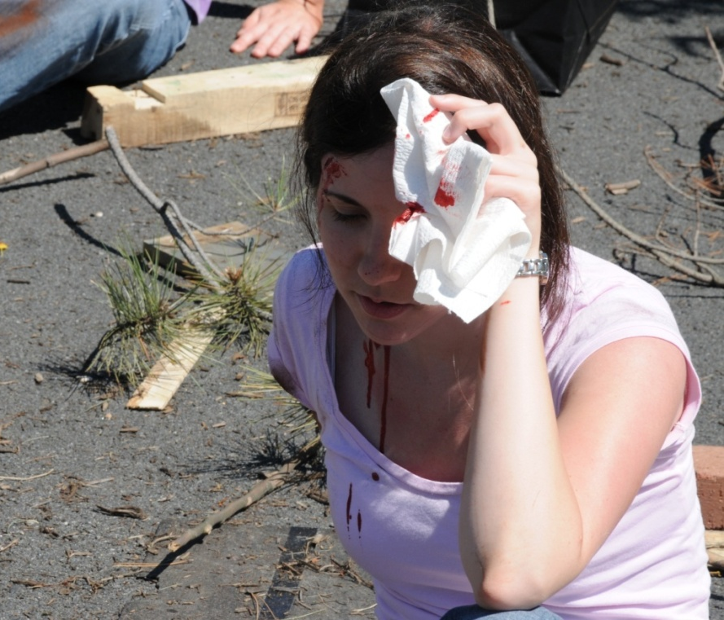
Step 2: Exercise Objectives (cont’d)
Focus is on execution of a procedure, not demonstration of a skill
Good verbs:
  Assess
  Evaluate
  Validate
  Test

Slide 29
Activity
Write Exercise Objectives
10 minutes:
Develop objectives for partner team
30 minutes (15 minutes each):
Partner teams
  Present objectives
  Get feedback and revise objectives
  Get written acceptance of objectives
Notes:
28

Slide 30
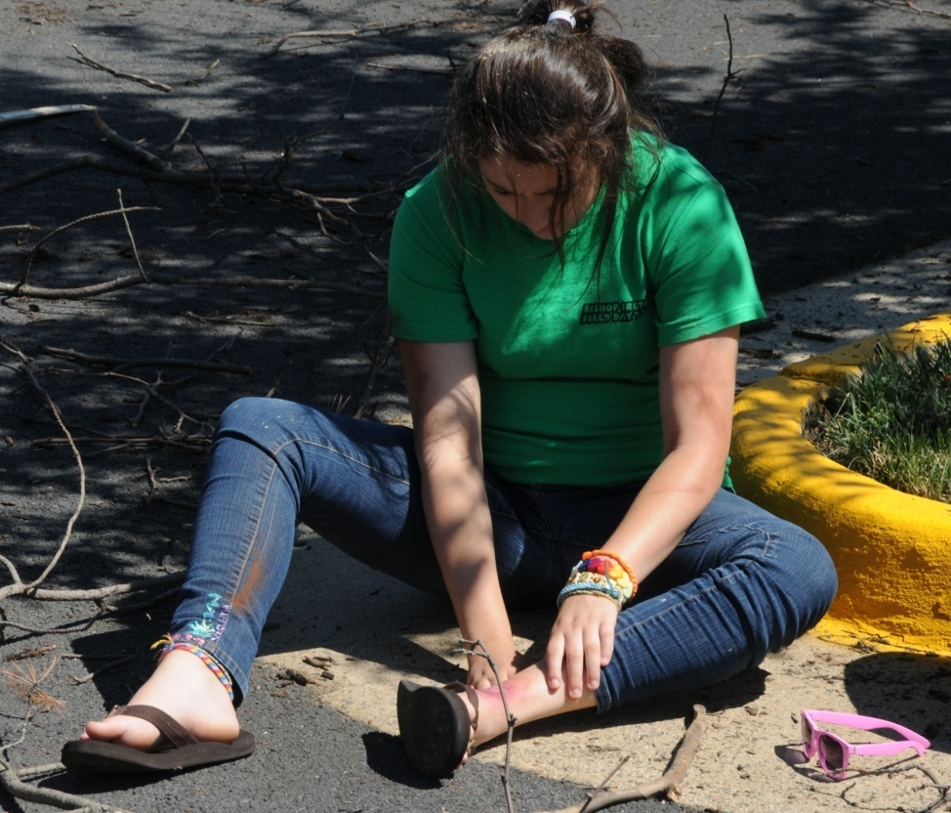
Step 2: Scope
Type of emergency/hazard
Location
Capabilities to be practiced
Participants/ Organizations
Duration
Exercise type

Slide 31
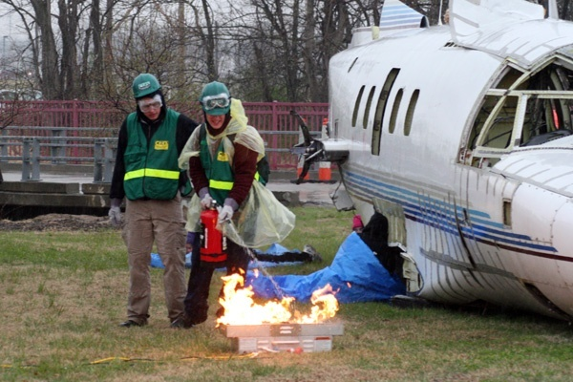
Step 2: Scenario
Brief description of events that have occurred up to time exercise begins
Sets mood for exercise and sets stage for later action

Slide 32
Step 2: Scenario (cont’d)
Key ingredients
  Addresses hazard identified in Needs Assessment
  Tests exercise objectives
  Provides appropriate practice opportunities for CERT members
  Can be conducted in available location

Slide 33
Step 2: Events and Evaluation Form for Facilitator(s) and Evaluator(s)
How well did players achieve objectives and respond to unforeseen events?
Contents
  Exercise objectives and events/messages
  Expected action by team
  Documentation of team response

Slide 34
Activity
Write An Exercise Plan
20 minutes:
Complete Scope
Develop Scenario
Notes:
33

Slide 35
What You Learned – Part 1
Reviewed exercises
  Types of exercises
  Who is involved
  Importance of being systematic
Discussed exercise swaps
  How they work
  Benefits of doing them
Reviewed criteria for well-designed exercise
Started working through 6 steps of exercise process
  Assess Needs
  Design an Exercise

Slide 36
What You Will Learn - Part 2
Complete Step 2: Design an Exercise
Work through Step 3: Plan for the Exercise
Talk briefly about the final three steps:
  Conduct the Exercise
  Debrief the Exercise with a Hot Wash
  Write the After Action Report

Slide 37
Exercise Swaps – Part 2
Community Emergency
Response Team

Slide 38
What You Will Learn - Part 2
Complete Step 2: Design an Exercise
Work through Step 3: Plan for the Exercise
Talk briefly about the final three steps:
  Conduct the Exercise
  Debrief the Exercise
  Write the After Action Report

Slide 39
Activity
Write An Exercise Plan (continued)
45 minutes:
Review Exercise Plan
Complete Events and Evaluation Form for Facilitator(s) and Evaluator(s)
Notes:
38

Slide 40
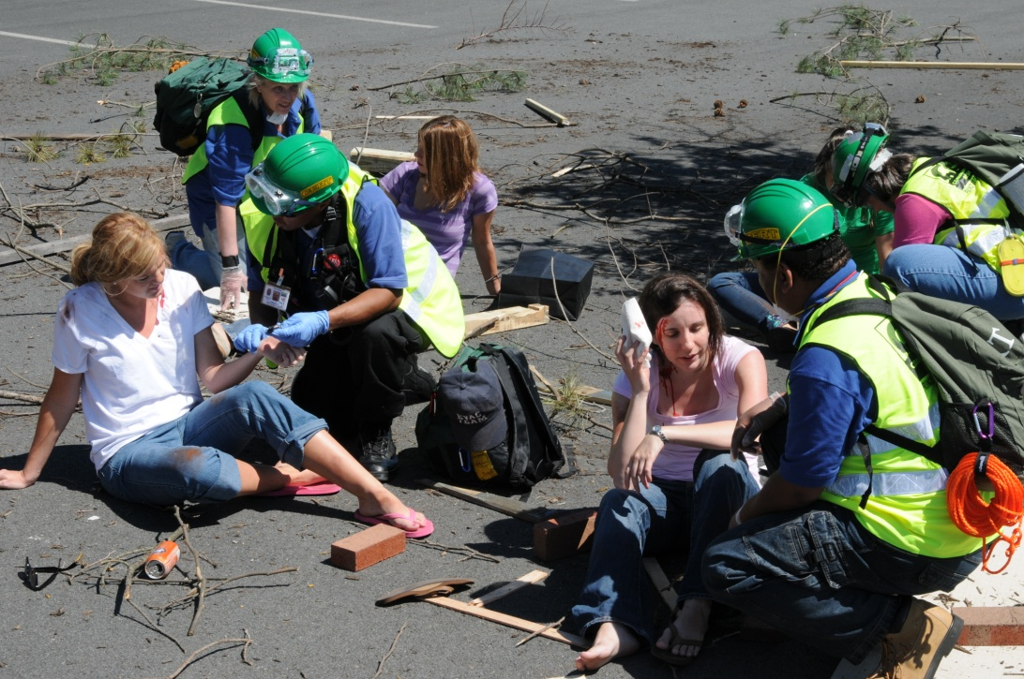
Step 3: Plan for the Exercise
Step 3 plans
logistics for
exercise

Slide 41
What Do You Think?
What are some logistical considerations when planning for an exercise?

Slide 42
Step 3: Plan For The Exercise
Logistics Plan
  Planning Considerations
  Site Selection and Setup
  Materials List
  Logistics Assignments
  Schedule
  Map(s)
  Survivor Injury/Actor Profile Cards
  Briefing Guides
    Player
    Exercise Staff
    Lead Facilitator
Logistics Plan

Slide 43
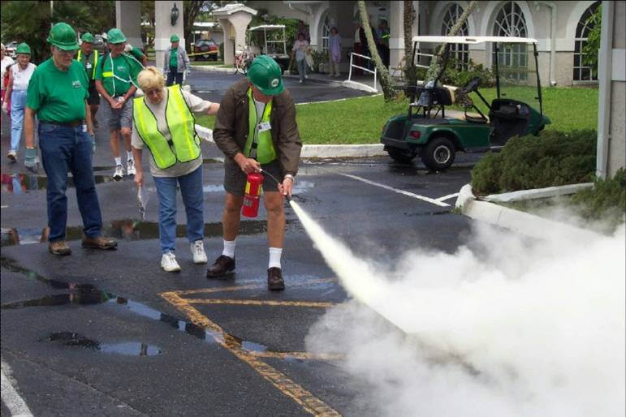
Site Selection And Setup
Realistic given scenario
Sufficient parking
Enough space
Permission to use site

Slide 44
Activity
Develop the Logistics Plan
60 minutes:
Facilitator
Possible site
Materials List
Logistics Assignments
Tentative Exercise Schedule
3-5 Actor Profiles

Slide 45
Step 4: Conduct the Exercise
Set up the exercise site
Have all players sign in
Brief all players
  Exercise staff
  Team members
  Volunteer role-players
Begin the exercise

Slide 46
Step 5: Debrief the Exercise with a Hot Wash
Conduct participant hot wash to gather feedback and to reinforce learning
  With CERT members and role-players
  Immediately following exercise
  Reflections and feedback collected verbally
  Participant Feedback Forms completed and collected

Slide 47
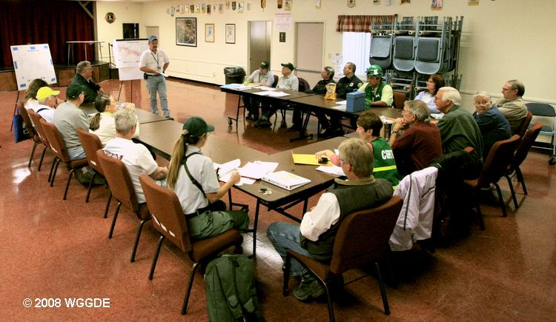
Step 5: Debrief the Exercise (cont’d)
Conduct exercise staff hot wash to identify strengths and weaknesses
  Best if immediately after participant hot wash
  Observed CERT procedures discussed
  Evaluation forms
  collected
  Facilitator/Evaluator
  Feedback Forms
  completed and collected

Slide 48
Step 6: Write the After Action Report
      Documents effectiveness of exercise
      Serves as basis for planning future exercises, upgrading plans, and taking corrective action
    After Action Report

Slide 49
What Do You Think?
What are some unexpected challenges a team might encounter when conducting the exercise?
How can you overcome those challenges?

Slide 50
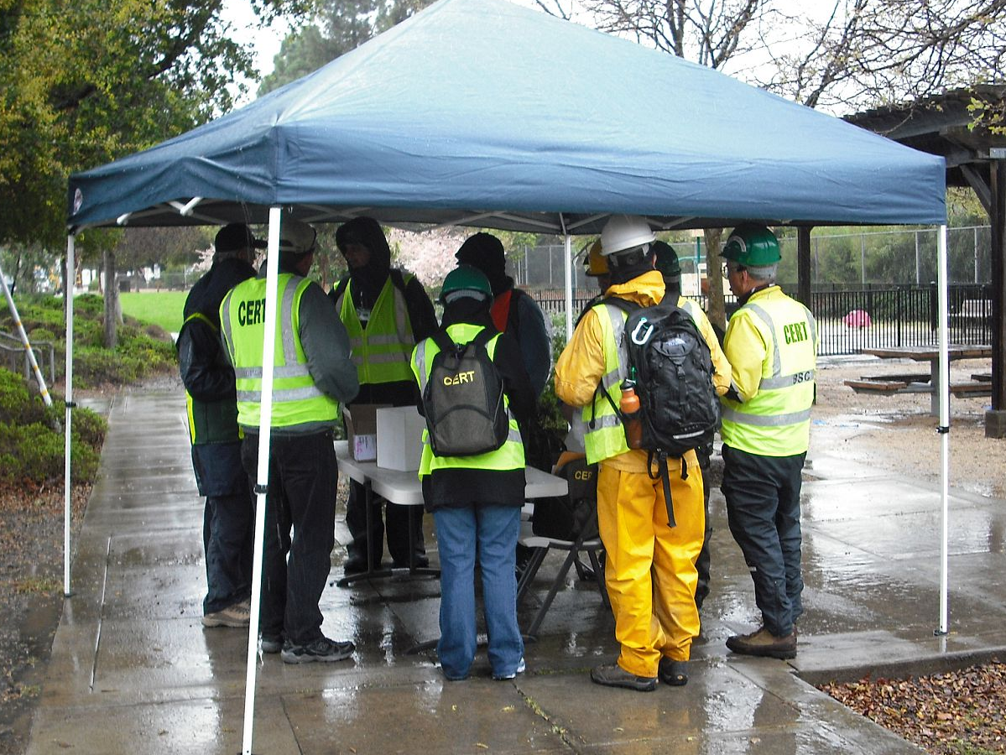
Challenges During Exercises
Disruptive volunteers
Inadequately prepared actors
Unforeseen weather
Pace too slow

Slide 51
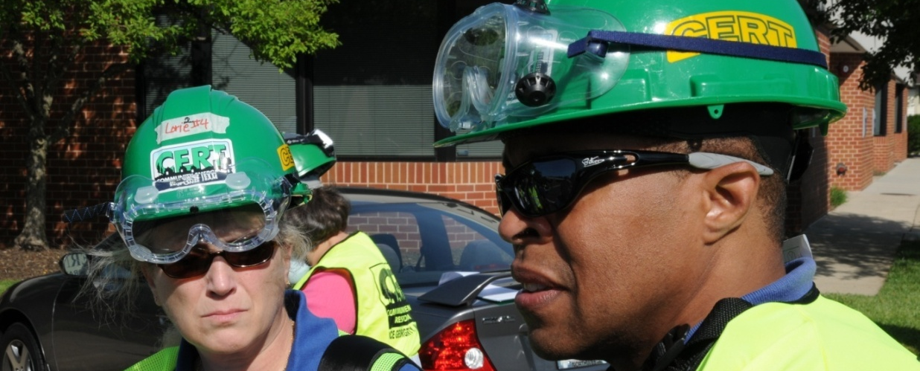
Mechanics of Exercise Swaps
Meetings and communication
Roles and responsibilities
Documents and information to be exchanged

Slide 52
Report Your Results
Provide complete Exercise Plan and After Action Report CERT to Program Manager or representative
Allows other design and player teams, and CERT program itself, to apply lessons learned from this exercise swap

Slide 53
Module Summary
Overview: Exercise Types, Players, and Format
Steps and Documents
Best Practices

