Slide 1




Emergency Communications
Community Emergency
Response Team

Slide 2
Module Learning Objectives
Describe the importance of communications in emergency response
Describe the various roles of CERT in communications during an activation
Describe how to use a communications plan

Slide 3
Module Learning Objectives (cont’d)
Identify communication modes used in emergency response
Describe how to properly communicate using communications devices
Use tactical call signs and pro-words to make and acknowledge a call

Slide 4
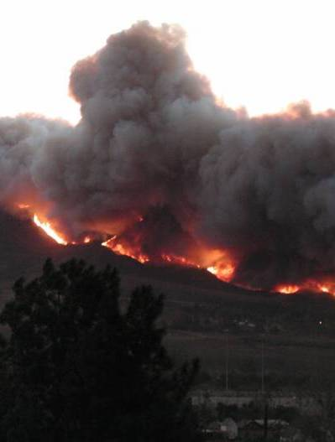
Introduction
Effective communications is the greatest logistical problem during an emergency event
CERT volunteers can be part of the solution

Slide 5
Introduction
Communications in disasters
  Hurricane Katrina
  September 11th
  Mineral, VA, earthquake
  Local examples

Slide 6
Overview
Role of CERT emergency communications during an activation
Communications plans
Communication modes
Basic radio anatomy
Communications operations
Practical exercises

Slide 7
Role of CERT Emergency Communications
Intra-team communications
  Allows volunteers to quickly and effectively communicate with each other
  Essential for functions such as light search and rescue and when dealing with large crowds
  Other examples?

Slide 8
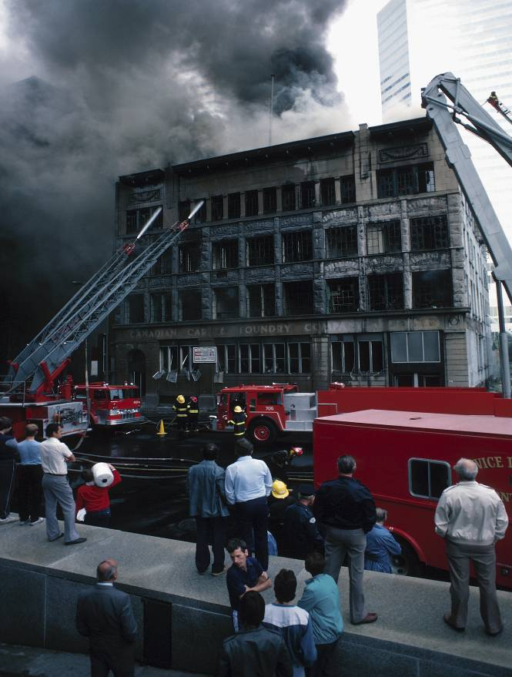
Role of CERT Emergency Communications (cont’d)
Communicating up to the next level
  Tiers of communication
  CERT volunteers are “eyes and ears”

Slide 9
Role of CERT Emergency Communications (cont’d)
Effective communications promotes safety
  Calling for help when needed
  Reporting safety-related incidents or concerns
  Accountability – Team leader keeping track of team members

Slide 10
Communications Plan
What is a communications plan?
  Logistical emergency plan
  Who communicates to whom
  How information flows

Slide 11
Communications Plan (cont’d)
Jurisdiction plan
  How different emergency response groups interact
  Role of CERT in jurisdiction plan

Slide 12
Communications Plan (cont’d)
Jurisdiction plan
  Insert local specifics here
  Insert local specifics here
  Insert local specifics here

Slide 13
Communications Plan (cont’d)
CERT Communications Plan
  How the CERTs are activated and volunteers are contacted
  How CERT members communicate with each other
  How CERT communicates to other emergency responders
  Fits into jurisdiction plan

Slide 14
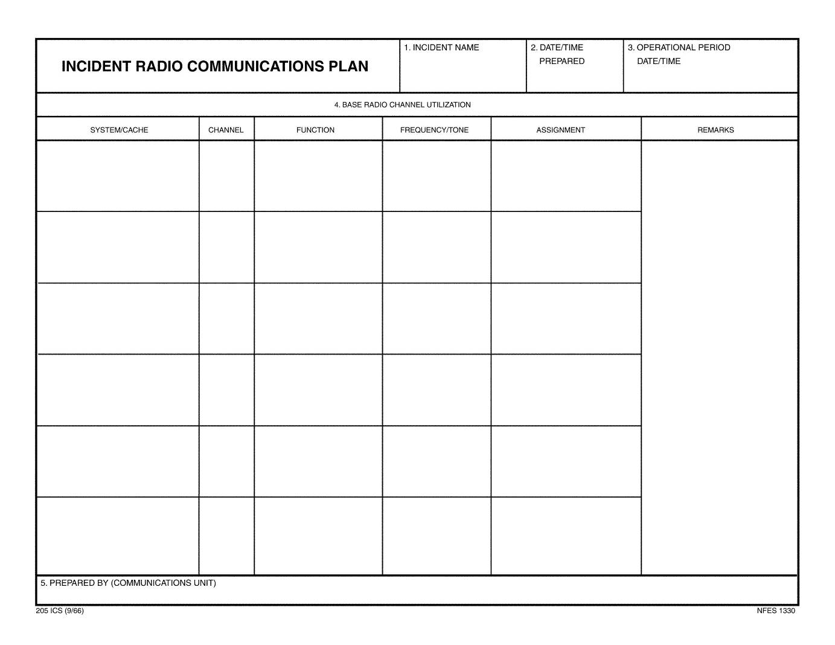
Communications Plan (cont’d)
ICS 205

Slide 15
Communications Plan (cont’d)
Notes:
Communications plan diagram

Slide 16
Communications Plan (cont’d)
Command
Other
Agencies
Team B
Leader
Team A
Leader
A1
B1
A2
B2
A3
B3
Notes:
Communications plan diagram (completed)

Slide 17
Communications Modes
Methods or technologies used in communications
Advantages and disadvantages
Runners, phones, radios, and computers

Slide 18
Communication Modes (cont’d)
Runners
Landline telephone
Cell phone
Two-way radio
Computer communications
Satellite phone

Slide 19
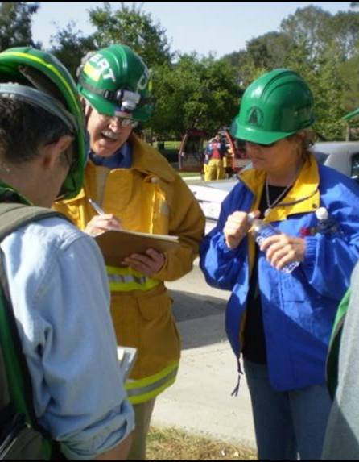
Runners
Advantages
  Reliability
  Flexibility
  Familiar with environment
  Availability
  No special training

Slide 20
Runners (cont’d)
Limitations
  Distance and time
  Requires written information for accuracy
  Availability
    Deplete your team
  Requires familiarity with the area

Slide 21
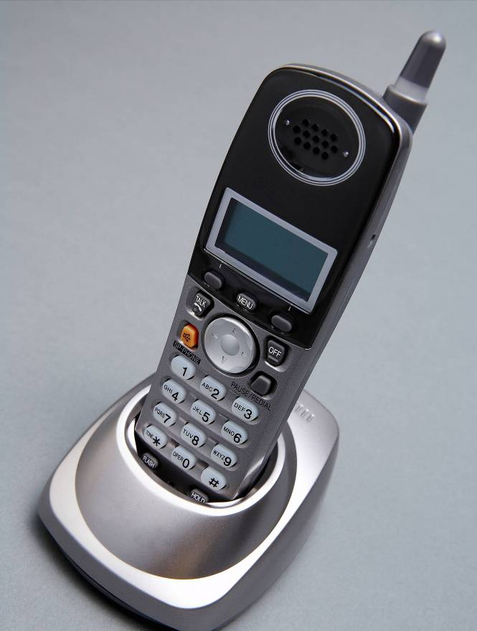
Landlines
Advantages
  Familiarity
  Commonplace
  Enhanced 9-1-1
  Data transfer

Slide 22
Landlines (cont’d)
Limitations
  Not mobile
  System overloads easily
  Network can sustain physical damage
  Power failure may/may not affect
    Corded phones vs. cordless phones
    Digital phones
    Voice Over Internet Protocol (VOIP)

Slide 23
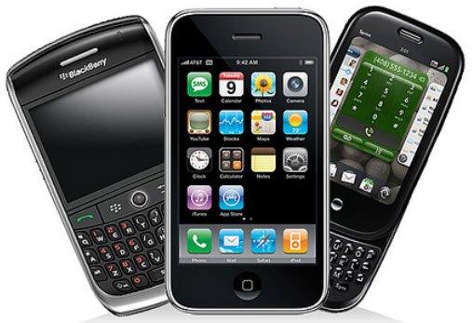
Cellular Phones
Advantages
  Familiarity
  Mobility
  Commonplace
  Text messaging
    Requires less bandwidth – may get through when voice will not
  Camera phones
Image from: https://www.linkedin.com/pulse/20140625151115-13006814-4th-amendment-protects-cell-phones

Slide 24
Cellular Phones (cont’d)
Limitations
  Towers may fail due to power outage or damage
  System overloads easily
  Requires knowledge of phone numbers
  May be dependent on landlines

Slide 25
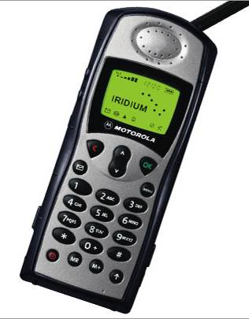
Satellite Phones
Advantages
  Always on
  Global operation
Disadvantages
  Expensive
  Rare
  Requires visibility to sky, or building with compatible antenna
Image from: http://www.bluecosmo.com/satellite-phones

Slide 26
Computer Communications
Advantages
  May work when other systems are down
  Provides electronic record
  Versatile network connections
  Relatively secure
  Large amounts of information
  Formatted/preformatted information
  Thumb drives and discs do not require Internet
  Information redistribution

Slide 27

Computer Communications (cont’d)
Limitations
  Equipment may not be mobile
  May require Internet connectivity
  Requires specific hardware
  Expensive
  Requires power source

Slide 28
Two-way Radio Communications
What is it?
Organizations
  Federal Communications Commission (FCC)
  Amateur Radio Relay League (ARRL)
  Amateur Radio Emergency Service (ARES)
  Radio Amateur Civil Emergency Service (RACES)

Slide 29
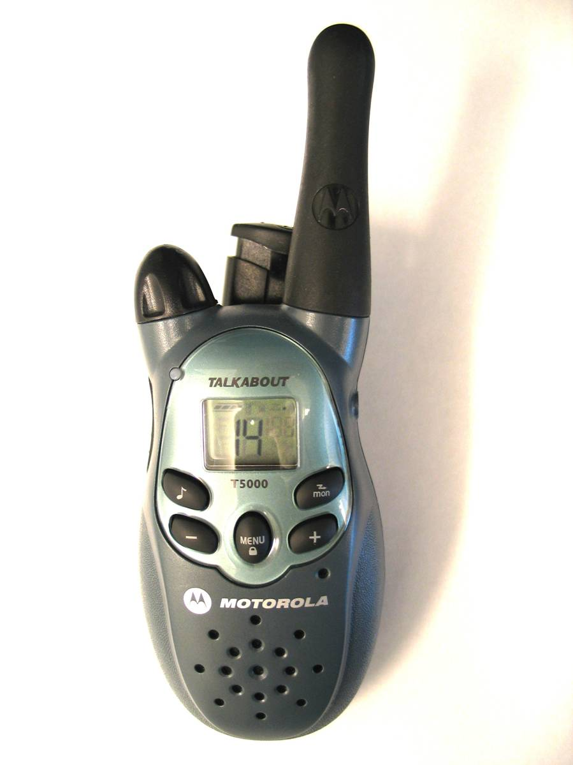
Two-way Radios
How they work
  Frequencies
  Channels
  Range
    Antenna, power level, atmospheric conditions
    Repeater vs. simplex

Slide 30
Two-way Radios (cont’d)
Family Radio Service (FRS)
  Advantages
    Inexpensive
    Widely used
    No license required
    Range up to 1 mile (varies with terrain)
    14 channels
    Shared communication with GMRS radios
    Best used for intra-team communications

Slide 31
Two-way Radios (cont’d)
FRS
  Limitations
    Hard to find (most are hybrids)
    Handheld only
    Cannot alter radio (no antennas) = Limited range

Slide 32
Two-way Radios (cont’d)
General Mobile Radio Service (GMRS)
  Advantages
    Inexpensive
    Range of 2-5 miles (varies with terrain)
    Best used for intra-team communications
    Base station or mobile
    Boost signal with external antennas or repeaters

Slide 33
Two-way Radios (cont’d)
GMRS
  Limitations
    Requires a license (one per family)
      Intended for family use
      Some business licenses are grandfathered
    Limited availability (hybrids)

Slide 34
Two-way Radios (cont’d)
FRS/GMRS Hybrid
  Channels 1-7: Shared between FRS and GMRS (no license required when operating at lower power settings)
  Channels 8-14: FRS-only channels; lower power
  Channels 15-22: GMRS-only; higher power
    Requires a license

Slide 35
Two-way Radios (cont’d)
FRS/GMRS Hybrids
  Advantages and limitations are the same as FRS radios and GMRS radios
  Widely available
  Handheld only
  Non-licensed users cannot operate on GMRS channels

Slide 36
Two-way Radios (cont’d)
Multiple-Use Radio Service (MURS)
  Advantages
    Handhelds or base units available
    3-4 mile range for handhelds
    Increase range with repeaters and external antennas
    Transmit voice or data
    No license required

Slide 37
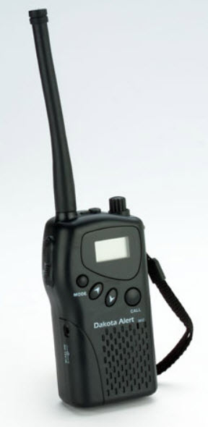
Two-way Radios (cont’d)
MURS
  Limitations
    Limited to 5 channels
    Limited availability
    More expensive than FRS/GMRS radios
Image from: http://www.dakotaalert.com/catb2b1/product_info.php?cPath=36&products_id=193

Slide 38
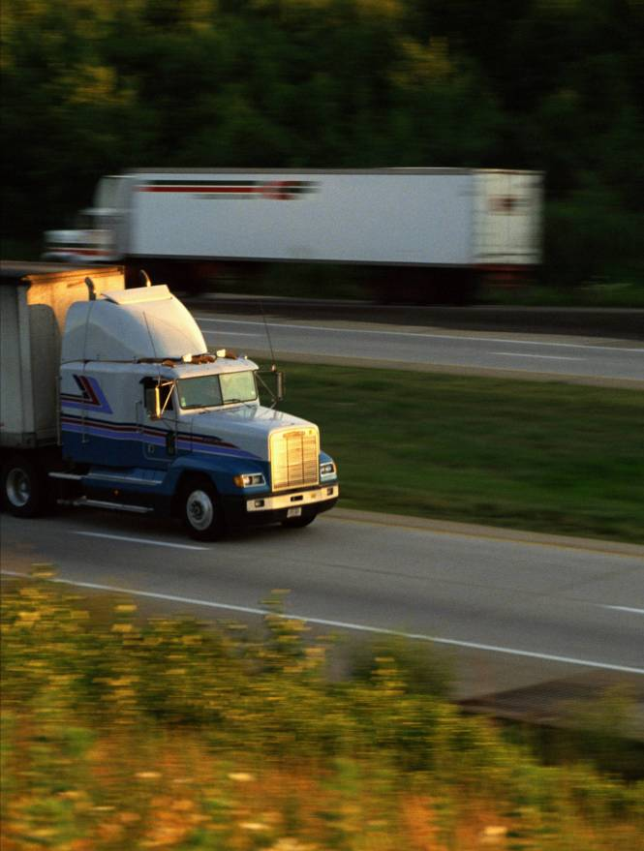
Two-way Radios (cont’d)
Citizen Band (CB)
  Advantages
    No license required
    40 channels
  Disadvantages
    Casual conversation
    Not reliable
    Not recommended for CERT use

Slide 39
Two-way Radios (cont’d)
Public Safety Bands
  Advantages
    Direct communication to emergency first responders, if authorized
    Extremely reliable
    Range up to 20 miles with simplex, 50 miles with repeaters
    Handheld, mobile, or base units

Slide 40
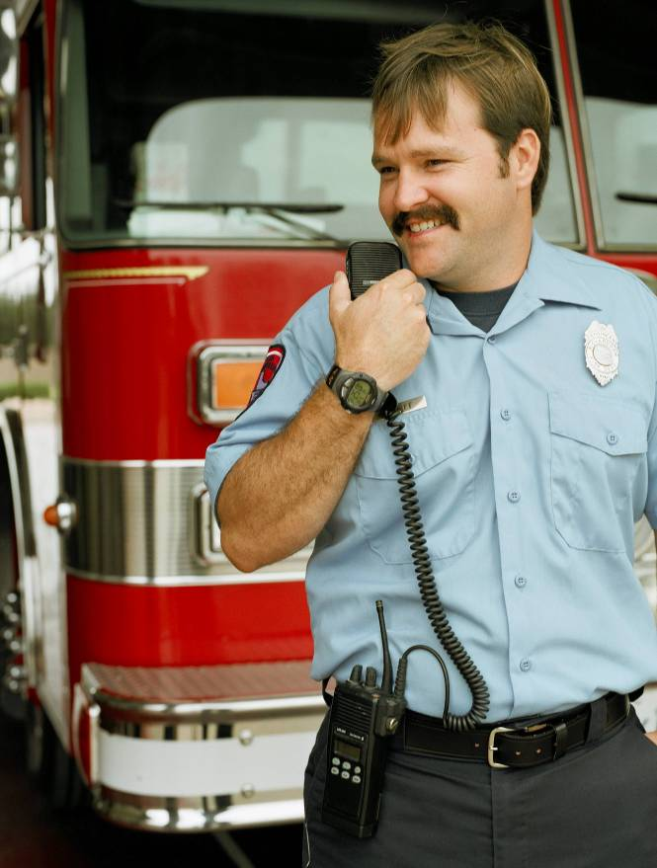
Two-way Radios (cont’d)
Public Safety Bands
  Limitations
    Requires authorization of jurisdiction
    Expensive
    Must be used with jurisdictional protocol
    Licensed to municipality or government entity

Slide 41
Two-way Radios (cont’d)
Amateur Radio (a.k.a. ham radio)
  Advantages
    Various data types (voice, text, data, photos, documents, e-mail, television)
    Range in excess of 100 miles with repeaters
    Operate using simplex or repeaters
    Good availability
    Moderately priced
    Handheld, mobile, and base stations available

Slide 42
Two-way Radios (cont’d)
Amateur Radio
  Advantages (cont.)
    Reliability
    Interoperability
    More simultaneous conversations possible
    Connect to computer
    Connect to global positioning system (GPS) and automated position reporting system (APRS)

Slide 43
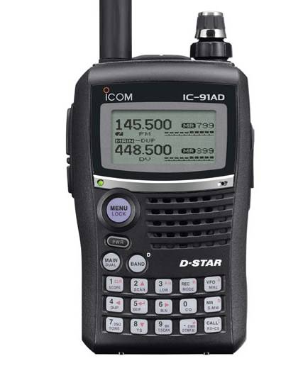
Two-way Radios (cont’d)
Amateur Radio
  Limitations
    Requires license
    No business use
    Operators cannot be paid
    Complex radios
    Complex protocols
Image from: http://www.icomamerica.com/images/products/large/91A_91AD_1.jpg

Slide 44
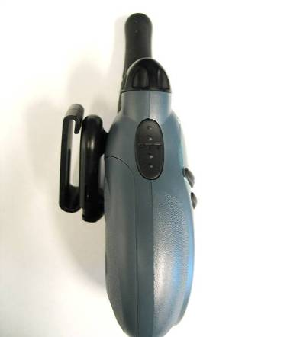
Basic Radio Anatomy
Volume & On/Off Switch
Antenna
Microphone
Push-to-Talk Button (PTT)
Speaker

Slide 45
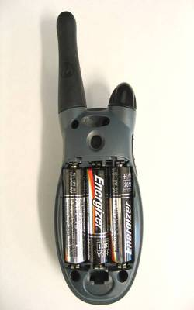
Basic Radio Anatomy (cont’d)
Battery Location
Headset Input Jack
Channel Monitor
Scan Button
Privacy Line (PL) Selector
& Lock Settings
Transmit Call Tone
Channel Selector

Slide 46
Basic Radio Anatomy (cont’d)
Battery Location
  Changing and charging batteries
  Radio unusable when charging
  Battery substitution
  Carry extra batteries
  Don’t overcharge
SAFETY NOTE: Alkaline batteries are NOT rechargeable

Slide 47
Basic Radio Anatomy (cont’d)
Privacy Line Selector
  Privacy codes
  Not really “private”
  Not standard from model to model
  Blocks who you can hear, not who can hear you

Slide 48
Net Operations
Net Control Operator
  Radio “traffic cop”
  Coordinates radio traffic
  Duties:
    Direct you to call
    Direct you to stand by
    Prioritize calls based on nature of message
    Direct you to a different channel

Slide 49
Tactical Call Signs
Assigned by Net Control Operator
Based on function and location
Names are not needed
Tactical call signs do not change for duration of assignment

Slide 50
Tactical Call Signs (cont’d)
Making a call
Acknowledging a call
Transmitting a message
Acknowledging receipt of message
Terminating a call
Amateur radio call signs

Slide 51
Radio Use
Speak across the microphone
“Echo principle”
Keep antenna vertical
Improving reception
  Elevation
  Moving around
  Rotation

Slide 52
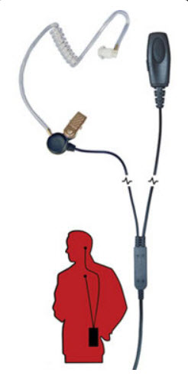
Radio Use (cont’d)
Headsets with microphones
  Hands-free use
Keep radios on
Image from: http://www.planetheadset.com/motorola-radio-accessories.php?type=earpiece#top

Slide 53
Pro-Words
“All before”
“All after”
“I spell”
“Affirmative”
“Negative”

Slide 54
Phonetic Alphabet
A--Alfa
B--Bravo
C--Charlie
D--Delta
E--Echo
F--Foxtrot
G--Golf
H--Hotel
I--India
J--Juliet
K--Kilo
L--Lima
M--Mike
N--November
O--Oscar
P--Papa
Q--Quebec
R--Romeo
S--Sierra
T--Tango
U--Uniform
V--Victor
W--Whiskey
X--X-ray
Y--Yankee
Z--Zulu

Slide 55
Practical Exercise – Role-playing
Scenario: Injured Animal Encounter
  CERT: Willow Park
  Command: CERT Command
  CERT Leader: Ask for status
  Team 1: Nothing of note
  Team 2: Bridge damage
  Team 3: Nothing of note
  Team 4: Injured dog

Slide 56
Module Summary
Communications is a key component of emergency response
CERTs assist emergency response agencies by communicating through ICS
Communication plans define how to communicate during emergency response
Each communication mode has advantages and limitations
Achieve effective communication by using radio operation, tactical call signs, pro-words, phonetic alphabet, and basic protocols

Slide 57
Emergency Communications
Thank you!

Slide 58
This slide intentionally left blank.

Slide 59
This slide intentionally left blank.

Slide 60
This slide intentionally left blank.

Slide 61
Tactical Call Sign Demonstration Script A
Southwest CERT Command
NOTE: You are calling EOC. You will initiate the call.
EOC, this is Southwest CERT Command, over.
EOC, this is SW CERT Command. Send 22 stretchers to corner of 12th Street shelter near CVS, over.
EOC, this is SW CERT Command, out.

Slide 62
Tactical Call Sign Demonstration Script B
EOC
NOTE: You are responding to a call from Southwest CERT Command. They will initiate the call.
Southwest CERT Command, this is EOC, over.
SW CERT Command, this is EOC, 22 stretchers at 12th Street shelter, over.

Slide 63
Small Scenario Role-playing Card
Player 1: CERT Command
Player 2: Southeast Team Leader
Southeast Team Leader has located an individual in need of medical transportation, and needs assistance (a wheelchair)

Slide 64
Small Scenario Role-playing Card
Player 1: Info Team Leader
Player 2: Info Team Member 1
Info Team 1 is alerting citizens in the area of an evacuation notice. One family in the area lacks adequate transportation.

Slide 65
Small Scenario Role-playing Card
Player 1: CERT Command
Player 2: CERT Group Leader
CERT Command has been contacted by police, who are requesting that a CERT Group be dispatched to aid with crowd control at the corner of 5th Street and Oak Street.

Slide 66
Small Scenario Role-playing Card
Player 1: CERT Search and Rescue 1
Player 2: CERT Search and Rescue 2
CERT Search and Rescue 1 is trying to help transport a citizen on a stretcher and needs assistance.

Slide 67
Small Scenario Role-playing Card
Player 1: CERT Operations
Player 2: CERT Fire Suppression Group Leader
CERT Operations has been alerted that CERT Fire Group should be redeployed to Light Search and Rescue on Grant Avenue.

Slide 68
Small Scenario Role-playing Card
Player 1: CERT Community Center
Player 2: CERT Logistics Coordinator
CERT Community Center has seen an influx of citizens suffering from dehydration. They are running low on water at the community center.

Slide 69
Small Scenario Role-playing Card
Player 1: CERT Sandbag # 1
Player 2: CERT Command
Floodwaters are rising, and the CERT Sandbag # 1 needs more bodies to help carry sandbags.

Slide 70
Small Scenario Role-playing Card
Player 1: CERT Fire Suppression Group Leader
Player 2: CERT Fire Suppression Team 2
CERT Group Leader has been given directions from local office of emergency management to manually turn off power of homes on the block.

Slide 71
Small Scenario Role-playing Card
Player 1: CERT Fire Suppression Team 1
Player 2: CERT Fire Suppression Group Leader
CERT Fire Suppression Team 1, equipped with fire extinguishers, has found several small fires burning near homes on a residential street.

Slide 72
Small Scenario Role-playing Card
Player 1: CERT Search and Rescue A
Player 2: CERT Command
CERT Search and Rescue A is controlling bleeding on a survivor injured by a falling tree limb during a storm. Additional medical treatment and transportation may be required.

