Slide 1
CERT Animal Response II

Slide 2
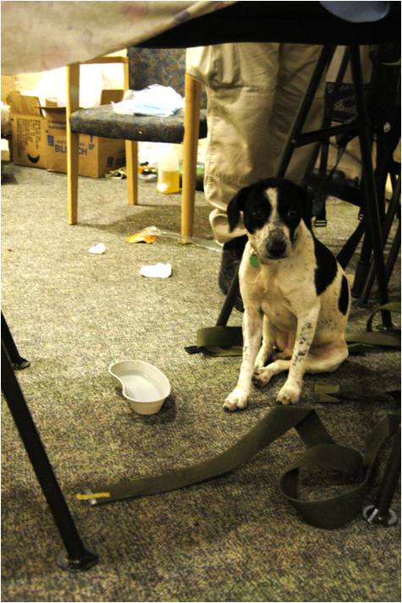
Module Purpose
The purpose of this module is to ensure that CERT members can respond safely and appropriately in emergency events involving animals.

Slide 3
Animal Categories
This module covers the following animal categories:
  Household pets and domesticated animals
  Service animals
  For-profit animals
  Non-commercial livestock
  Wildlife
  Exotic animals
Notes:
2

Slide 4
What You Will Learn
The Role of CERT in Responding to Animal Issues
CERT Responder Safety When Dealing With Animals
Knowledge and Skills Needed for CERT Functions That May Involve Animals
Sources for Additional Training and Information
Notes:
3

Slide 5
Module Objectives
Describe the CERT role in emergency functions that involve animals
Describe techniques and procedures for maintaining personal safety when dealing with animals during an emergency
Demonstrate basic skills needed to perform CERT functions that may involve animals

Slide 6
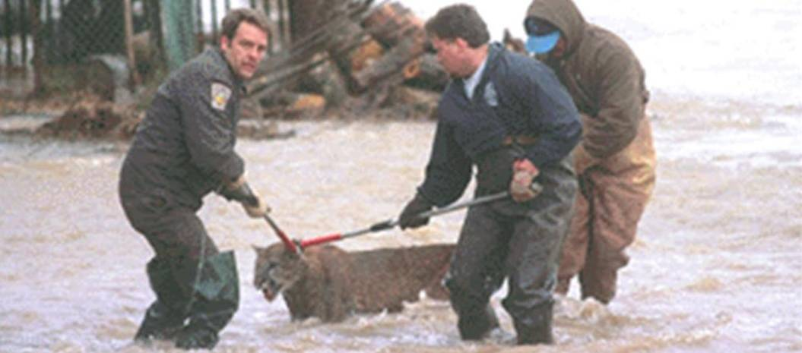
Module Objectives (cont’d)
Identify practices for maintaining animal safety during an emergency
Identify sources for additional training and information

Slide 7
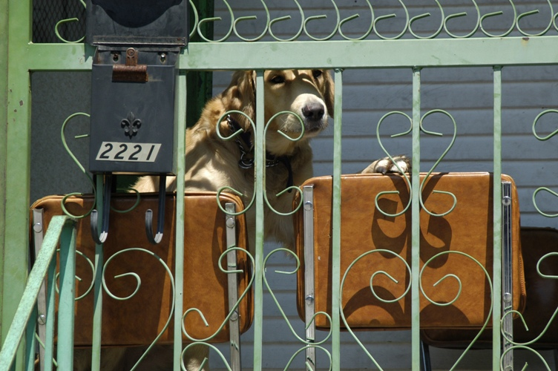
CERT Functions That May Involve Animals

Slide 8
CERT Responder Safety with Animals
This topic will cover:
  Encountering Animals
  Zoonotic Disease Transmission
  Injuries Caused by Animals
  Psychological Self-Care

Slide 9
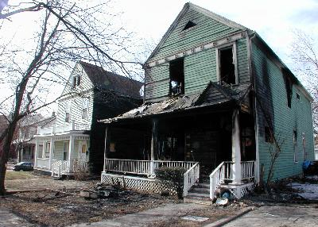
Scenario
Notes:
8

Slide 10
Encountering Animals
Size up the situation
  Look for presence of owner
  Look for evidence of animals
  Consider local environment
  Be prepared for illegal animal activity
  Perform damage assessment
Notes:
9

Slide 11

1. Look for Presence of the Owner
Notes:
10

Slide 12

2. Look for Evidence of Animals
Notes:
11

Slide 13
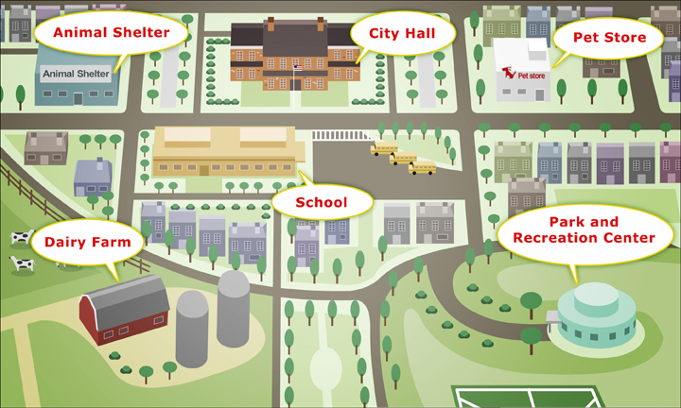
3. Consider the Local Environment
Notes:
12

Slide 14
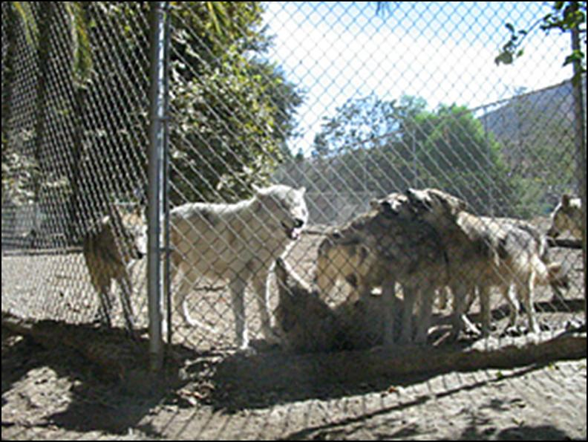
4. Be Prepared for Illegal Animal Activity
Notes:
13

Slide 15
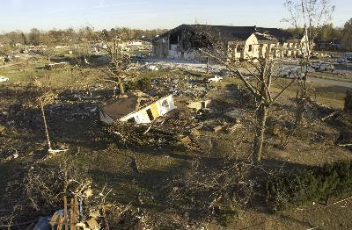
5. Perform Damage Assessment
Notes:
14

Slide 16
Approaching an Unknown Dog
Expect the unexpected
Do not let dog block your escape
Do not show fear
Maintain relaxed posture
Control environment if possible
Avoid direct eye contact
Do not get near dog’s face
Notes:
15

Slide 17
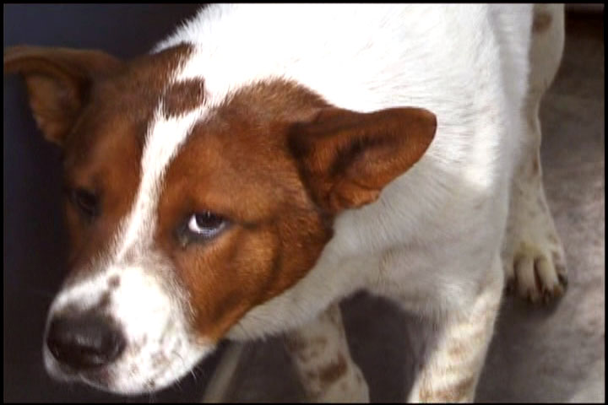
Approaching an Unknown Dog (cont’d)
Try gaining dog’s confidence
Try to contain dog
Consider size of your team
Know your limitations
Notes:
16

Slide 18

The “Sit” Command
Say “Sit” firmly but not loudly
Hold your hand in a “Stop” gesture
Notes:
17

Slide 19
If a Dog Attacks
In the event of any dog attack, call 911 immediately
Use basic commands
Put object or distance between yourself and dog
Back away; do not run away
If you fall, curl up and cover your head
Do not scream or yell
If dog latches on, protect your face
Notes:
18

Slide 20
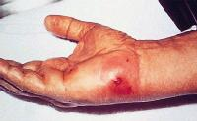
Injuries Caused by Animals
Notes:
19

Slide 21
Psychological Self-Care
Working with animals can be emotional
Responders may be affected by emotions of animal owners
Do not push yourself beyond your limits
Animals can also reduce stress
See CERT Basic Training Unit 7 Disaster Psychology

Slide 22
Knowledge and Skills Needed for CERT Functions Involving Animals
This topic will cover:
  Cleaning and Disinfection
  General Animal Care
  Animal Handling
  Caring for Injured Animals
  Communicating with Animal Owners
  Animal Identification and Documentation

Slide 23
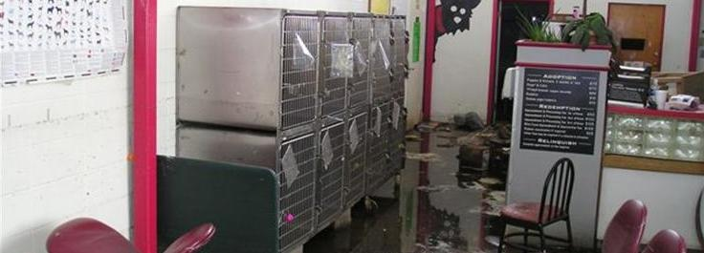
Cleaning and Disinfection
Debris and organic material MUST be removed as soon as possible
Clean with soap and water
Apply a suitable disinfectant

Slide 24
General Animal Care
Follow nutritional and environmental requirements
Not feeding animal is better than feeding wrong food
All animals need clean and potable water
Store feed where animals can’t access

Slide 25
Animal Handling: Dogs
For non-aggressive dogs:
Avoid prolonged direct eye contact
Use a soft voice
Approach dog with your body turned sideways
Move toward the dog slowly
Use a slip leash to control the dog
Do not loom over dog
Do not grab dog by collar

Slide 26
Animal Handling: Dogs (cont’d)
For frightened dogs:
  Seek assistance unless you are experienced
  Don’t approach unless others can assist you
  Move slowly and try to get dog to come to you
Aggressive dogs: Call animal control or law enforcement

Slide 27
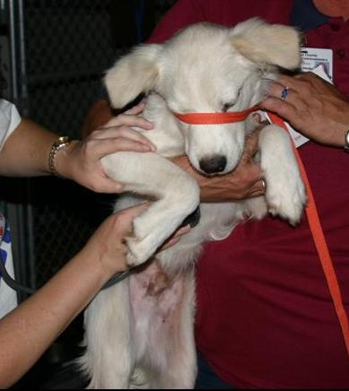
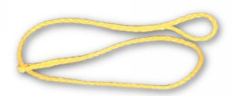
Dog Restraints: Leashes
Use only if dog is not aggressive
If given time, some dogs may calm down
Keep dog calm as you slip on leash
Slip leashes are best
Improvise with rope or twine

Slide 28
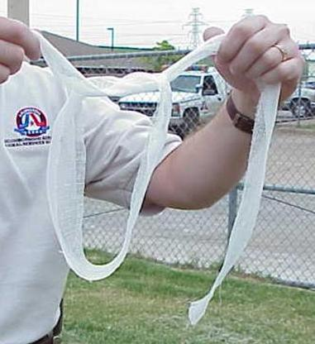
Dog Restraints: Muzzles

Slide 29
Dog Restraints: Standing
  Place arm under dog’s neck and other arm behind rear legs
  Pull dog’s head snugly against your shoulder

Slide 30
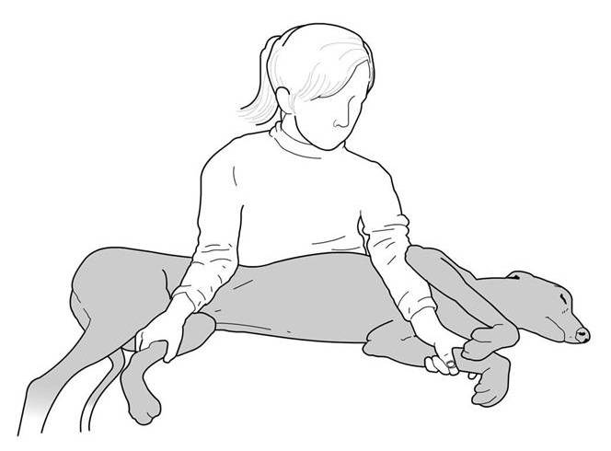
Dog Restraints: Lateral

Slide 31
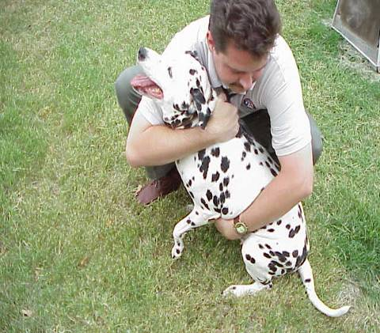
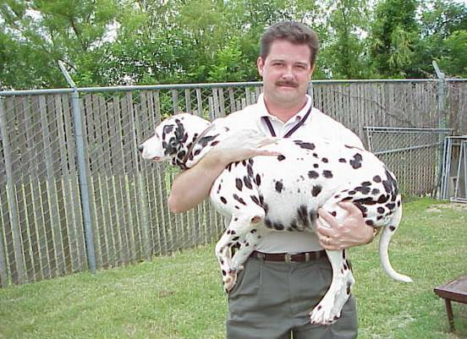
Carrying Dogs

Slide 32
Transporting Dogs
Make sure dog crates are adequate size
Allow only one dog per crate
Clean and disinfect crates between animals
If not in cage, leash or tether dog inside vehicle
Control climate within vehicle
Keeping dogs in stationary vehicles in hot weather can result in death

Slide 33
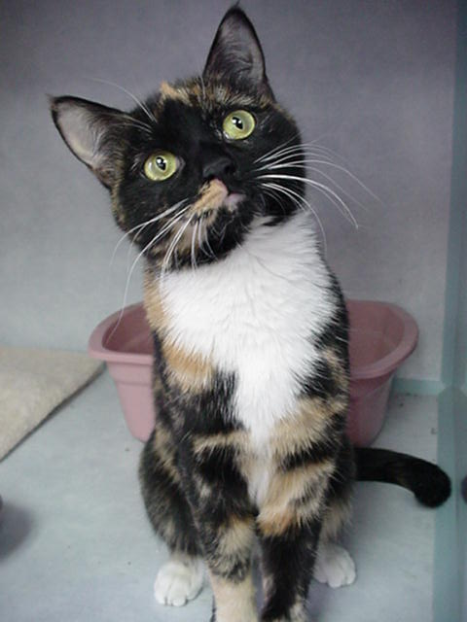
Animal Handling: Cats
Approaching Cats
Speak slowly and softly
Approach with your side facing cat
Move slowly
Work with a partner

Slide 34
Animal Handling: Cats (cont’d)
Out-of-Control Cats
Back off and allow cat to calm down
Use double thick or armored gloves and eye protection
Attempt capture with fishing nets, blankets, or traps
If possible, let professional animal handlers do the job

Slide 35
Transporting Cats
Have owner present if possible
Always wear gloves
Use towels to lift and carry
Tap on cat food can to get cat to come to you
Use as little restraint as needed
Cats may be frightened by unexpected stimuli
Cats become defensive easily
Place cats in carriers for transporting

Slide 36
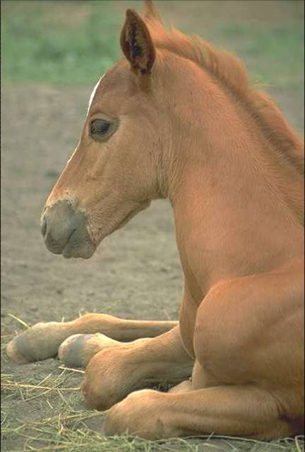
Animal Handling: Horses
Control the head
Use a halter or lead rope
Be patient and careful
Use a soft, soothing voice
Do not move suddenly
Do not lose your temper

Slide 37
Animal Handling: Livestock
Use halter or lariat and wear gloves
Use proper footwear ─ no steel-toed boots
Wear heavy pants
Use radios and whistles for communication
Use fences, chutes, or panels to push livestock
Line vehicles or people to push livestock
Herd animals will move away if approached

Slide 38
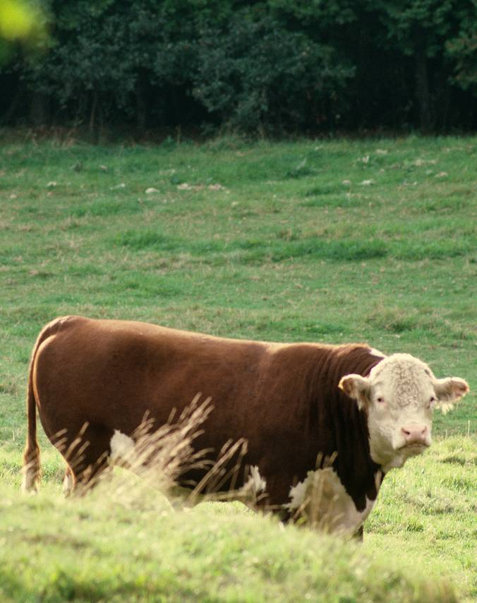
Herding and Containing Cattle
Herd animals using flags, waving, or working dogs
Never lead cattle unless they are show animals
Contain animals with survey tape, caution tape, or portable barricades

Slide 39
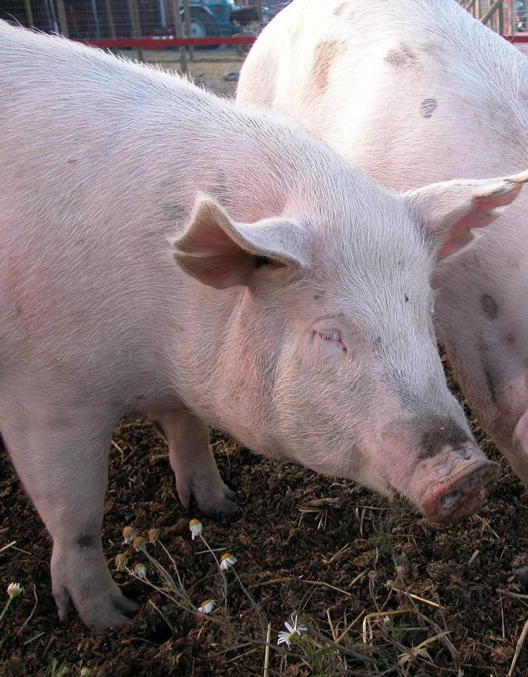
Animal Handling: Swine
Swine
  Cannot be led
  Will bite
  May be put in cages
  Shouldn’t be chased
Use rigid sheets for herding
Wear hearing protection

Slide 40
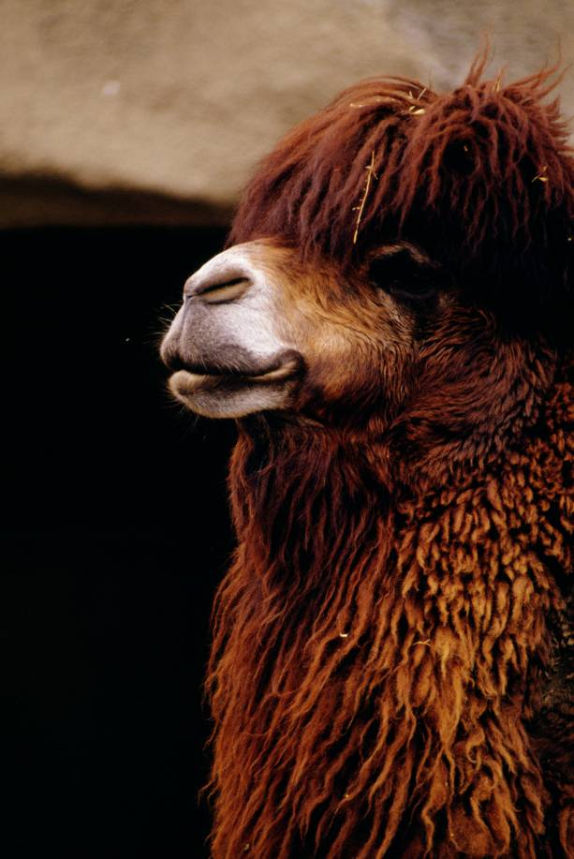
Animal Handling: Llamas and Alpacas
Should be handled similarly to horses
Are used to halters
Do not like to get caught
May spit if upset
Will bite

Slide 41
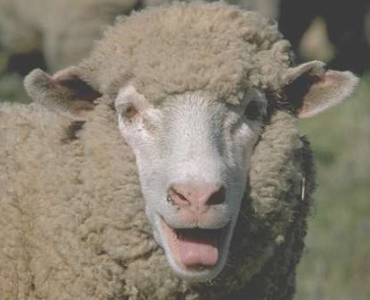
Animal Handling: Sheep and Goats
Can usually be herded
Small enough to restrain manually

Slide 42
Handling Exotic Animals and Other Species
Exotic animals are becoming increasingly common as pets
They require professional handling
  Big cats are extremely dangerous and have no fear of people
Wolves and wolf hybrids may be aggressive
Exotics may be used to guard drug operations
Birds can also be aggressive
Monkeys and apes can be exceedingly strong and dangerous

Slide 43
Caring for Injured Animals
Act within framework of CERT training
Perform sizeup
Be careful: Stressed animal may bite, scratch, kick, or attack
Restrain appropriately
If unable to restrain, do not attempt first aid
If possible, transport animal for professional help

Slide 44
Communicating with Animal Owners
Understand psychological strain on pet owners
Refer to CERT Basic Training Unit 7 Disaster Psychology
Don’t underestimate human-animal bond
Provide emotional support for animal owners

Slide 45
Animal Identification
Animals can be identified with:
  Tags
  Microchips
  Tattoos
  Ear tags
  Collars
  Bands on birds
  Branding on livestock
Some communities may have system for identifying dangerous animals
Notes:
44

Slide 46
Module Summary
In this module, we reviewed:
Your role as a CERT member in functions involving animals
Protecting your safety when dealing with animals
Knowledge and skills you will need for CERT functions involving animals
Notes:
45

