Slide 1
CERT Animal Response I

Slide 2
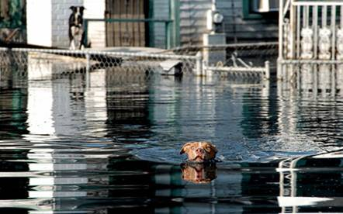
Module Purpose
The purpose of this module is to teach CERT members emergency preparedness for animal owners and how to recognize specific animal behaviors.
Notes:
1

Slide 3
Animal Categories
This module covers the following animal categories:
  Household pets and domesticated animals
  Service animals
  For-profit animals
  Non-commercial livestock
  Wildlife
  Exotic animals
Notes:
2

Slide 4
What You Will Learn
Animal Issues in Emergency Management
Animal-Related Emergency Management Functions
Disaster Planning for Animals
General Animal Behavior
Preview of CERT Animal Response II
Notes:
3

Slide 5
Module Objectives
Explain why animal issues are an important consideration in emergency management
Demonstrate knowledge of animal-related emergency management functions
Explain emergency preparedness for animal owners
Describe general guidelines for handling animals
Notes:
4

Slide 6
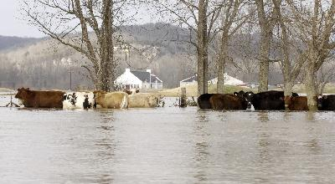
Importance of Animal Issues
Notes:
5

Slide 7
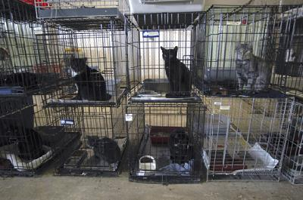
Animal-Related Emergency Functions
Notes:
6

Slide 8
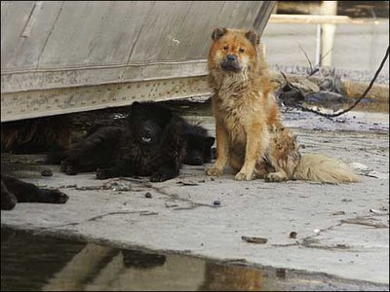
Disaster Planning for Your Animals

Slide 9
Preparing for a Disaster
CERTs should prepare by:
  Identifying potential hazards
  Mitigating the impact of hazards
  Creating a disaster plan
  Assembling disaster supplies
  Participating in training and exercises
  Knowing your community’s disaster response plan
Notes:
8

Slide 10
Identifying Potential Hazards
What types of disasters could occur in your community?
  Natural
  Technological
  Terrorist
How could a disaster affect your animals?
Notes:
9

Slide 11
Mitigating the Impact of Hazards
Reducing the impact of disasters
Making changes that protect properties or facilities
Examples:
  Encourage animal facilities to relocate out of disaster-prone areas
  Encourage animal facilities to have emergency plans, including evacuation plans
  Encourage livestock owners to develop plans to remove animals when flooding is a threat
Notes:
10

Slide 12
Creating a Disaster Plan for Animals
Preparing to Evacuate Your Pet/Service Animal
Preparing to Stay at Home With Pets/Service Animals During a Disaster
Pet/Service Animal Care After a Disaster
Preparations for Livestock
Special Considerations for Exotic Animals
Notes:
11

Slide 13
Preparing to Evacuate Your Pet/Service Animal
Identify where you will stay if evacuated
Plan your evacuation routes
Update vaccinations and identification tags
Gather evacuation supplies
Make a plan for evacuating without your pet
Notes:
12

Slide 14

Preparing to Stay at Home with Pets/Service Animals
Bring pets inside
Have newspaper on hand
Be aware that animals may isolate themselves if afraid
Separate dogs and cats
Separate smaller pets away from cats and dogs
Notes:
13

Slide 15
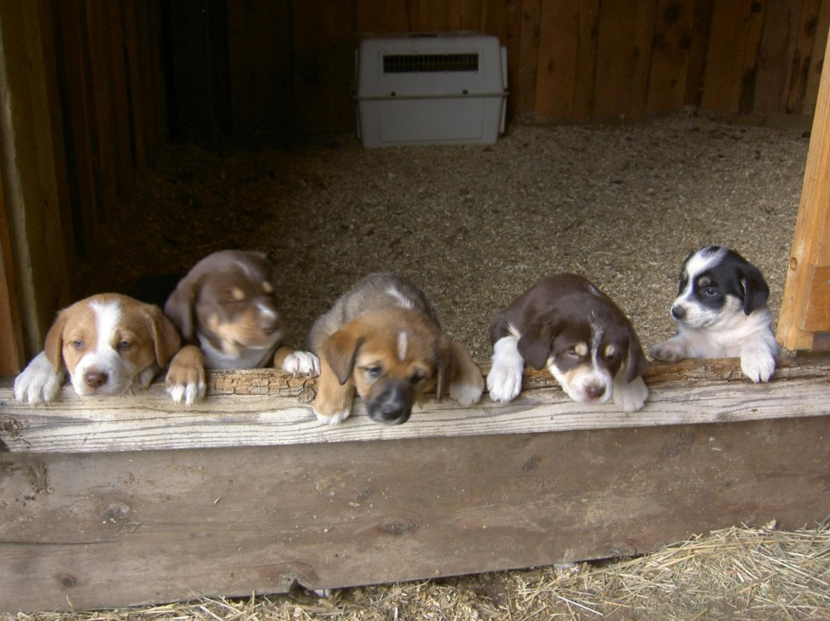
Caring for Pets and Service Animals After a Disaster
Animal behavior may change after a disaster
Leash pets for the first few days
Displaced wildlife may pose a threat to pets
Downed power lines are another hazard
Notes:
14

Slide 16
Making Preparations for Livestock
Ensure all animals have identification
Have an evacuation plan
  Relocate on property
  Transport animals to safe site
Evacuation sites should be prepared for livestock
If not evacuating, identify safest shelter
Take precautions in severe cold weather
Notes:
15

Slide 17
Special Considerations for Exotic Animals
Owners should have a plan to secure animals during emergencies
Exotics may need to be separated from other animals
Exotics may need to be registered with authorities
Notes:
16

Slide 18
Assembling a Disaster Supply Kit
Evacuation Checklist
  For pets/service animals
  For livestock
Shelter-in-Place Checklist
  For pets/service animals
  For livestock
Post information for emergency personnel on your property
Notes:
17

Slide 19
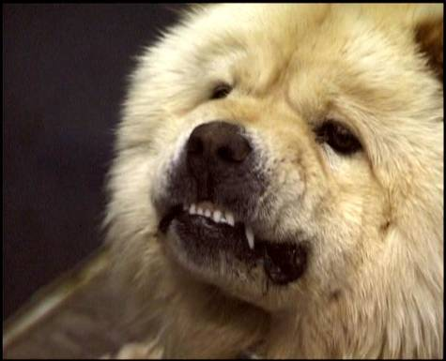

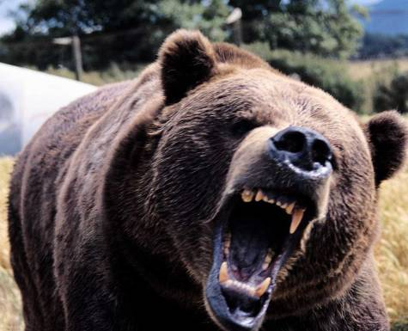
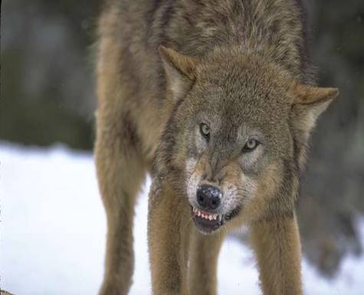
Grouping Animals
What do these animals have in common?

Slide 20
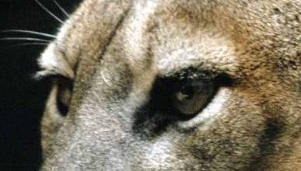

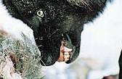
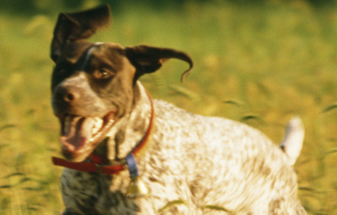
Characteristics of Predator Animals
Vision
Feet
Teeth
Instincts

Slide 21
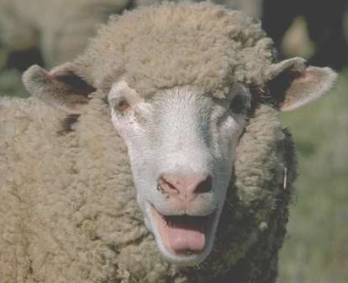
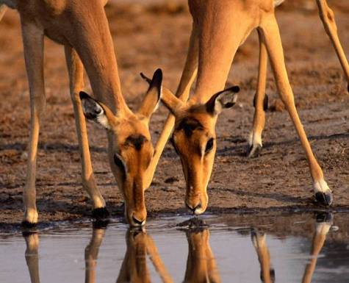
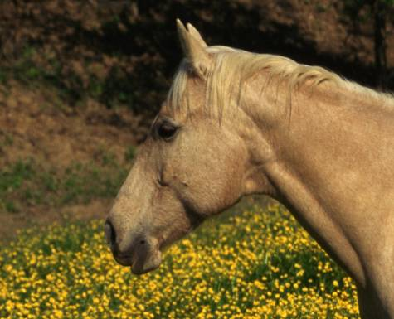
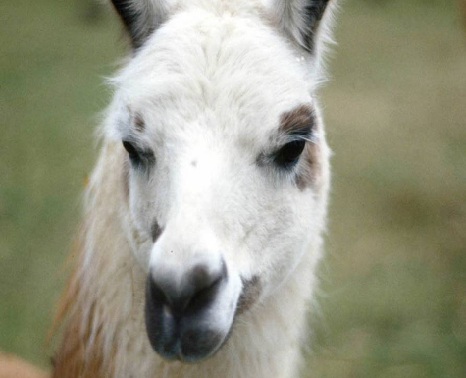
Grouping Animals
What do these animals have in common?
Notes:
20

Slide 22
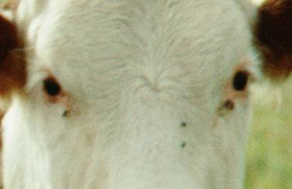
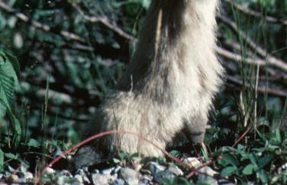
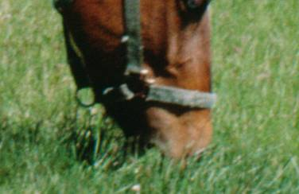
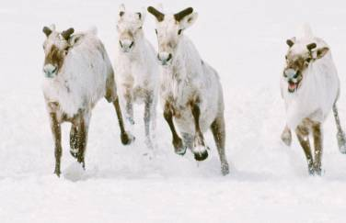
Characteristics of Prey Animals
Vision
Feet
Teeth
Instincts
Notes:
21

Slide 23
Animal Domestication
Breeding species for desired characteristics
Domesticated animal behavior
Domesticated animals may revert to instinctive behavior
Predator animals may chase and attack
Prey animals may run or hide
Notes:
22

Slide 24










Dog Facial Expressions
Increasing Aggression
Increasing Fear
Notes:
23

Slide 25
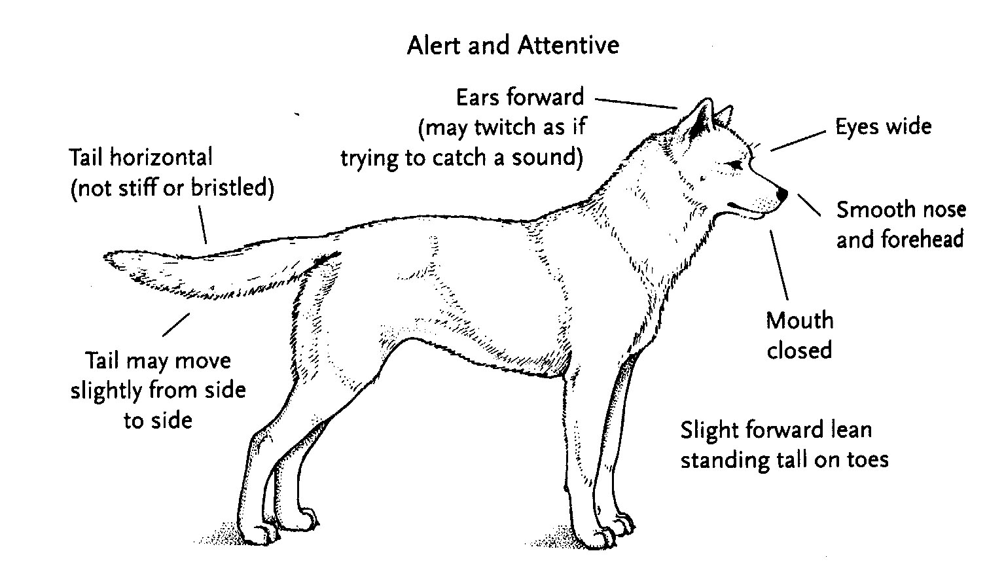
Dog Body Language
Notes:
24

Slide 26
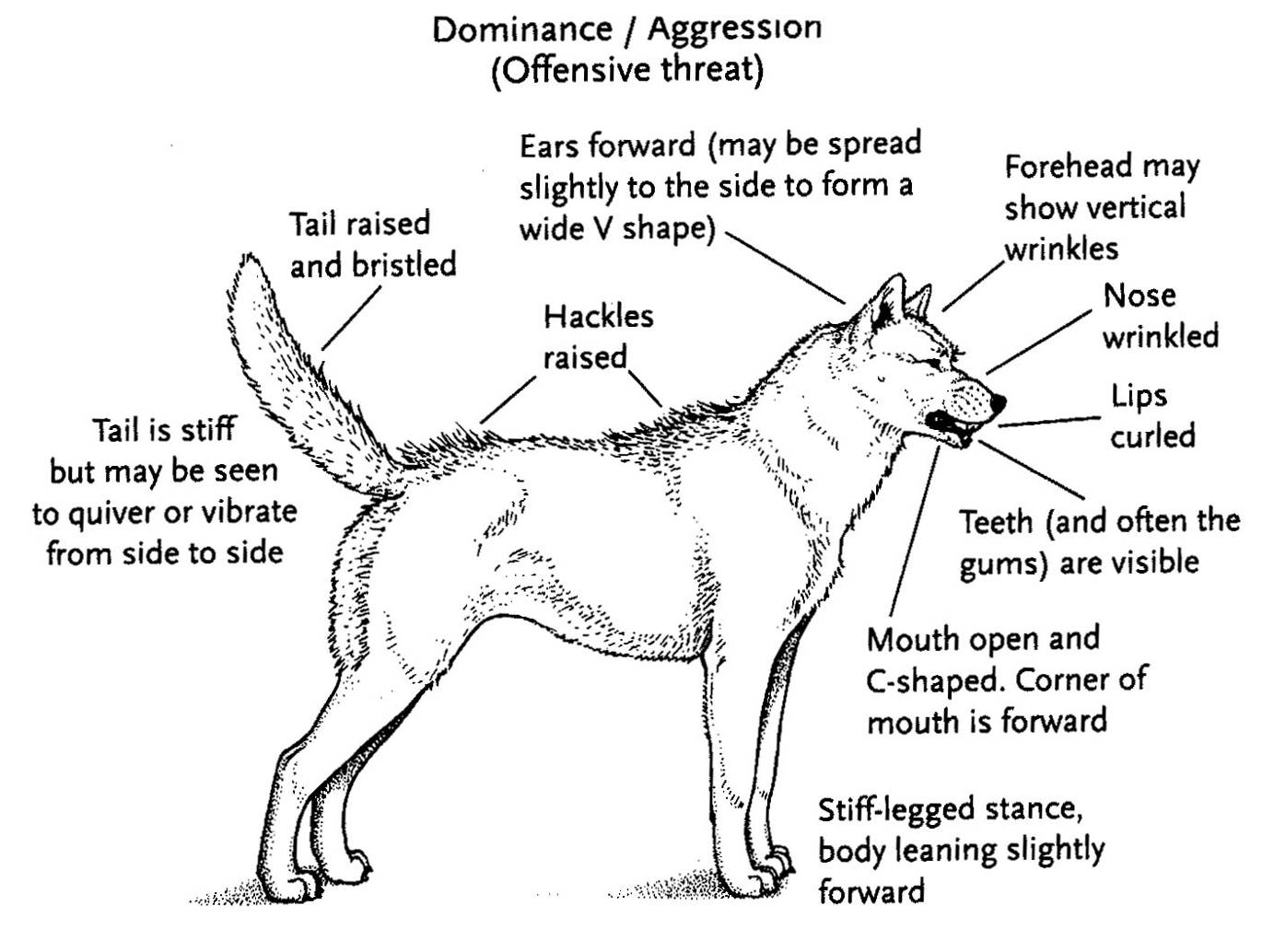
Dog Body Language (cont’d)
Notes:
25

Slide 27
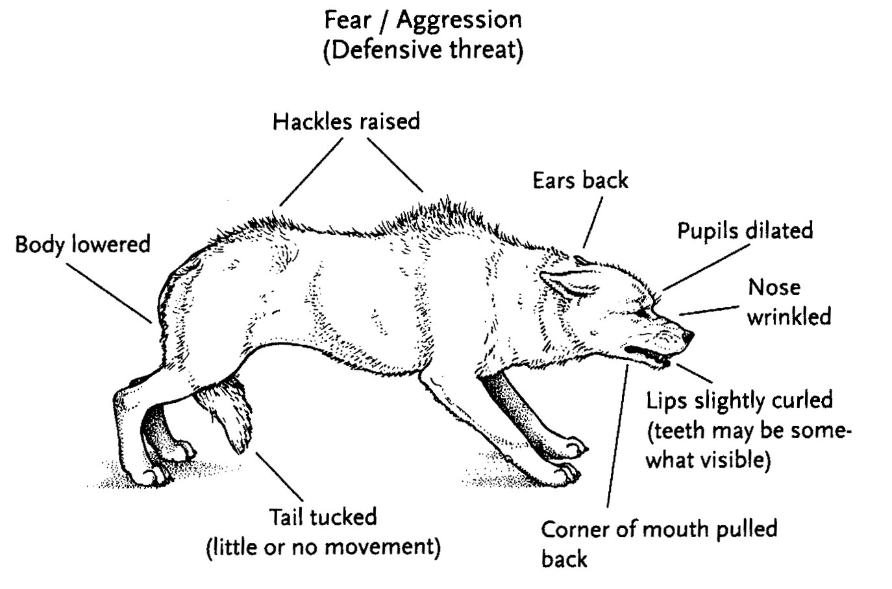
Dog Body Language (cont’d)
Notes:
26

Slide 28
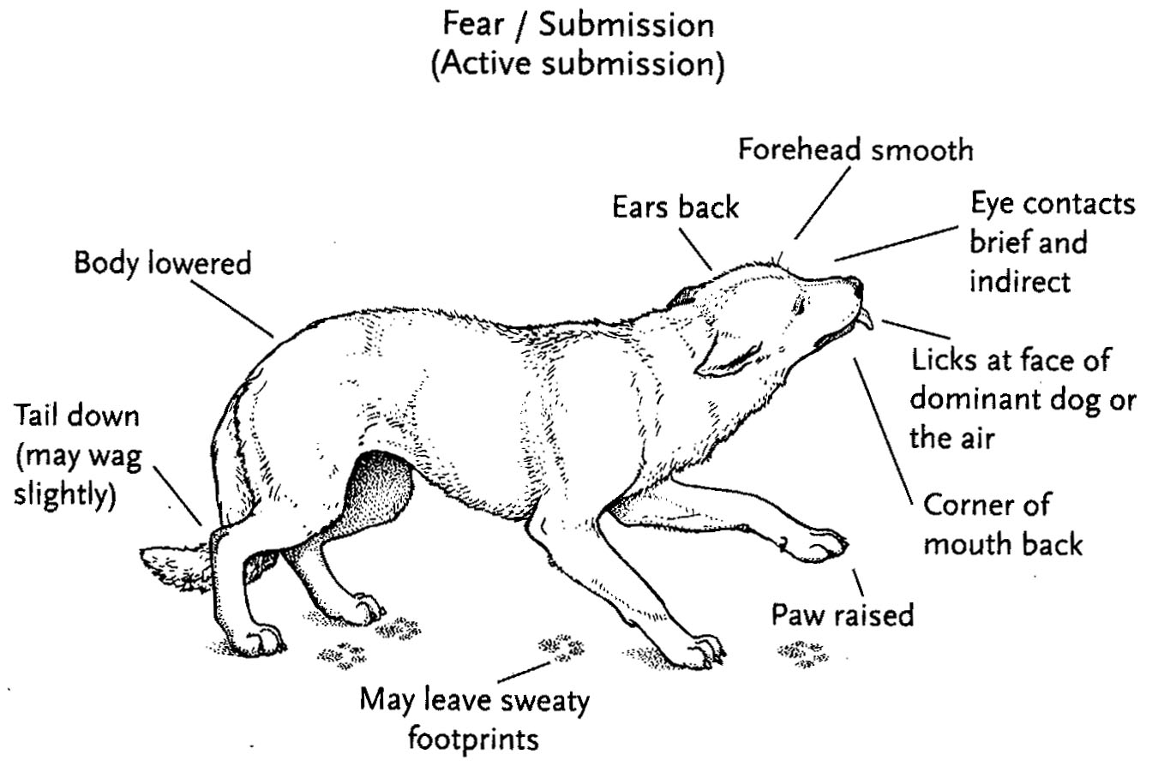
Dog Body Language (cont’d)
Notes:
27

Slide 29
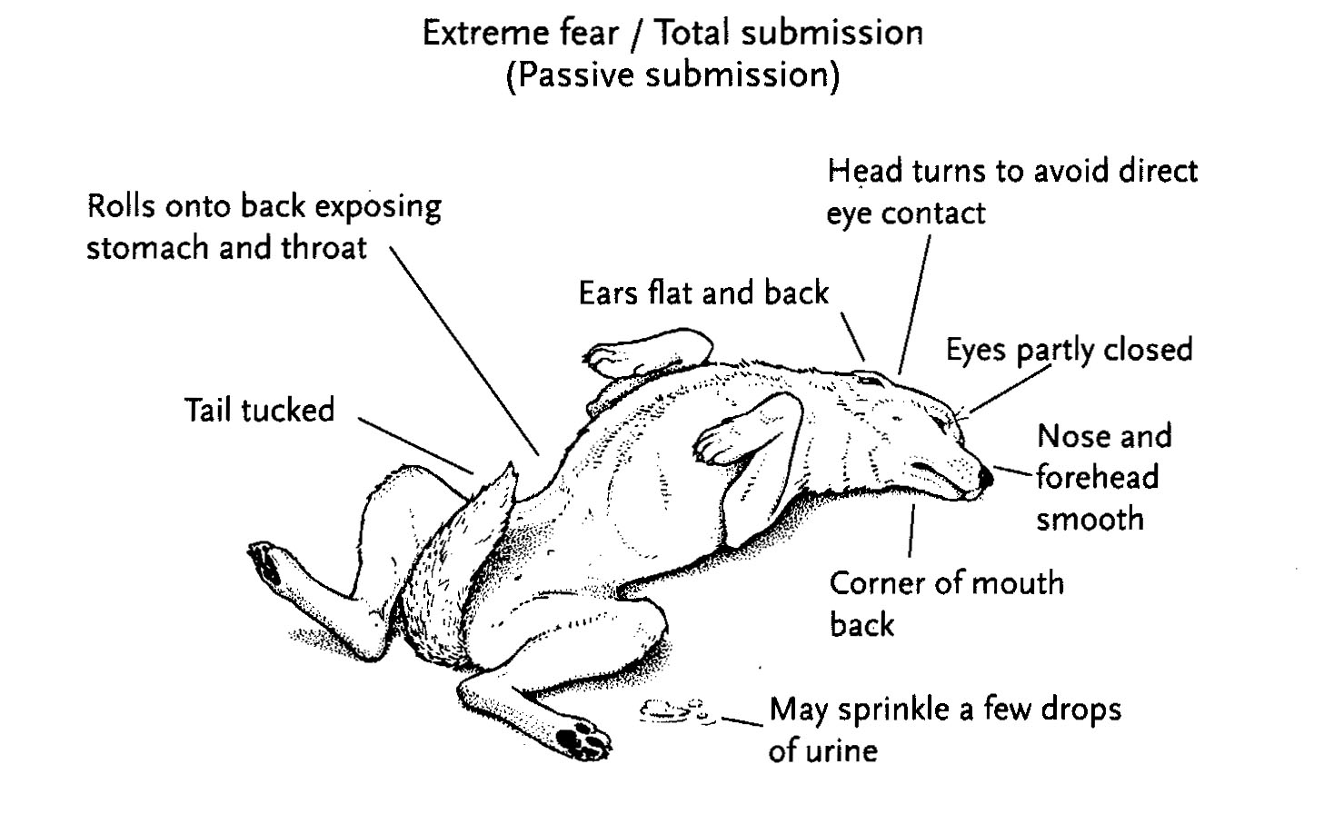
Dog Body Language (cont’d)
Notes:
28

Slide 30
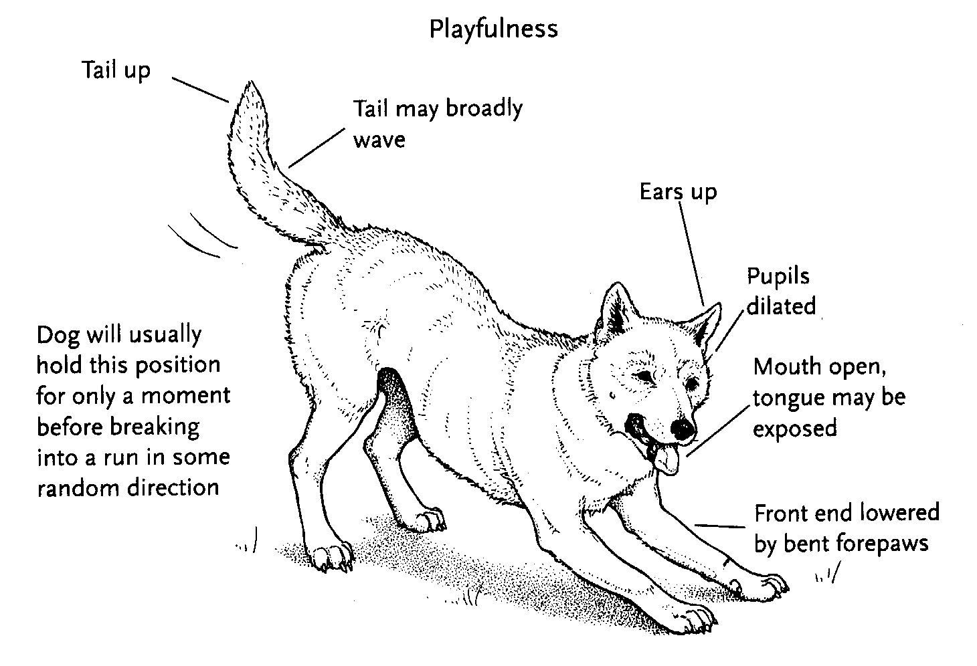
Dog Body Language (cont’d)
Notes:
29

Slide 31
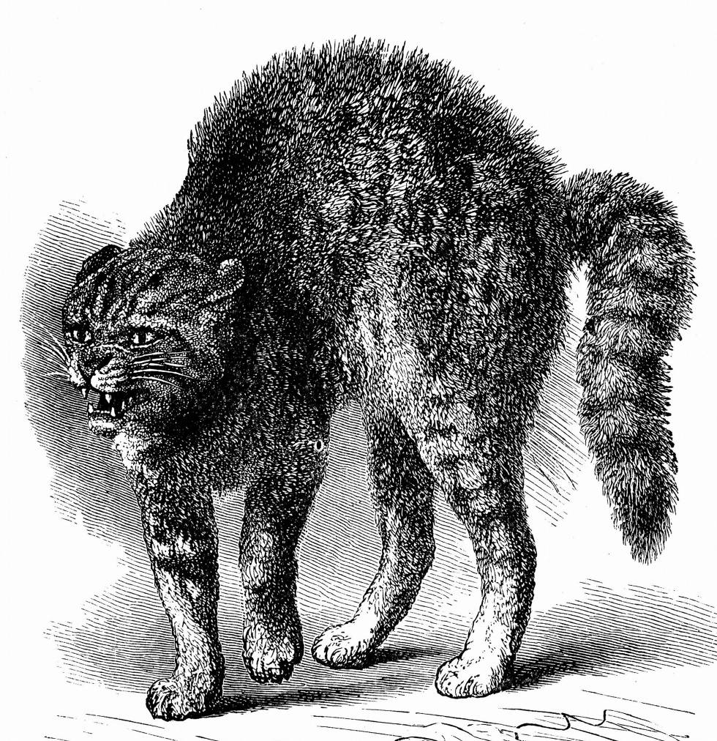
Cat Body Language
Notes:
30

Slide 32
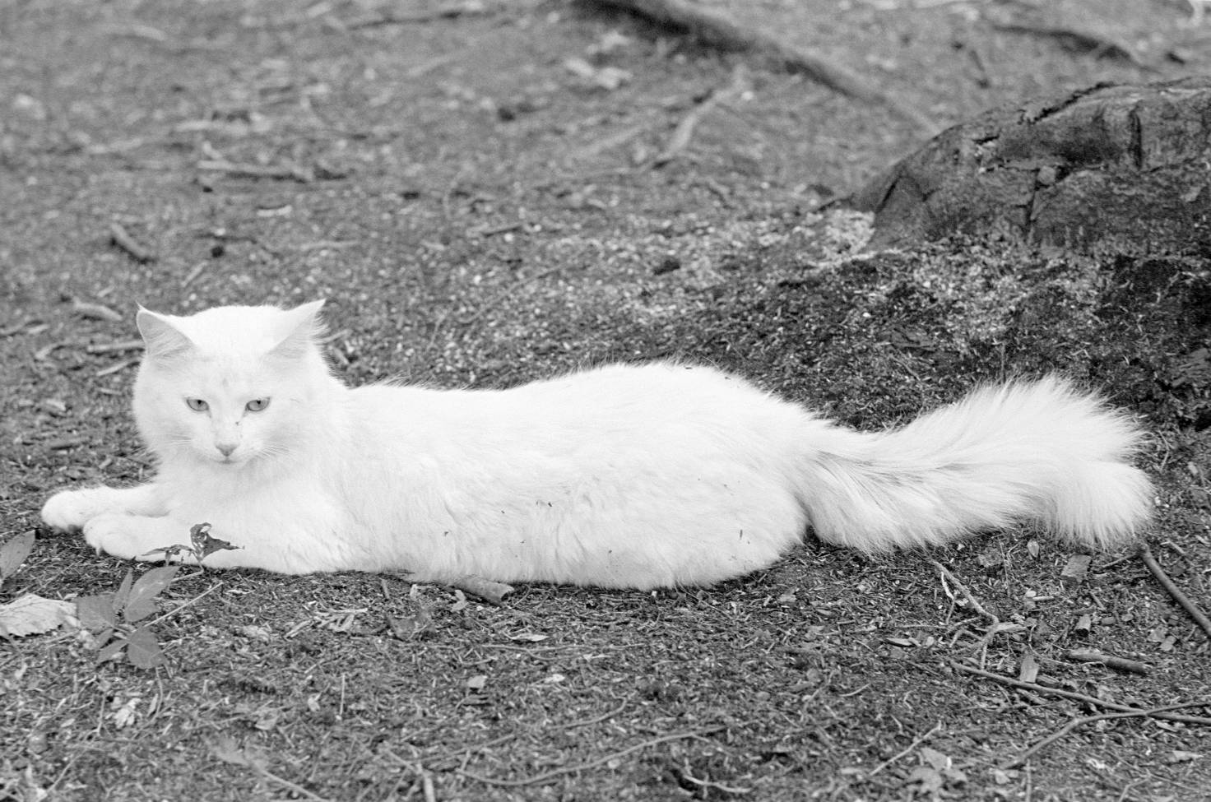
Cat Body Language (cont’d)
Notes:
31

Slide 33

Horses, Cattle, and Swine
Horses
  Instincts
  Senses
  Behavior
  Body language
Cattle
  Bovines
  Bulls
  Tips
Swine
Notes:
32

Slide 34
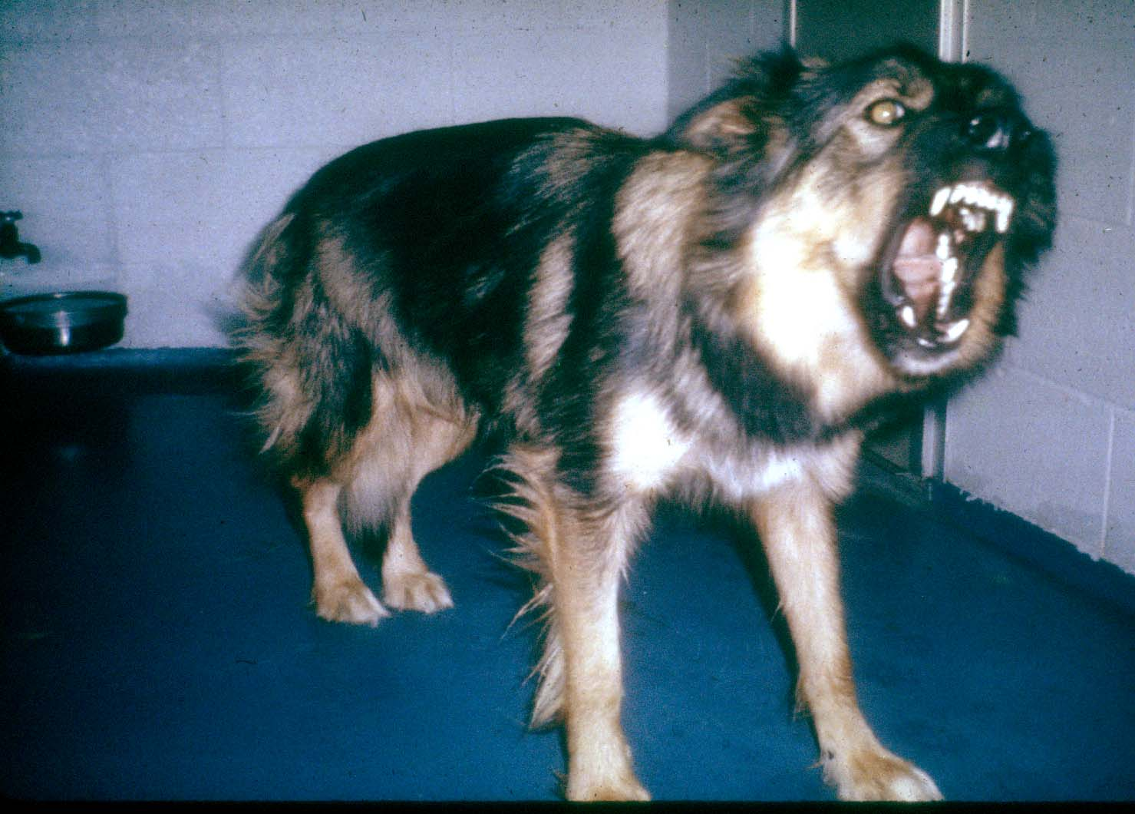
Identifying Animal Behavior
Notes:
33

Slide 35
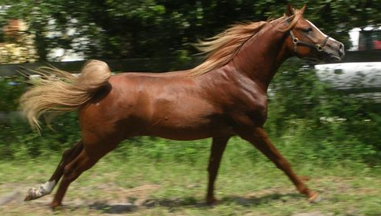
Identifying Animal Behavior (cont’d)
Notes:
34

Slide 36
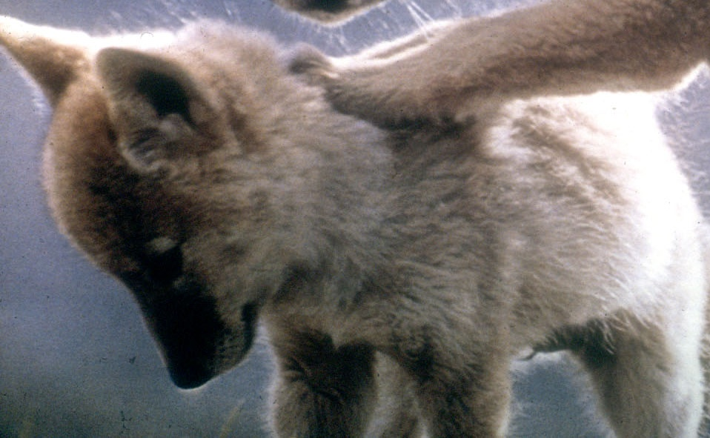
Identifying Animal Behavior (cont’d)
Notes:
35

Slide 37
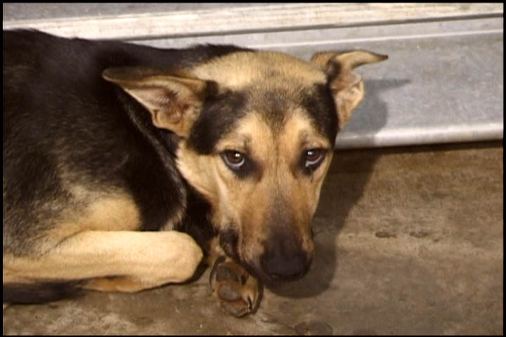
Identifying Animal Behavior (cont’d)
Notes:
36

Slide 38
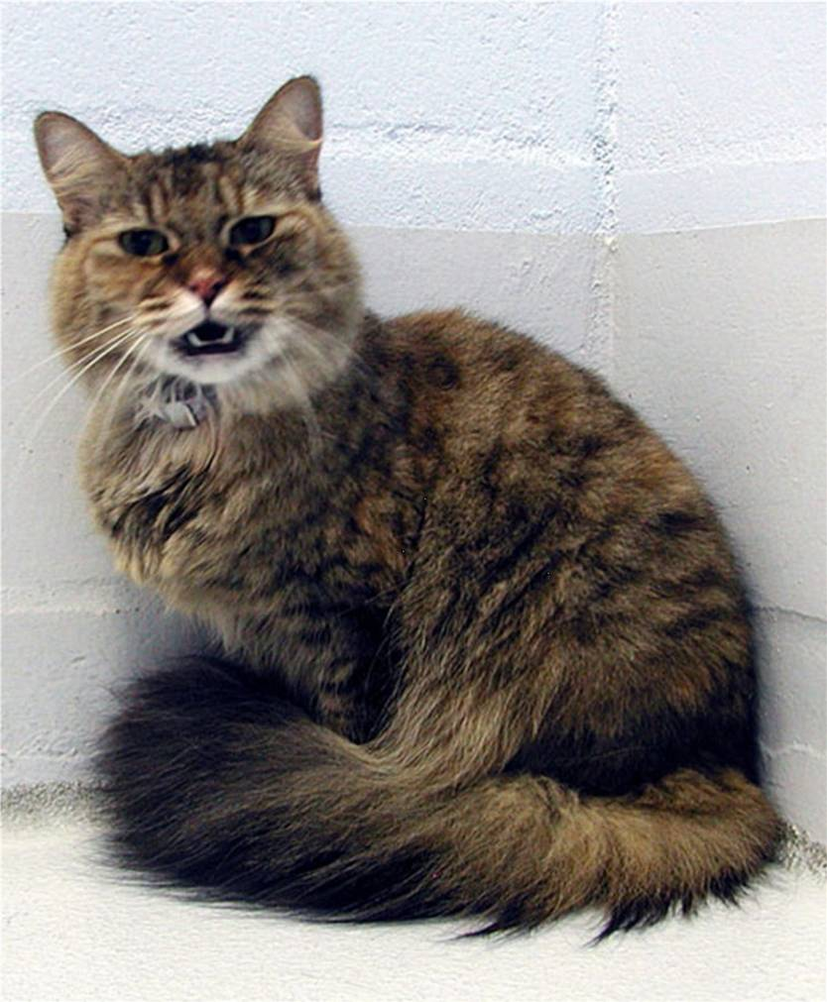
Identifying Animal Behavior (cont’d)
Notes:
37

Slide 39
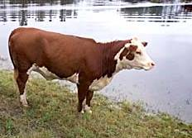
Identifying Animal Behavior (cont’d)
Notes:
38

Slide 40
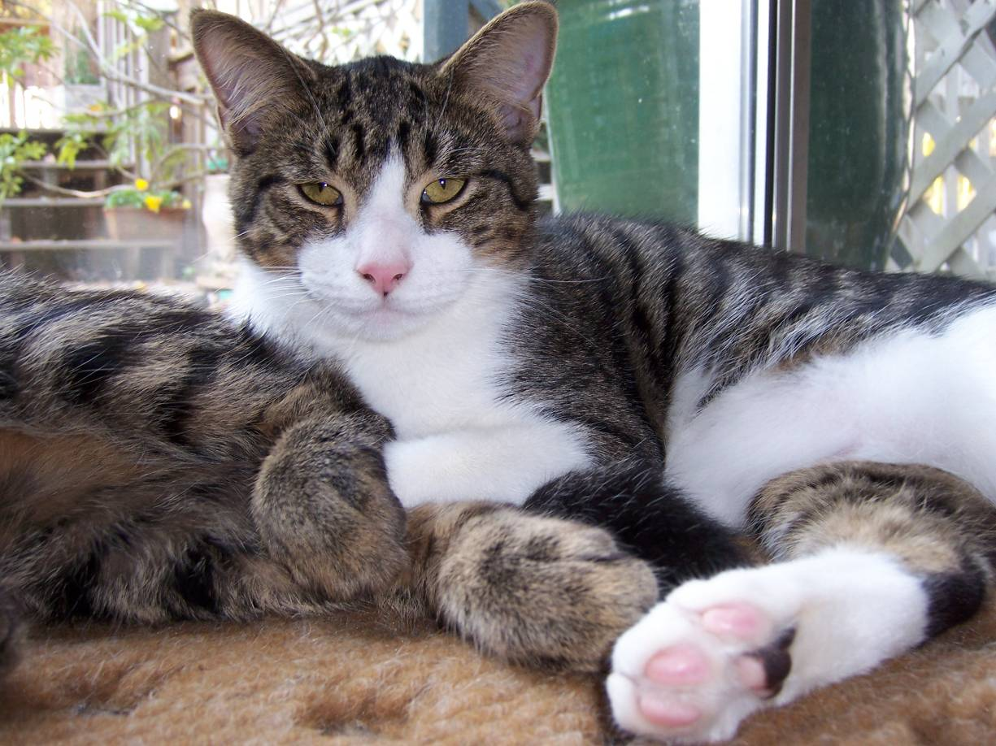
Identifying Animal Behavior (cont’d)
Notes:
39

Slide 41
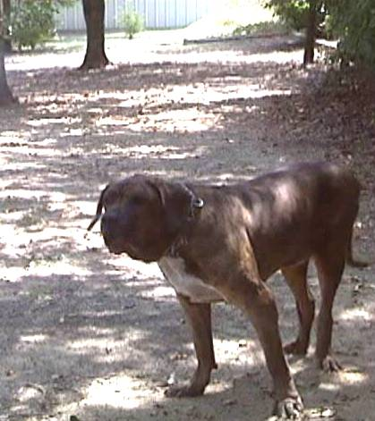
Preview of Animal Response II
Notes:
40

Slide 42
Preview of Animal Response II (cont’d)
Come back for Animal Response II to learn:
  Your role as a CERT member responding to animal issues
  How to protect yourself during animal encounters
  Knowledge and skills for CERT functions involving animals
Notes:
41

Slide 43
Module Summary
In this module, we reviewed:
  Animal Issues in Emergency Management
  Animal-Related Emergency Management Functions
  Preparedness for Your Animals
  General Animal Behavior
Notes:
42

